Slide 1
Setting up your study space
The first step in working at home effectively

Slide 2
For this session you will need...
Paper and a pen
The video here: Inner Drive messy desk
Copy of the ‘Six tips for study space’ handout
You may also like to watch the recording of me talking through the session here

Slide 4
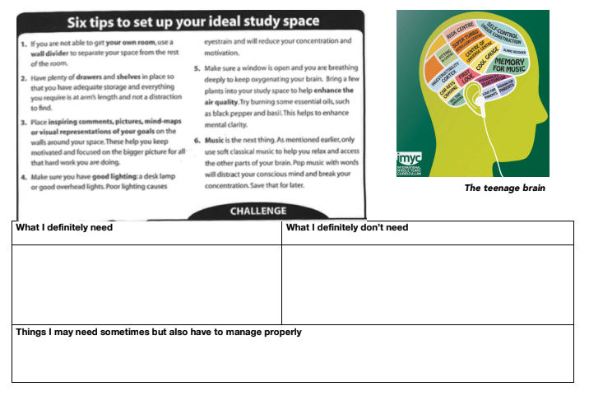
The handout shows some ideas of thing you need to help you work effectively.
Pause this presentation now and fill in the second page for yourself
Link to handout
Screenshot of the 2nd page

Slide 5
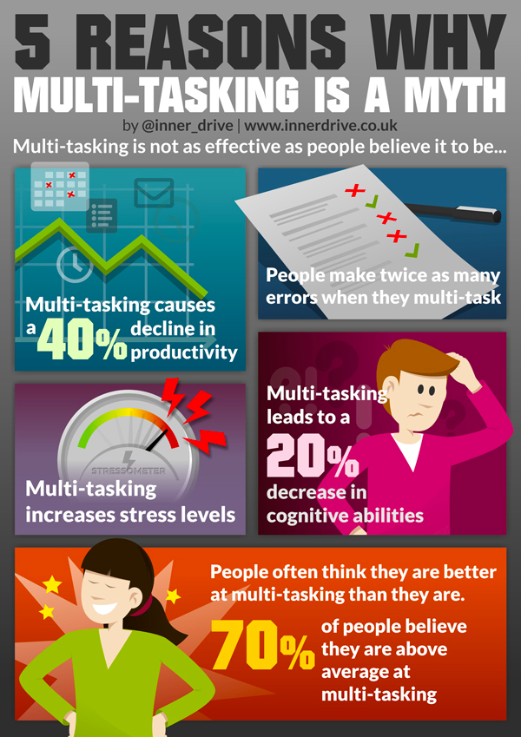
Multi-tasking is a myth….

Slide 6
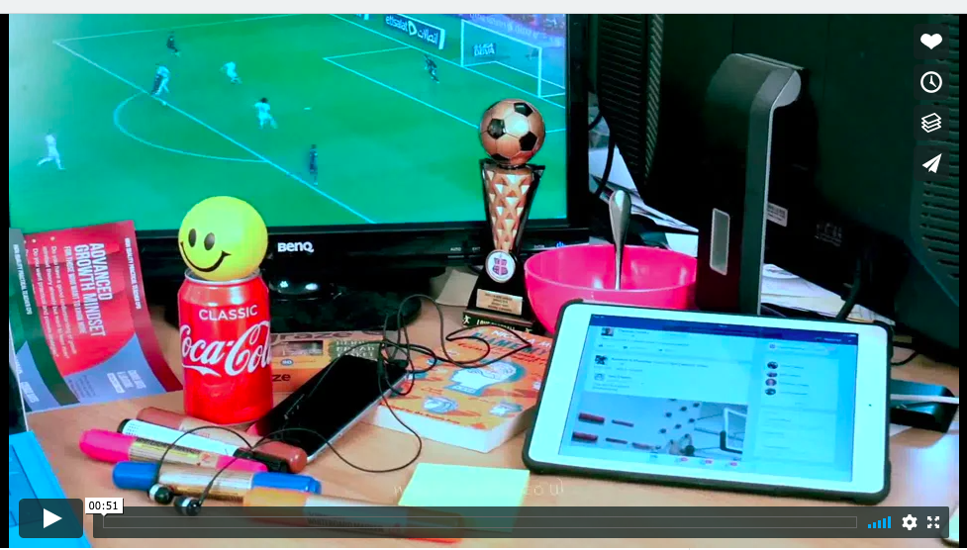
Pause this presentation again and watch the video ‘Messy desk’
As you watch it, write down the distractions you spot

Slide 7
Now compare your list to this one...
Food
Fizzy drink
Headphones/ music
Stress ball
Phone
Ipad with notifications switched on
Tv showing football game
Did you see any more?
Compare this list with what you wrote on the handout under ‘things I may need but have to manage properly’. What steps will you take now to help you study effectively?

Slide 8
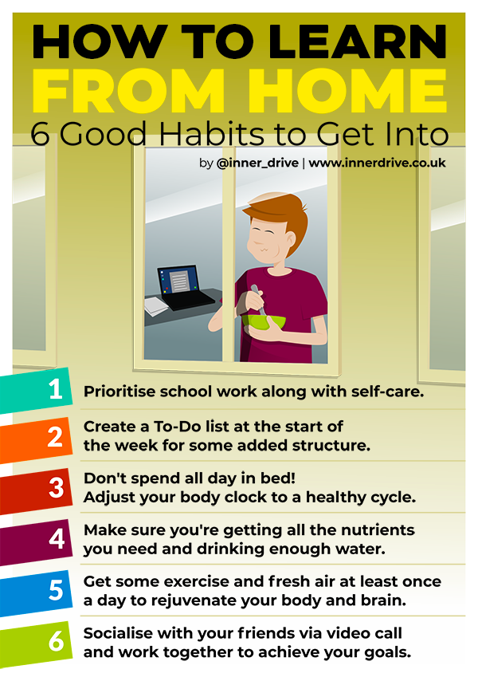
Challenge
Take a photo of your study space now and your study space after you have re-organised it to help you work effectively.
You are now ready to move on to your next session

