Slide 1
There follow two more examples
One for History and one for French.
Each use the Question and Answer structure.
Have a look at them both and come up with your own good/ could do better list

Slide 2
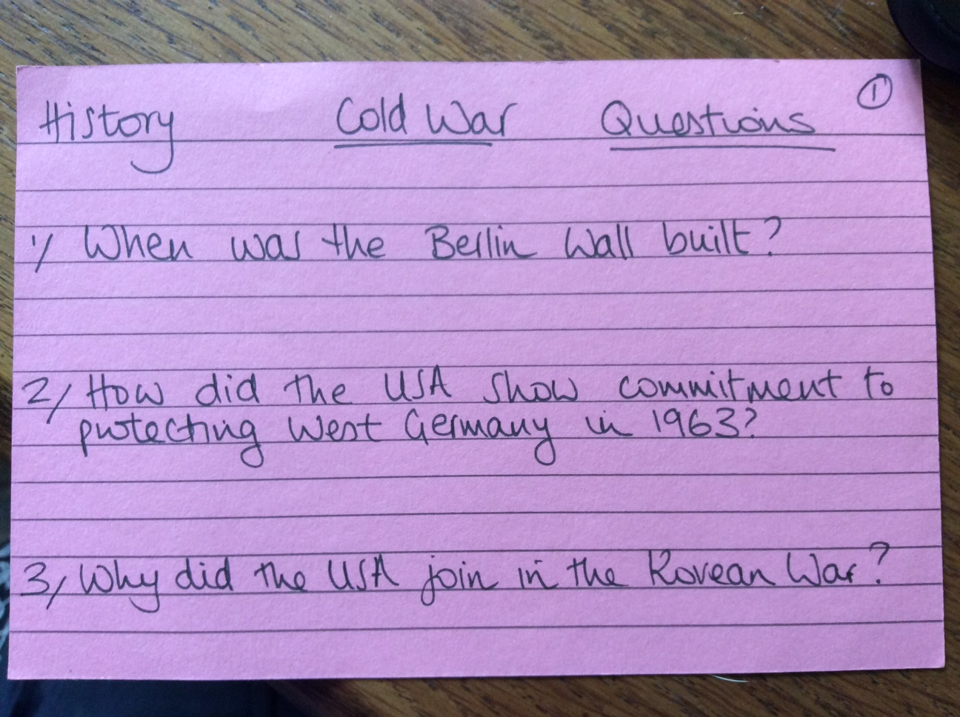
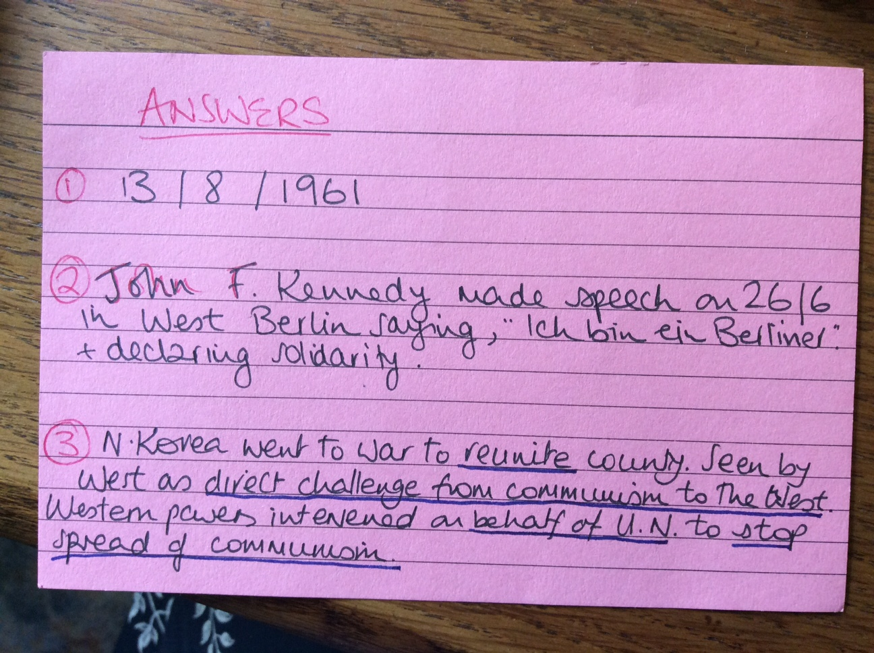
History
Question side Answer side

Slide 3
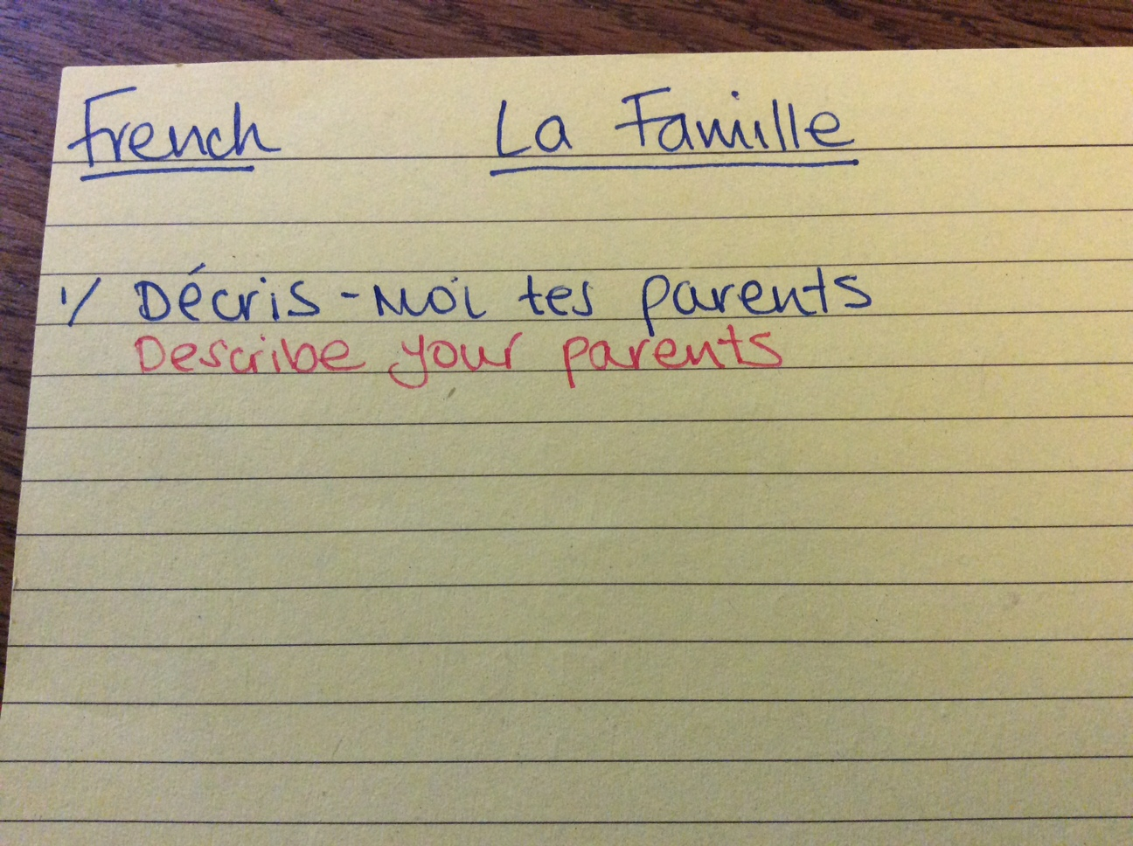
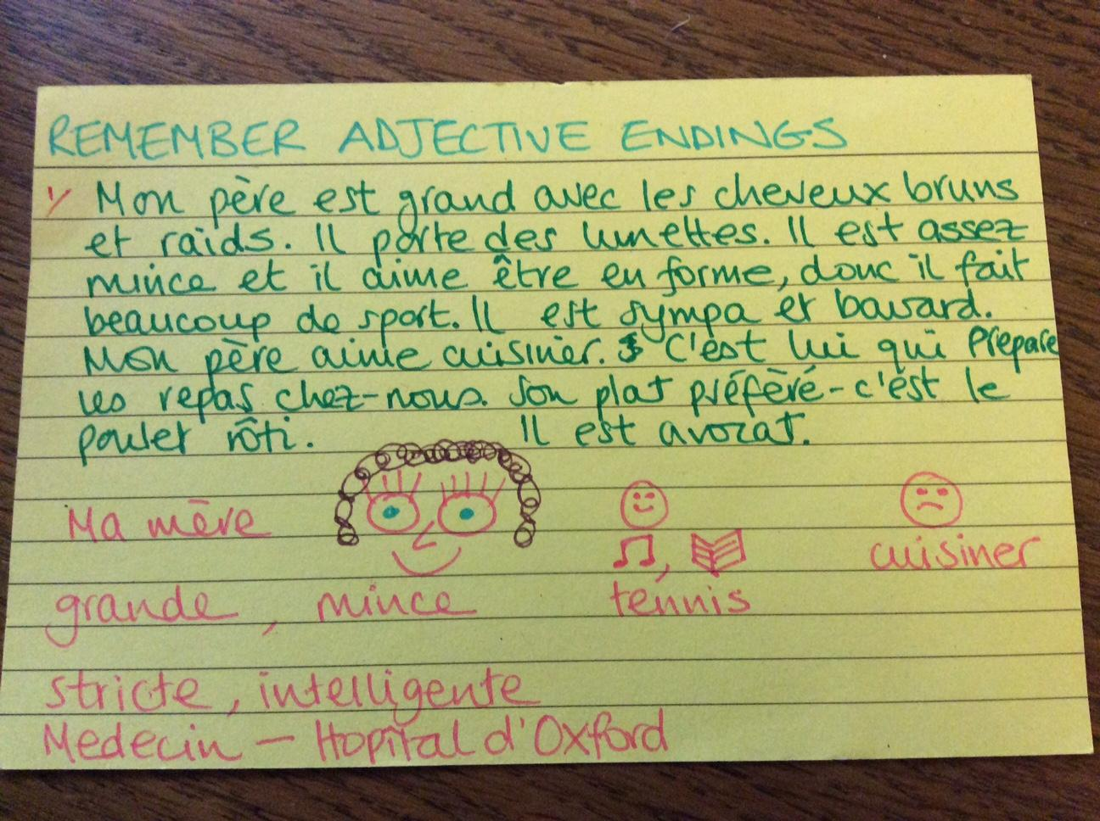
French
Question side Answer side

Slide 4
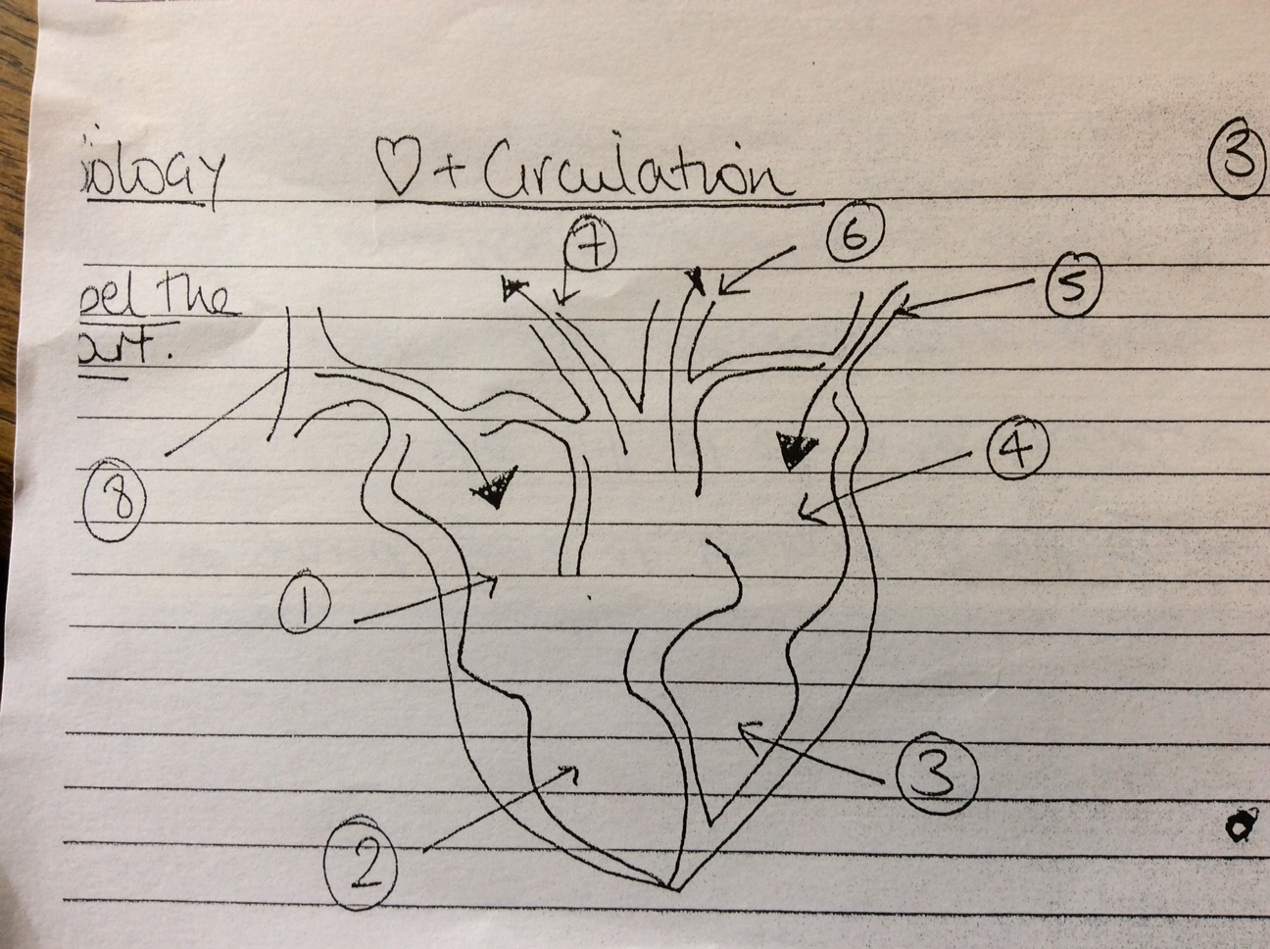
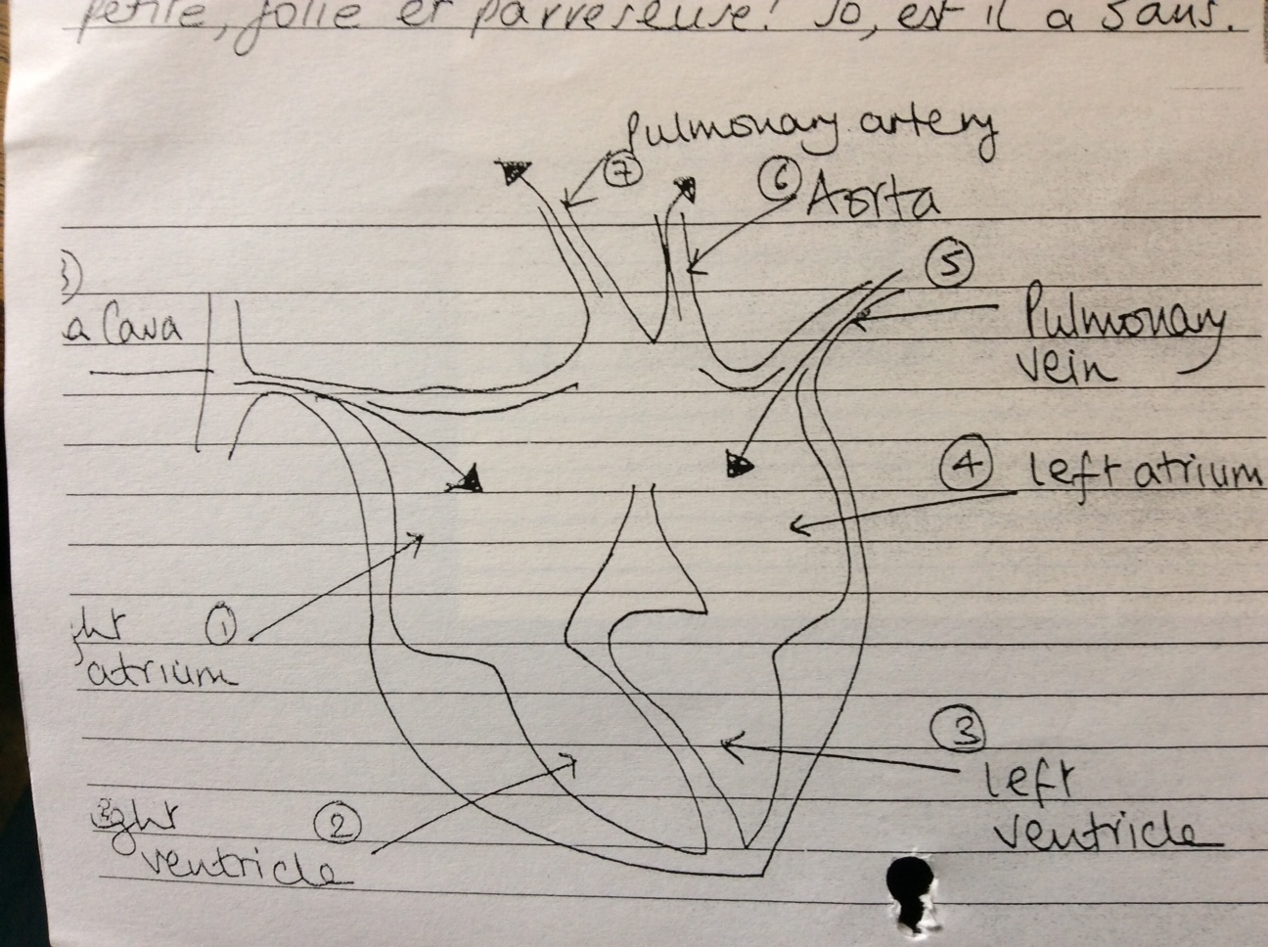
Biology example
Using diagrams

Slide 5
Alternatives
Cover up labels with post-its and see if you can label the diagram yourself
Put information in a table and do ‘look, cover, write check’ by covering up one column
Write out quotes/ speech/ oral presentation and learn it line by line

Slide 6
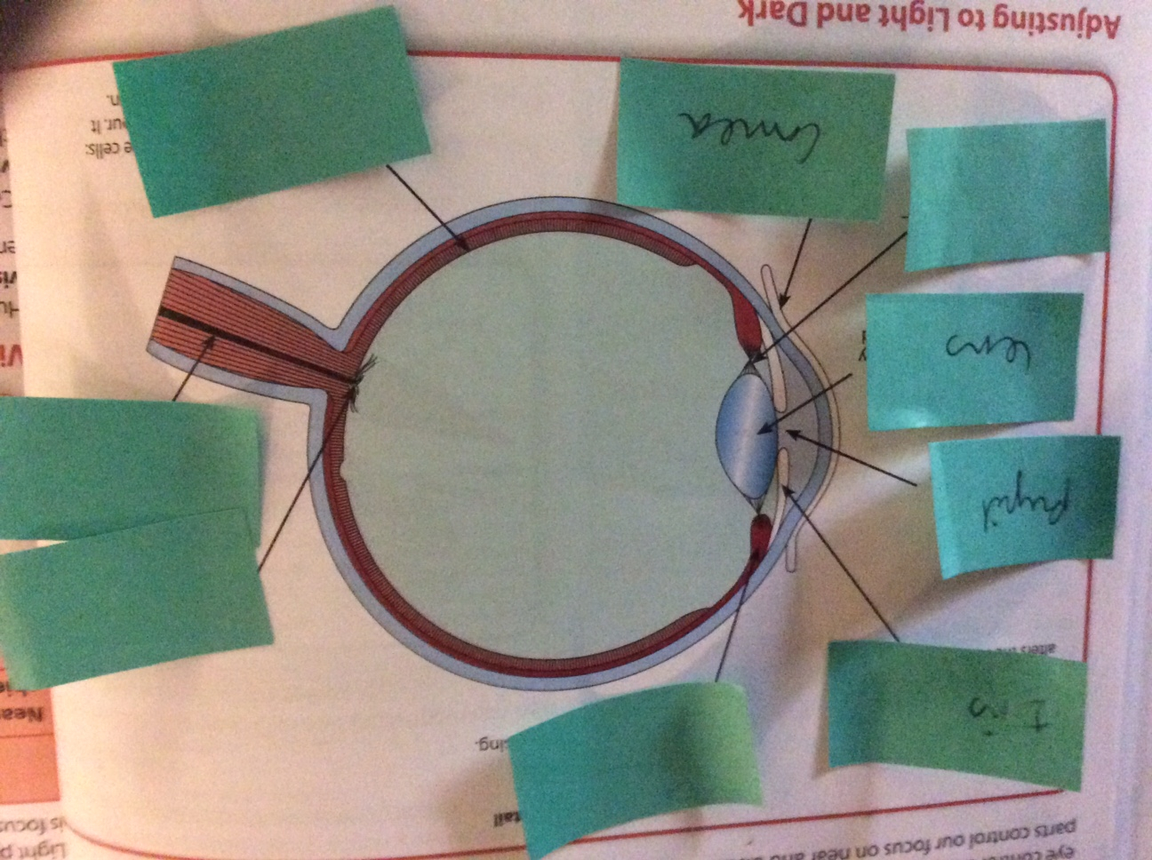
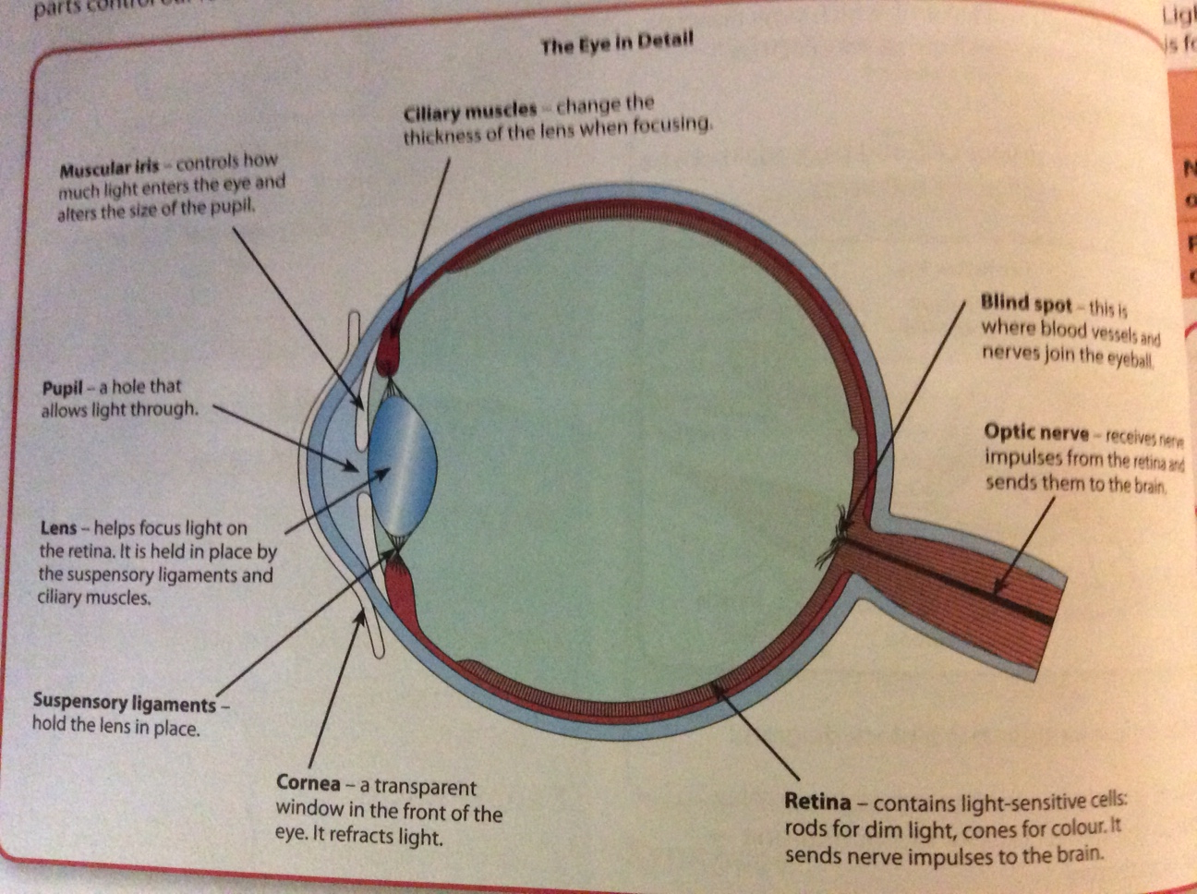
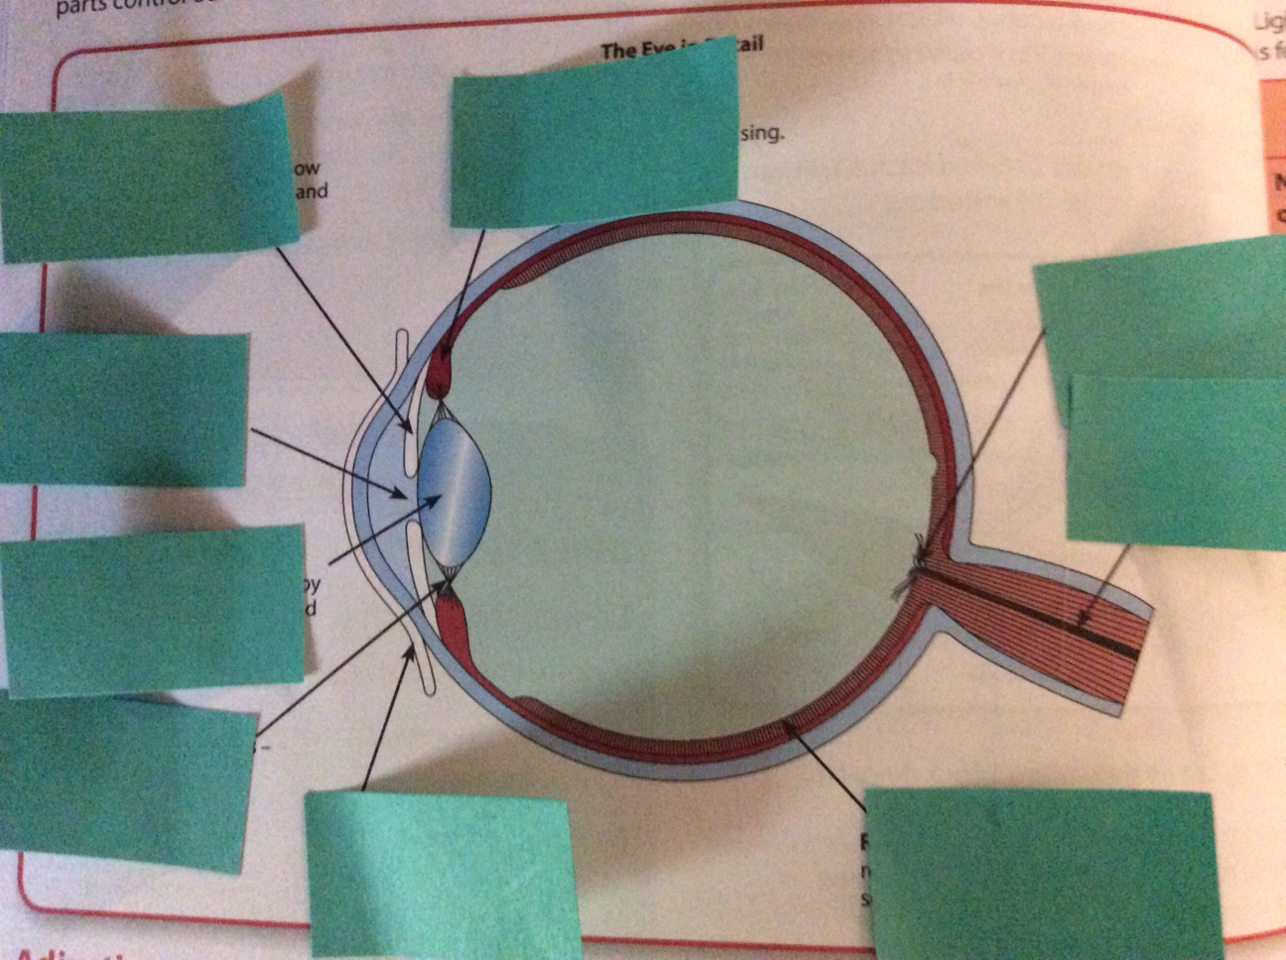
Alternative ideas: Using post-its on a diagram

Slide 7
Alternative ideas: using a table
Particle | charge | mass
proton | +1 | 1
neutron | 0 | 1
electron | -1 | negligible

Slide 8
Alternative ideas: look, cover, write, check
For speeches - learn line by line
For formulae and equations
For common vocab
For definitions
Think of your own ideas

Slide 9
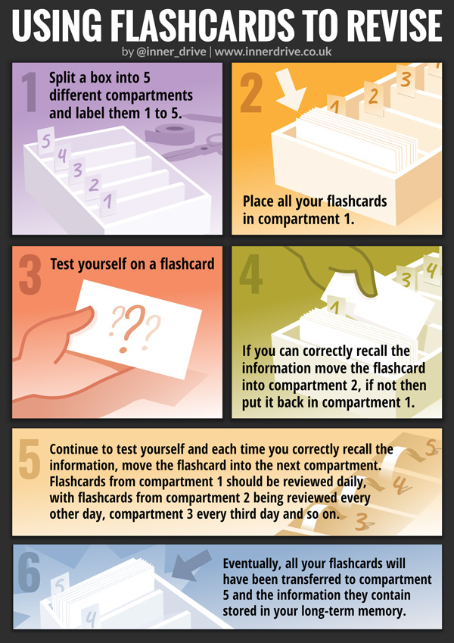
Keep going
Don’t stop after you first get them right,
Keep going till you never get them wrong

