Slide 1
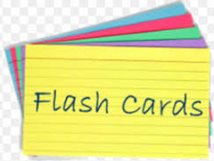
Making effective revision
(or flash) cards
And putting them to use

Slide 2
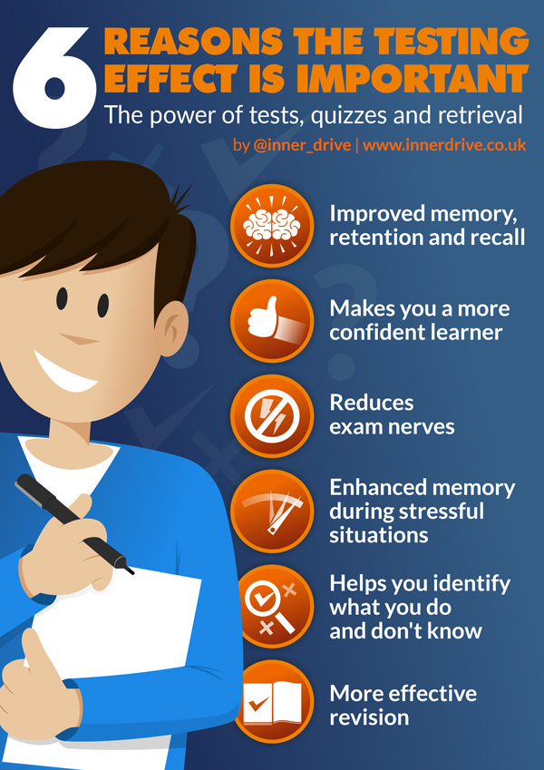
From the last session….
Testing yourself is an important aspect of learning material

Slide 3
One way to do this is to make revision (or flash) cards
Useful for factual content eg dates, definitions
Does not depend on screens/ being online
Better to make your own rather than download them or use someone else’s

Slide 4
What does a good card look like?
Colour-coded
Simple
Clear title
Facts on one side, questions on another
Title Subject/ topic
Useful fact 1
Useful fact 2
Useful fact 3
Useful fact 4
Useful fact 5
Helpful diagram

Slide 5
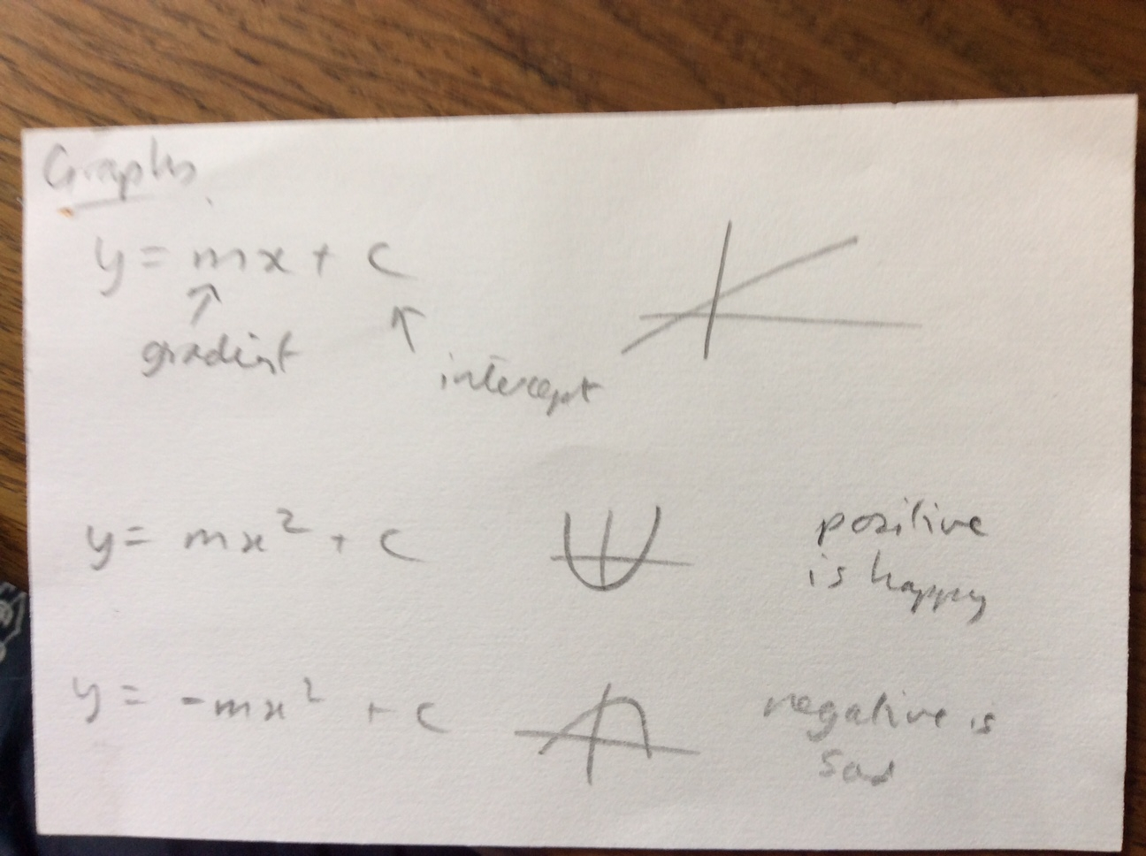
Traditional one
Maths notes on graphs:
What do you think are the good points?
How could it be better?

Slide 6
Thoughts….
Good | Could do better
Simple - not too much information Has diagrams Has way of remembering positive and negative shapes | No way to test yourself or check know/ can use information

Slide 7
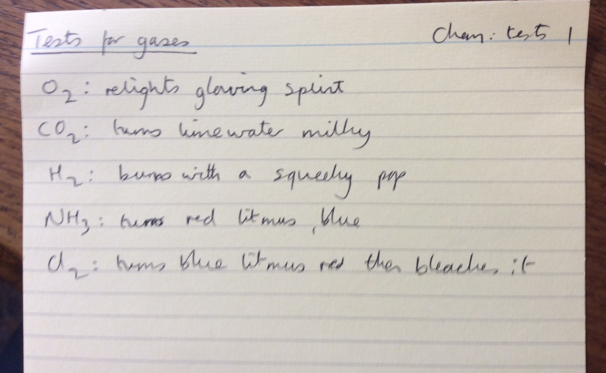
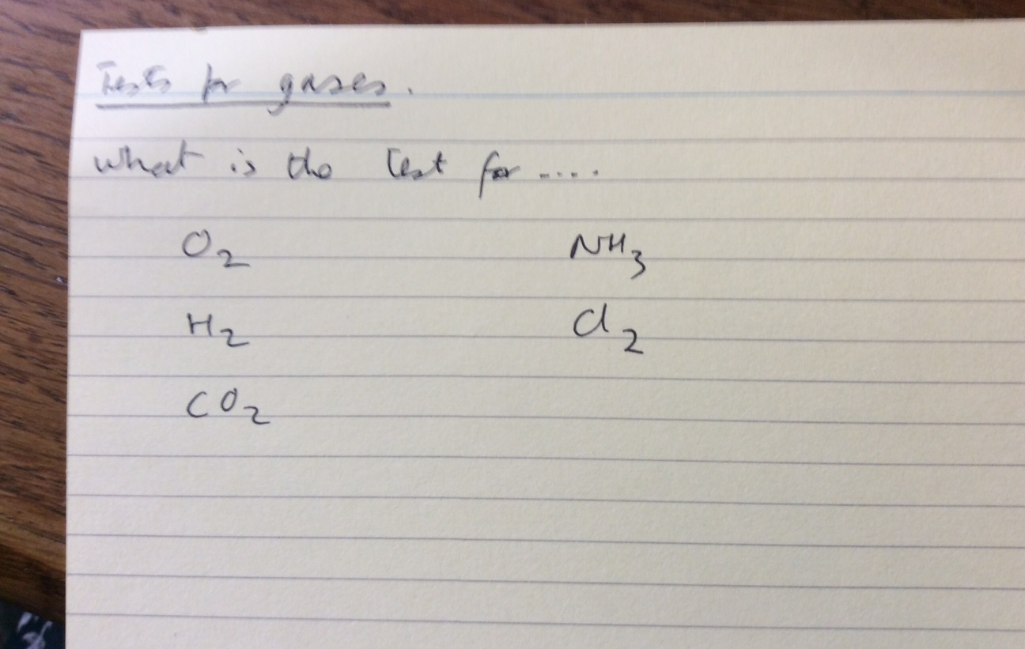
The second example
Tests for gases in Chemistry.
Notes side Questions side

Slide 8
Thoughts….
Good | Could do better
Simple - not too much information Has facts to learn then can be used to test yourself

