Slide 1
Summer term 2020
Moving Mechanism Challenge

Slide 2
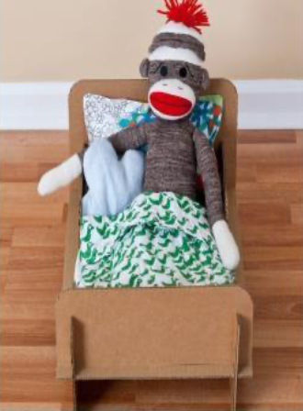
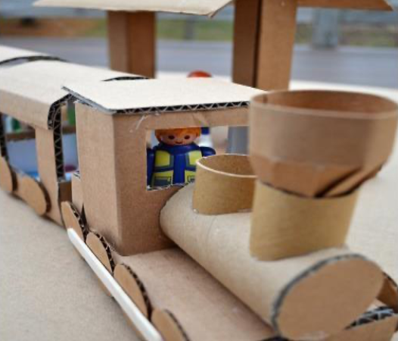
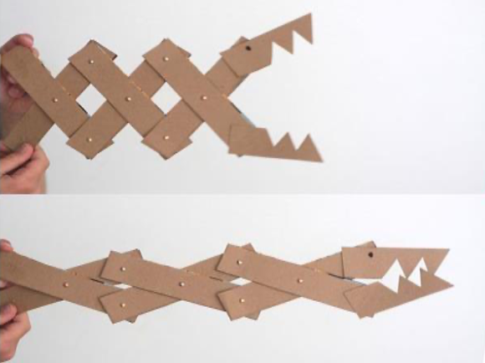
Design Brief
As a society we throw away huge amounts of packaging. Lots of retailers are working towards reducing the amount of materials they use in product packaging. As consumers and designers we need to help reduce the waste by recycling and/or upcycling where we can.
Your task is to design and make a child’s toy from household cardboard waste. You should include some form of movement or mechanism in your toy.
It should be designed for an appropriate age bracket, e.g 2-5 years, 6-8 years or 9-11 years.

Slide 3
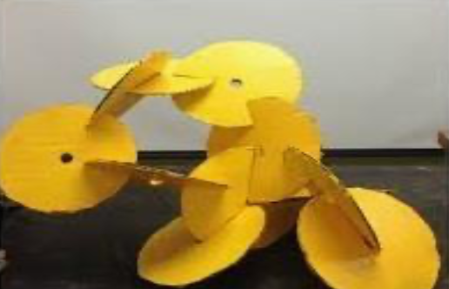
What Equipment/Materials do you need?
You will need to find the following pieces of equipment/materials:
thin card, old cereal boxes are ideal. used toilet roll tubes could be a good idea. You could use thicker corrugated card, but this is harder to cut.
Something to join your pieces of card together - perhaps sticky tape or masking tape? If you don’t have these at home you could design your toy with joining slots.
scissors - be careful!
pencils and other usual drawing implements.

Slide 4
Time scale
You have until the final lesson of the term to submit photos of your final outcome.
This will be the work of the next 3 to 5 lessons depending on your timetable.
You should aim to spend no longer than 5 hours on this design challenge.

Slide 5
How will you be successful?
Your toy should be functional and have a good quality finish. You can do this by planning, measuring, cutting accurately and careful consideration over how you will join your parts. Try to cut your tape rather than tearing it and don’t use more tape than is necessary.
Your toy should encourage imagination or be educational. A good research page is here
you should think about your chosen target age range and list the things you think they would like in a new toy.
You should sketch a range of ideas before you decide on an idea and then create your toy.

Slide 6
Outcomes
You should present your ideas in the blank pages in this presentation. You will need to include, as a minimum:
A page of inspiration or research, including some on movement or mechanisms
A range of pencil sketches scanned or photographed
a finished product photographed
Bonus points
A Fusion 360 or TinkerCAD model and drawing of your finished product

Slide 7
What research have you carried out?

Slide 8
Upload a picture or scan of your sketches:
Personal feedback
What went well your design?
What can be improved?

Slide 9
Upload a picture of your finished product:
Personal feedback
What went well your design?
What can be improved?

Slide 10
BONUS - Upload a screenshot of your finished Fusion 360 or TinkerCAD model:

Slide 11
Checklist
By your final lesson make sure that you have:
Completed the Research page
Completed the Sketching page
Completed the Final photo page
Given your own feedback

