Slide 1
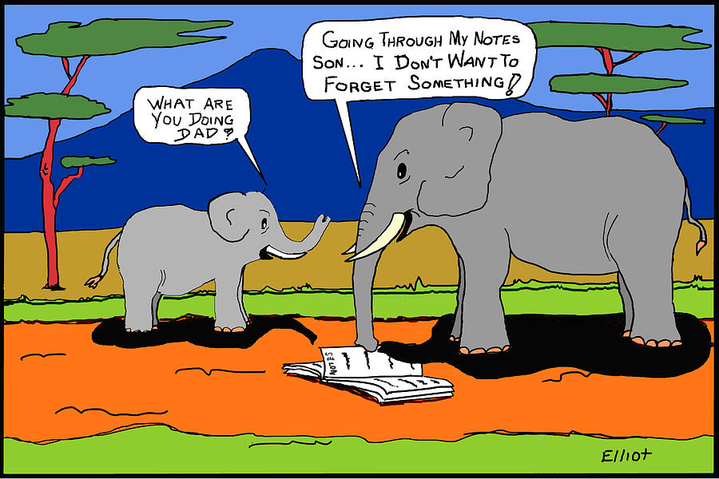
How your Memory works
And what can I do to remember stuff I’ve learned?

Slide 2
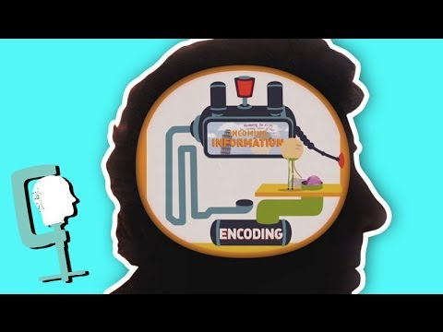
Getting started
Watch the Headsqueeze video here then pause then presentation and see if you can write down the stages in the memory making process….. from memory!
Check with the list on the next slide.

Slide 3
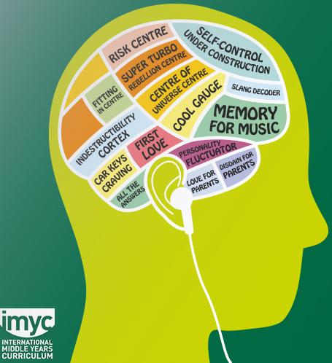
How your memory works
Stages in memory-making process
Encoding
Consolidation - “brain glue”
Retrieval - “a memory is only a memory when you remember it”
The teenage brain

Slide 4
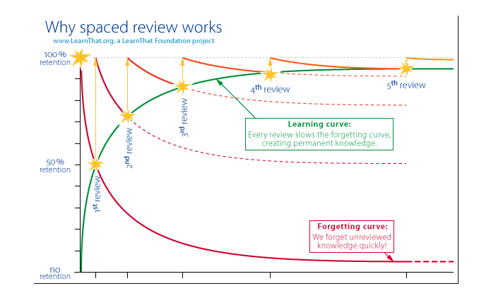
We all forget things

Slide 5
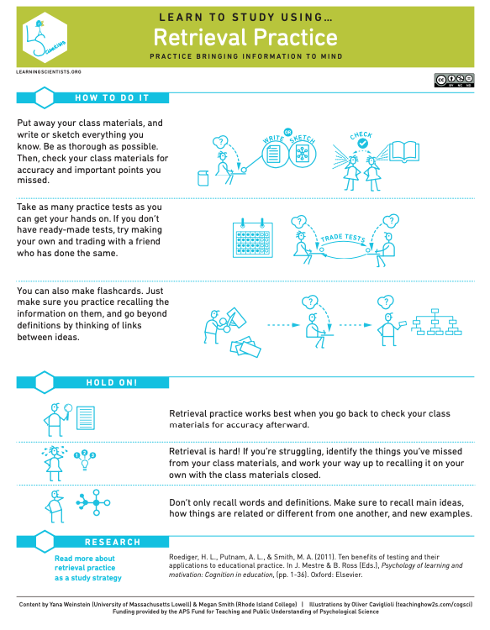
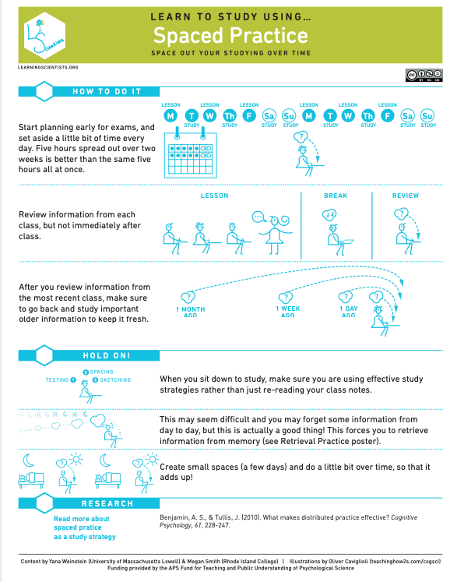
Retrieval over time
Flashcards
Quizzes
Answering questions
.

Slide 6
How do I remember?
Review your work. Space these reviews out and ensure you practice retrieving the information.
Cramming is bad and stressful; proper preparation prevents poor performance

