Slide 1
product redesign_remote Learning task

Slide 2
Lesson One

Slide 3
Introduction to project
All of the products in your house have been designed and engineered to perform a function. That might be to undertake a specific job such as your kitchen kettle, or perhaps they have been designed to improve the aesthetics of a room such as a piece of lighting. Whatever the product, it will have gone through extensive development before being released to the market.
After a huge amount of research, time and money many of the products in your home could be improved :-
Perhaps they could do their job better?
Perhaps they could be more easily repaired?
Perhaps they could be manufactured from a more environmentally friendly material?
Your task is to follow the pages in this booklet to show
Research
Designing
Development
Evaluation

Slide 4
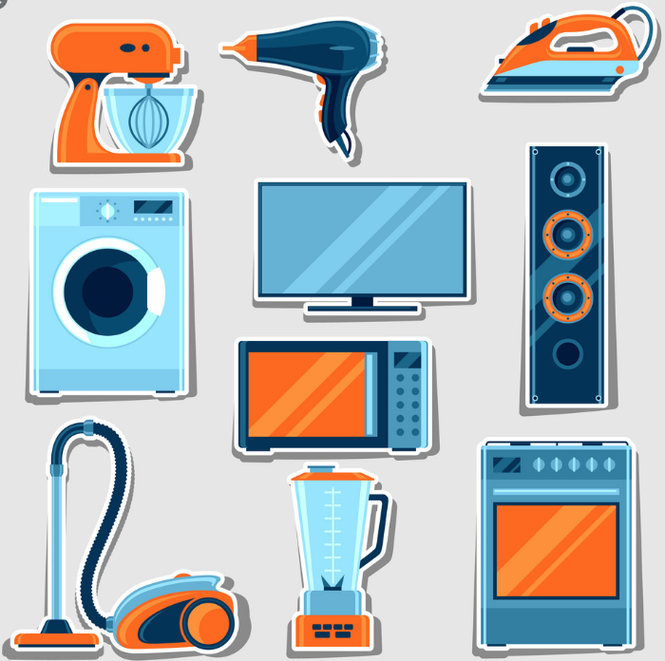
TASK 1 - RESEARCH
Wander around the house and identify 3 everyday objects that you think you may be able to improve by redesigning them, perhaps one from the kitchen, the bathroom and the living room.
Think about :
How well they do their job - Could you make them work differently?
Why are they made from their current material?
Could they combine with another object to create a better, more useful product?
How could they be improved?
Are they fit for their intended purpose?

Slide 5
My CHoSEN PRoducts
Take a picture of your product and copy it across into this picture frame or copy a relevant image from Google images
Take a picture of your product and copy it across into this picture frame or copy a relevant image from Google images
Take a picture of your product and copy it across into this picture frame or copy a relevant image from Google images
Briefly describe your product and how it works
Briefly describe your product and how it works
Briefly describe your product and how it works

Slide 6
My CHoSEN PRoducts
copy Your Image Again
Copy Your image Again
Copy Your Image Again
Briefly describe what you really like about it
Briefly describe what you Don’t like about it
Briefly describe what you really like about it
Briefly describe what you Don’t like about it
Briefly describe what you really like about it
Briefly describe what you Don’t like about it

