Slide 1
product redesign_remote Learning task

Slide 2
Lesson Five

Slide 3
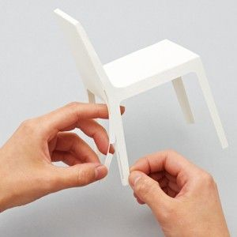
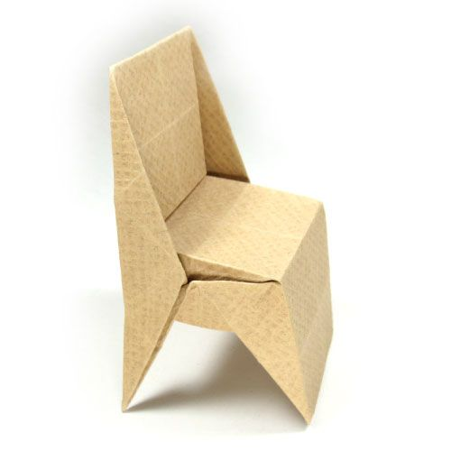
Paper or Card Modelling
Use paper or card and create a model of your chosen idea
Take photos and upload them to your document
Add feedback alongside your photos:
What went well with your design?
What can be improved?

Slide 4
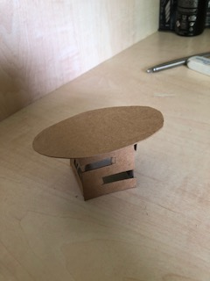
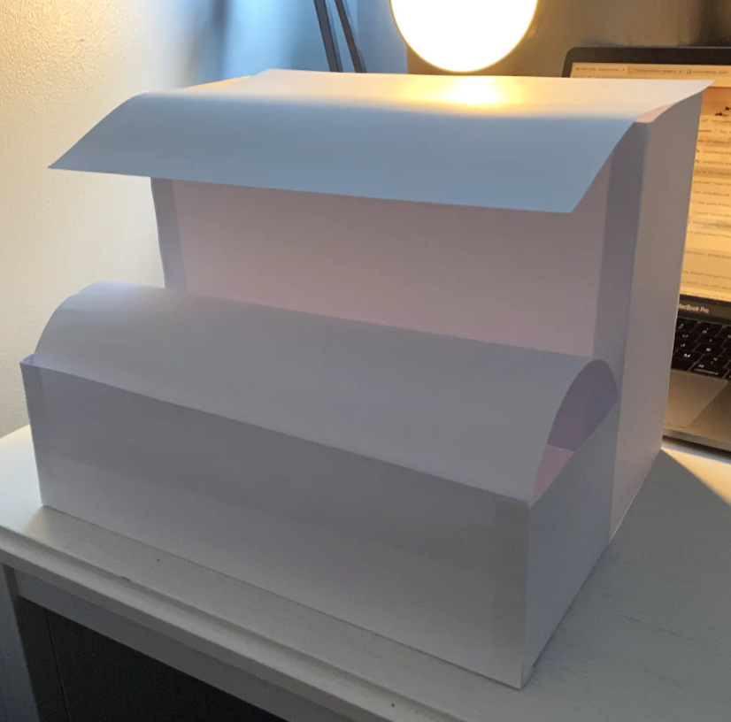
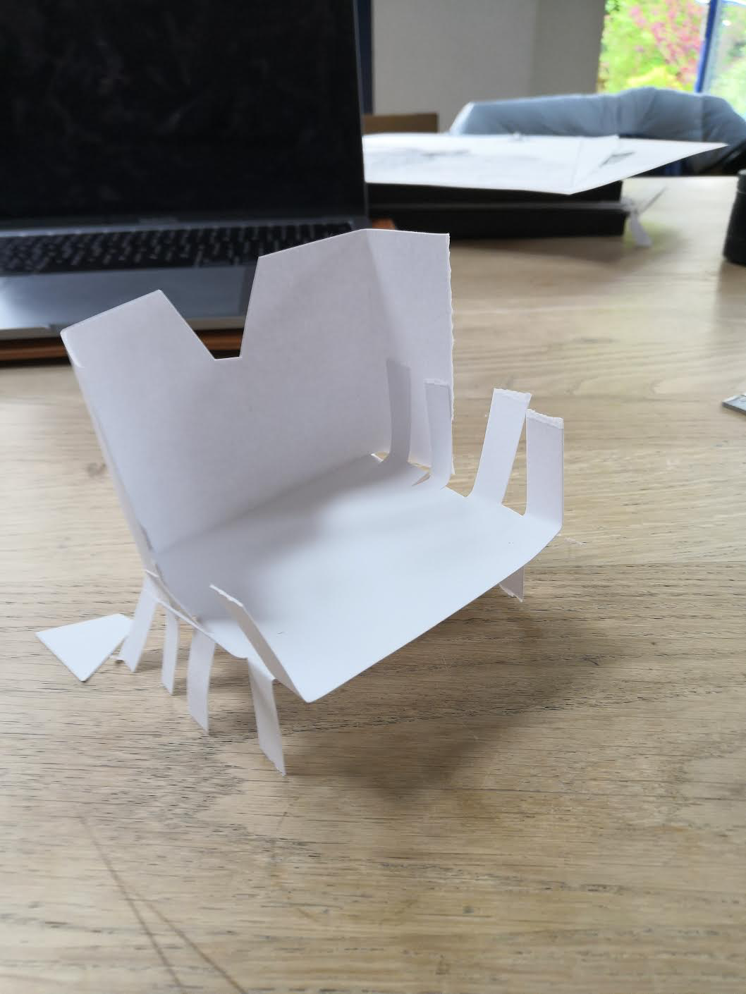
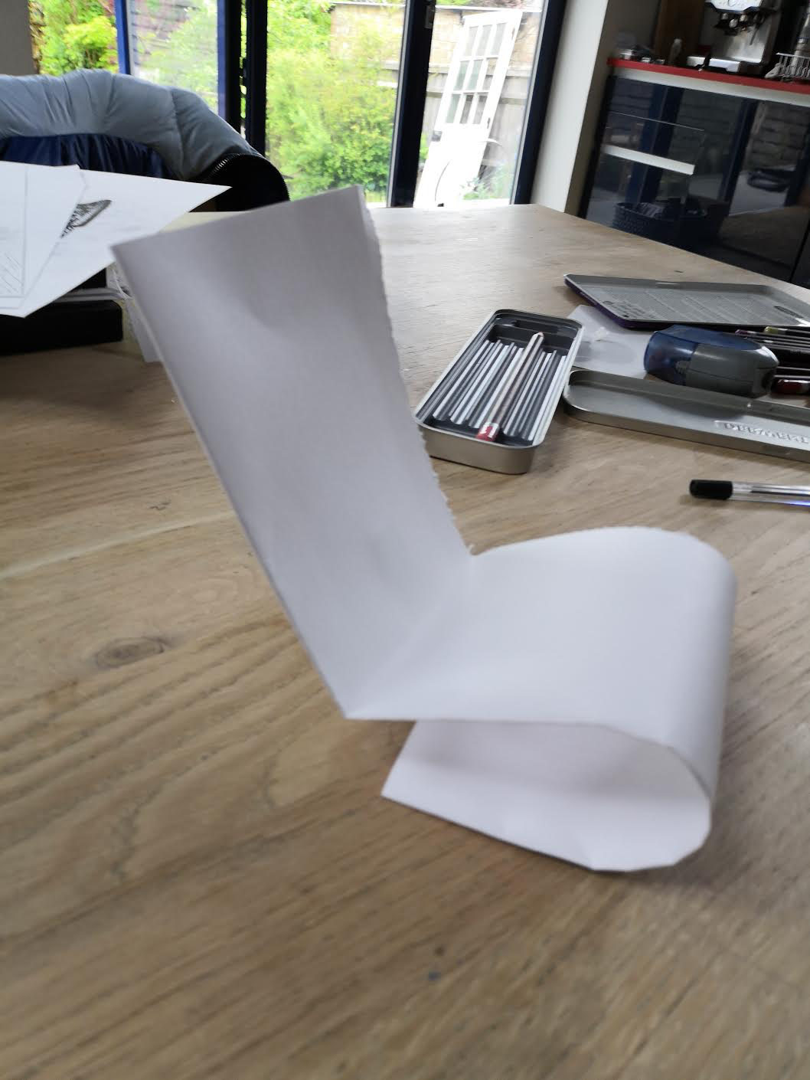
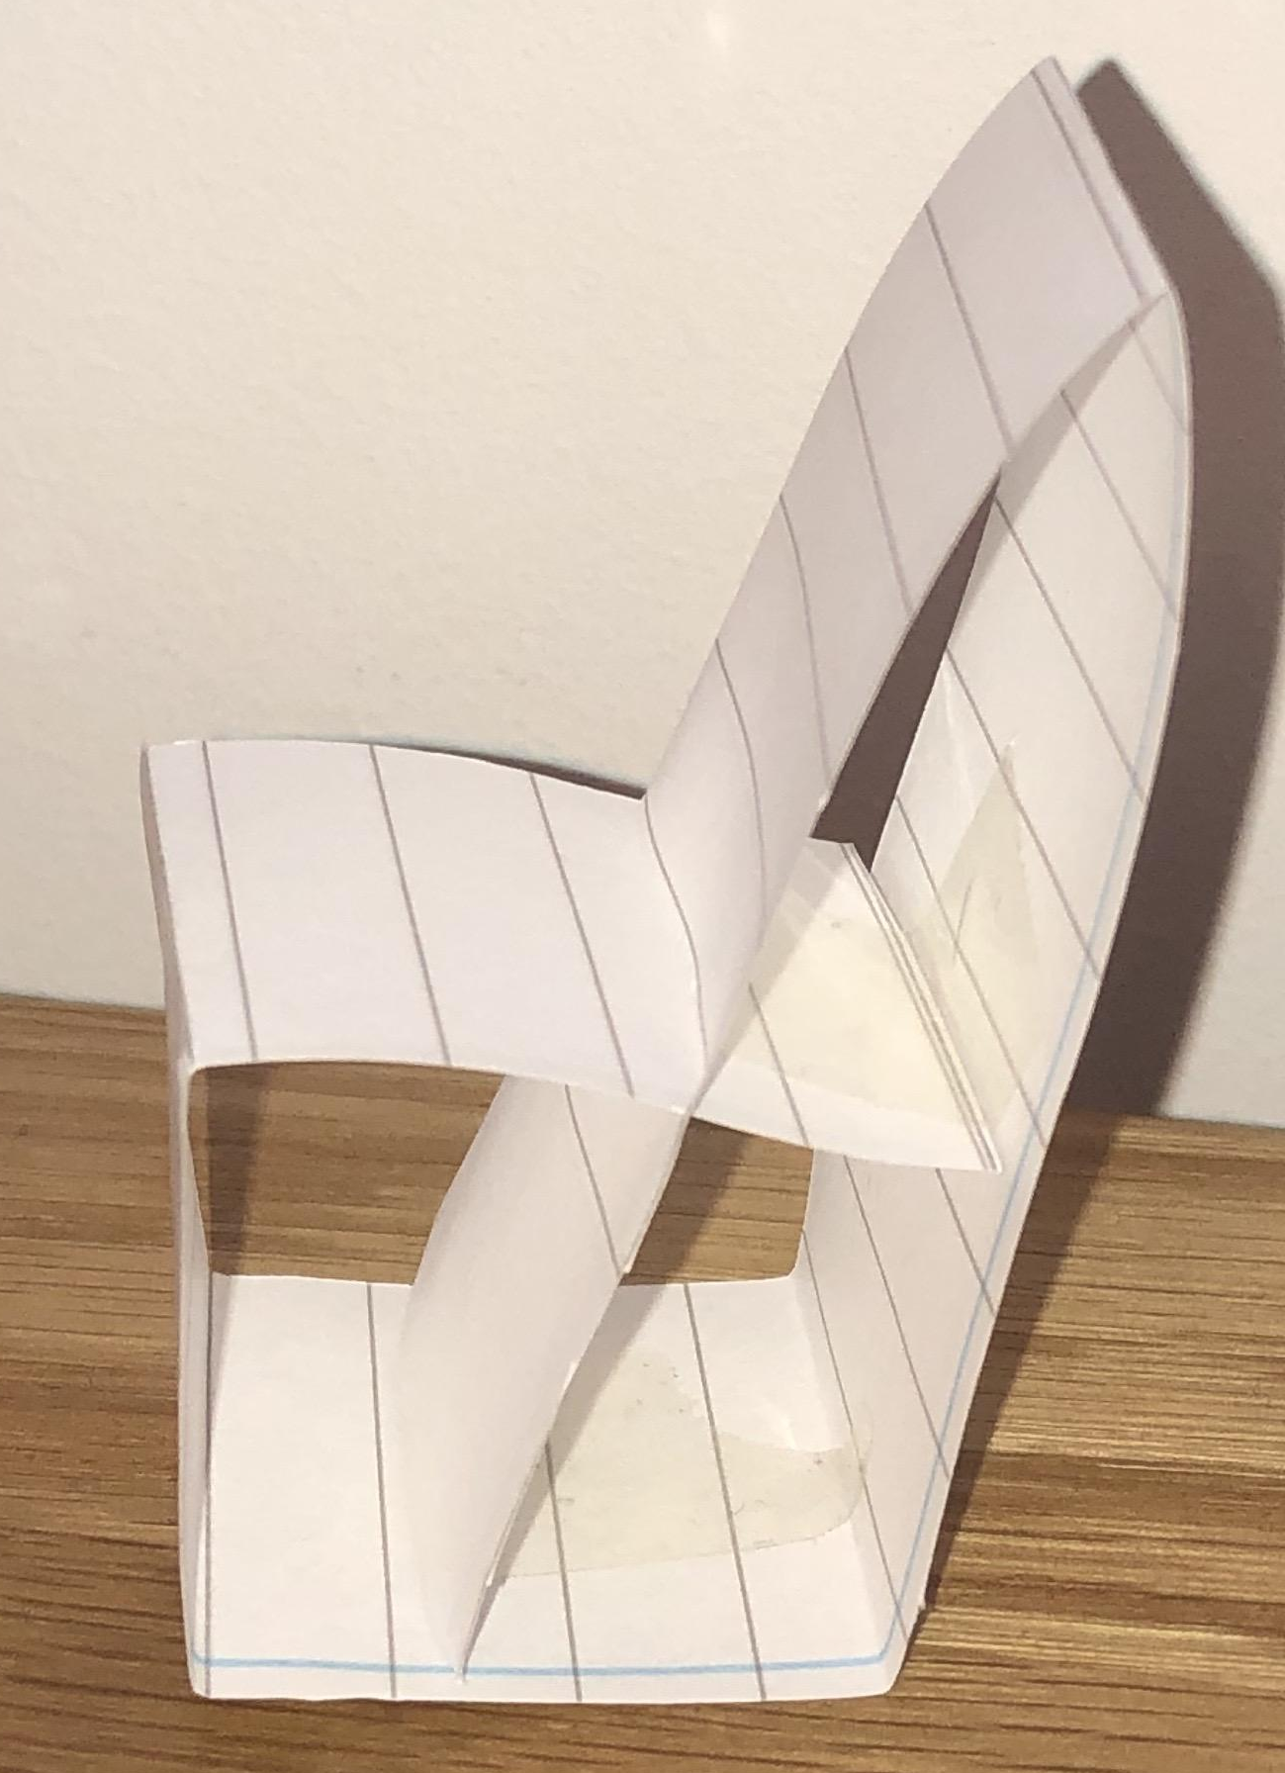
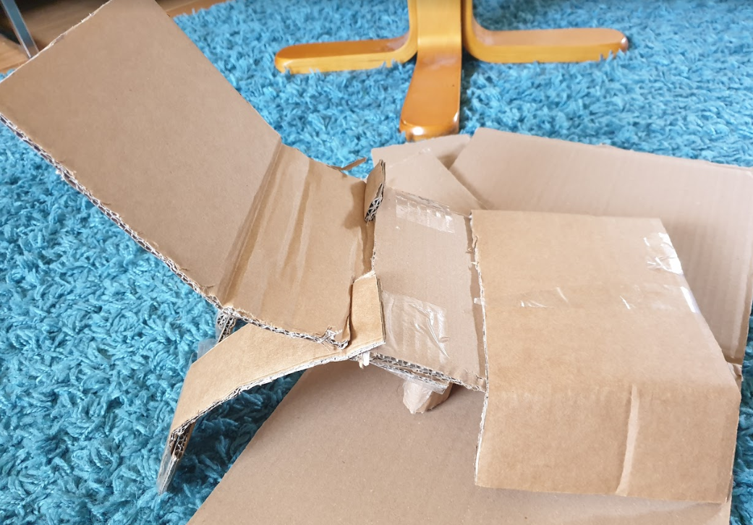
Examples

Slide 5
Upload a picture of your paper or card models:
Personal feedback
What went well your design?
What can be improved?

