Slide 1
product redesign_remote Learning task

Slide 2
Lesson Three & Four

Slide 3
Sketching
You need to complete two pages of design ideas. This should be:
One page of quick small sketches, with a bit of annotation to help explain your ideas
One page with a final design idea with lots of annotations to explain all the different features
Try to gain some feedback on your final idea
This will probably take you most of two lessons
See the examples on the next pages

Slide 4
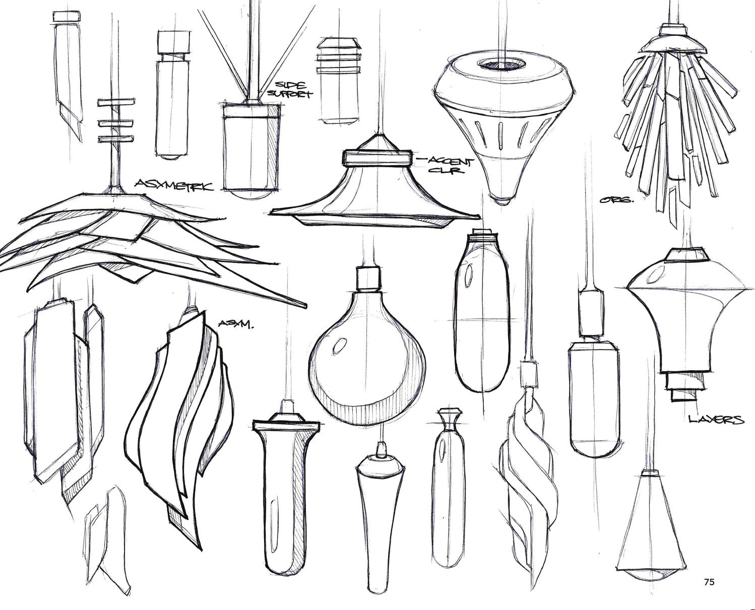
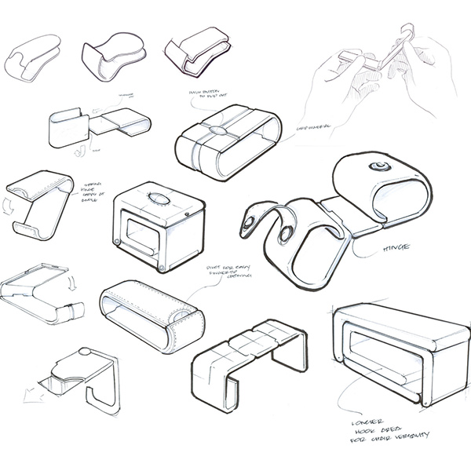
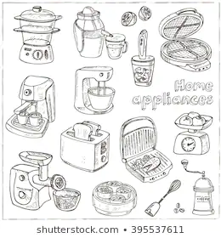
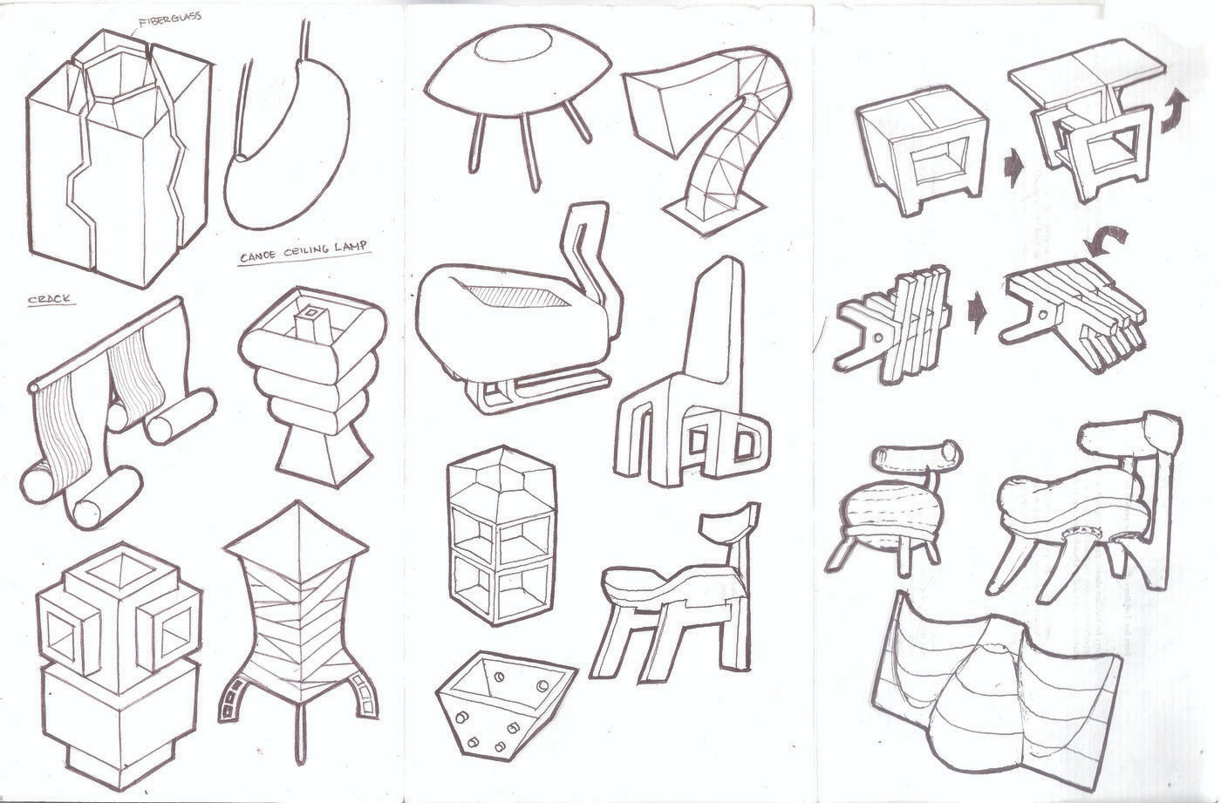
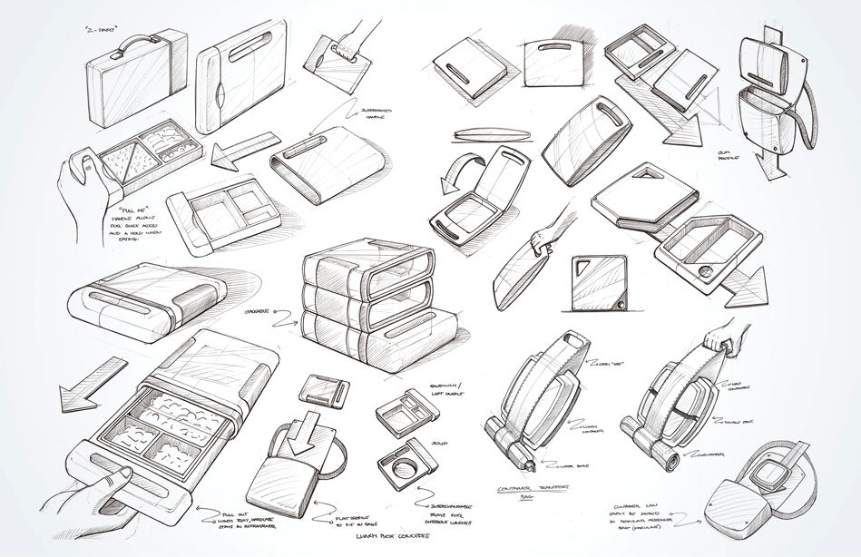
SKetching - example of quick small sketches

Slide 5
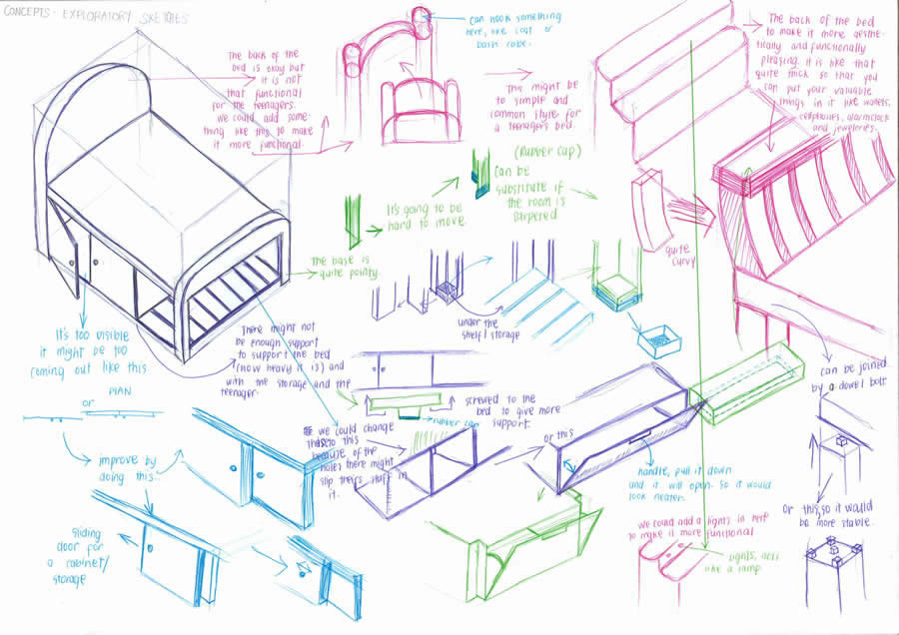
Sketching - detailed example 1

Slide 6
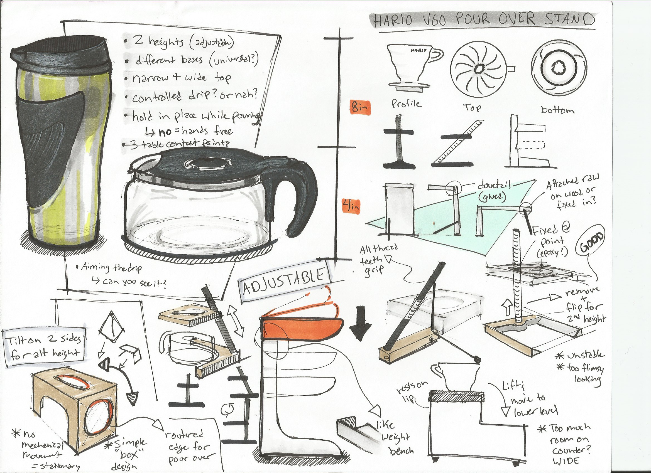
Sketching - detailed example 2

Slide 7
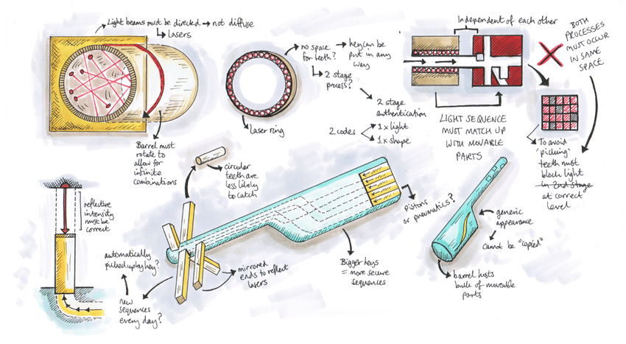
Sketching - detailed example 3

Slide 8
Upload a scan or picture of your page of quick ideas:

Slide 9
Upload a scan or picture of your page with your detailed design:

Slide 10
Your favorite aspects of a product may not be the same as everyone else in your household and it is important to gain feedback on your design ideas
Task 2 - First and Third party feedback
What do you like and dislike about your final sketch idea:
Ask another person in the house to take a look at your sketch ideas.
Summarise Their Feedback :

