Slide 1
product redesign_remote Learning task

Slide 2
Lesson Two

Slide 3
Detailed product Analysis
Last lesson you looked at three objects in your house and explained what you liked and disliked about them.
You now need to really explore one of these products in a little more detail before you can confidently attempt to redesign and improve its function. One way that we can do this is by undertaking a product Analysis.
When we analyse a product we can use the following acronym to help guide our investigation
A C C E S S F M
Can you try and work out what each of the initials may represent?

Slide 4
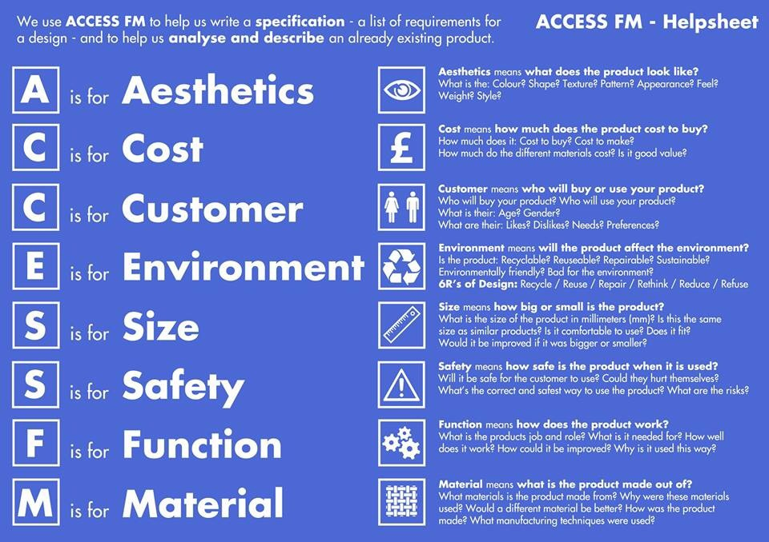
Did you manage to work them all out ?
Task 1 - Use the Information above to complete the product Analysis grid on the next page

Slide 5
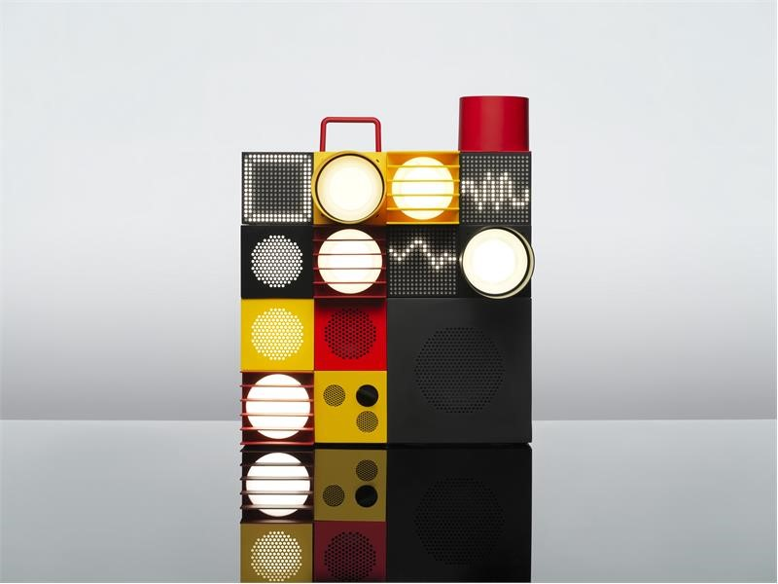
Function :
It is a speaker and light system.
It is modular so that you can add to it
You can 3d print components from the internet
Customer :
Cost :
Size :
copy An Image of your favourite product to redesign
aesthetics :
Safety :
Materials :
ABS plastic, because it comes in a range of colours and it is durable and easily moulded
Environment :

Slide 6
Your favorite aspects of a product may not be the same as everyone else in your household and it is important to gain as much information before starting your redesign.
Task 2 - User Observations
Ask another person in the house to interact with your product. How do they use it ? It is instinctive? Do they use it in the same way as you?
Summarise your observations :
Ask your user what they like most about the product and wHAt aspects of it do they feel could be improved? Are they the same observations that you found?
Summarise Their Feedback :

