Slide 1
Lesson Three

Slide 2
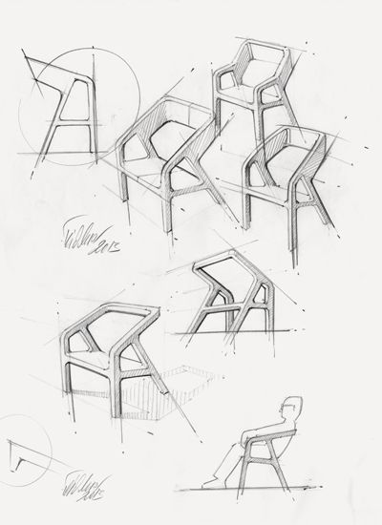
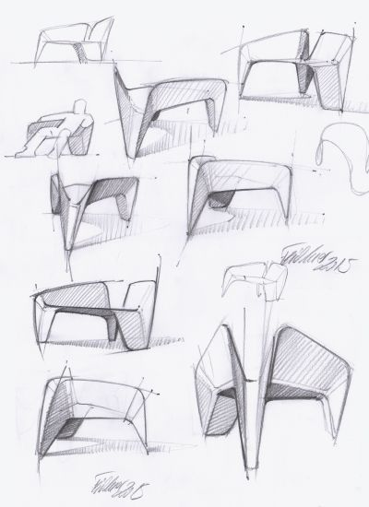
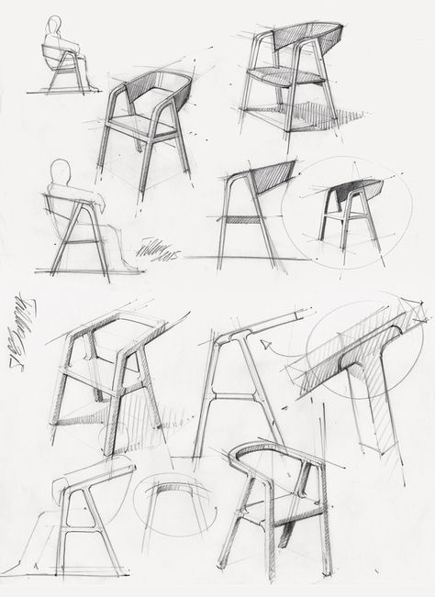
Design Sketches (Three designs with different Views)

Slide 3
Lesson Four

Slide 4
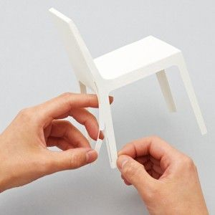
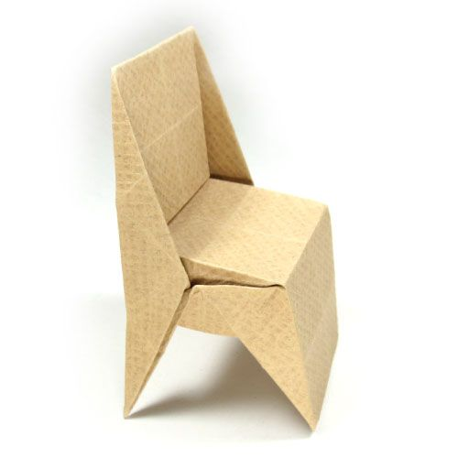
Paper Modeling of Ideas
Use paper or card and create a model of each of your ideas.
Take photos and upload them to your document. What went well with each design?
What can be improved?
Which design have you chosen to develop and why?

Slide 5
Lesson Five

Slide 6
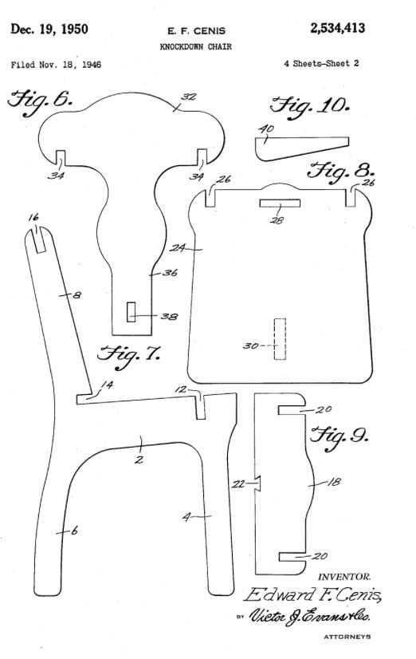
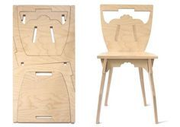
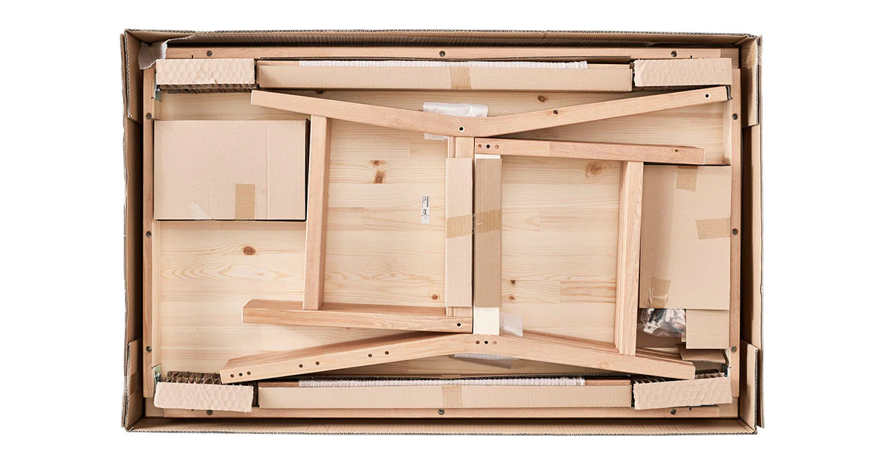
Final Design IDea (2d View - Flat Pack view)
TASK
Create a drawing of your design, showing what each piece of card would look like before it is assembled.

Slide 7
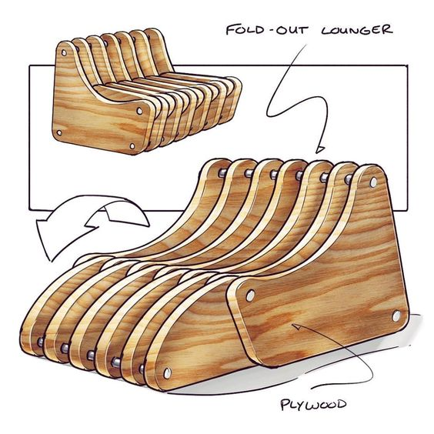
Final Design IDea (3D Assembled Design)
TASK: FINAL DESIGN IDEA (3D)
Create a drawing that shows your assembled piece of furniture in two different viewpoints (as practice in lesson).
You should render (colour) your design and explain any key features.

Slide 8
Lesson Six

Slide 9
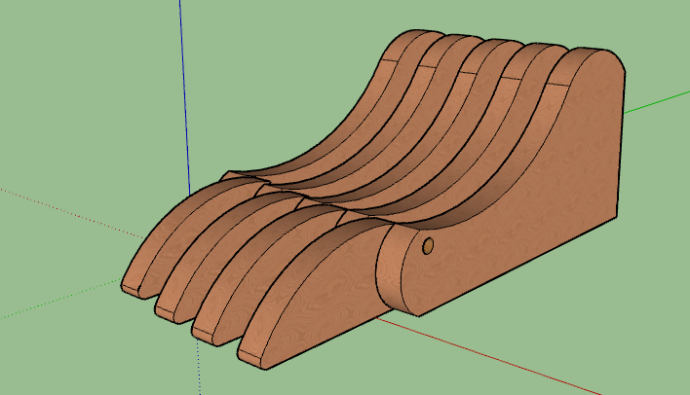
Final Design IDea (CAD)
TASK:
Using TinkerCAD or Fusion 360, create a 3D model of your design idea.
If you are stuck, follow the tutorials built into TinkerCAD
https://www.tinkercad.com/
You can create a new account based on your School Email

Slide 10
Lesson Seven

Slide 11
3D Cardboard Model (Photos)
Finally, use cardboard to create a 3D model of your design. Take photos and include in your document.

Slide 12
Lesson Eight

Slide 13
Evaluation
Did you finish the FLAT PACK project in the time available? Did you have to adapt your design to finish?
Are you pleased with your outcome? Explain how it meets the design specification.
Would you change anything about your project if you made it again?
What stage of making your design did you find most difficult? Explain why.
What stage of making your idea did you find most enjoyable? Explain why.
How could you develop your idea further?

