Slide 1
Lesson Two

Slide 2
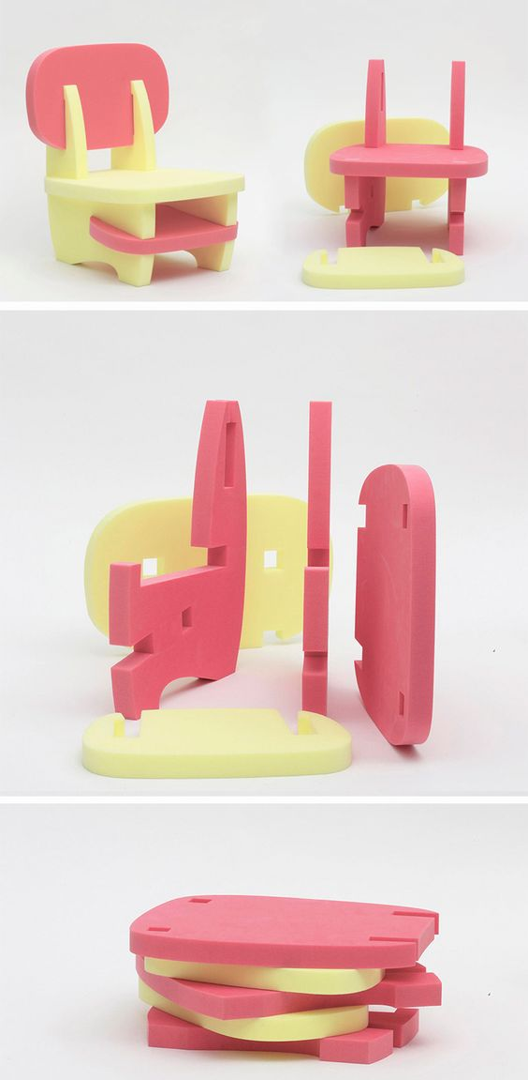
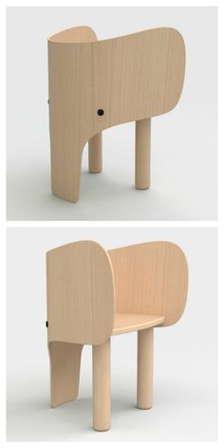
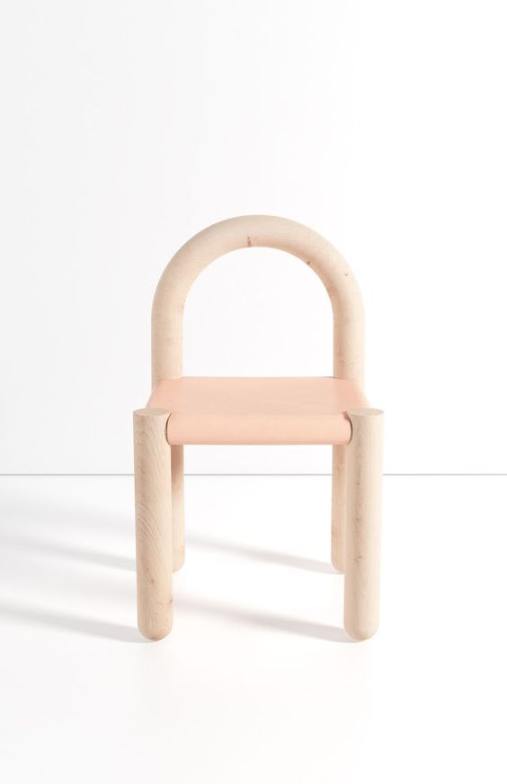
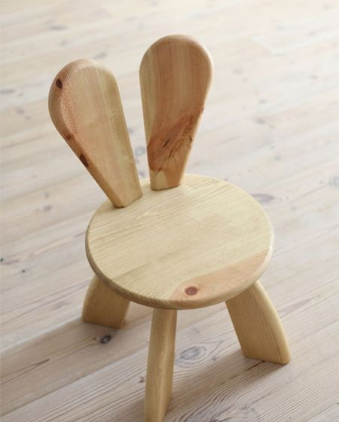
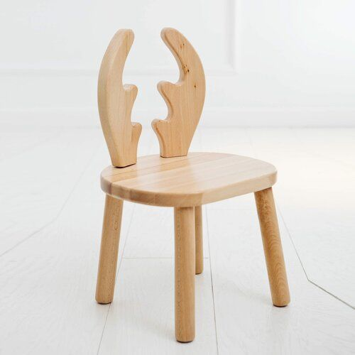
Designers
Current Designers
TASK:
Based on your mind map and target market, you should research different furniture designers that produce flat pack or modular furniture and collect images of their work.
Explain why you chose those designers and what you like about their work.
Pedro Paulo-Venson
Yanko
Mark Venot
Hiromatsu
Wayfair

Slide 3
The work of Existing Designers

Slide 4
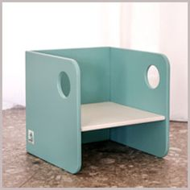
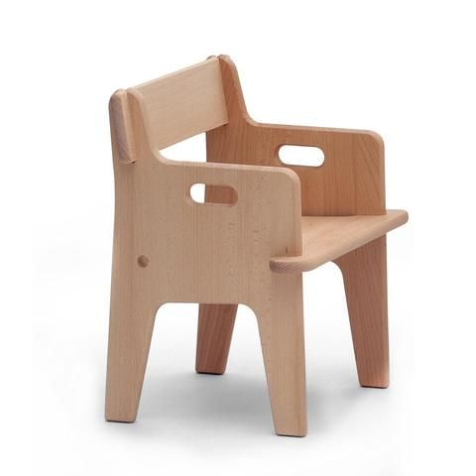
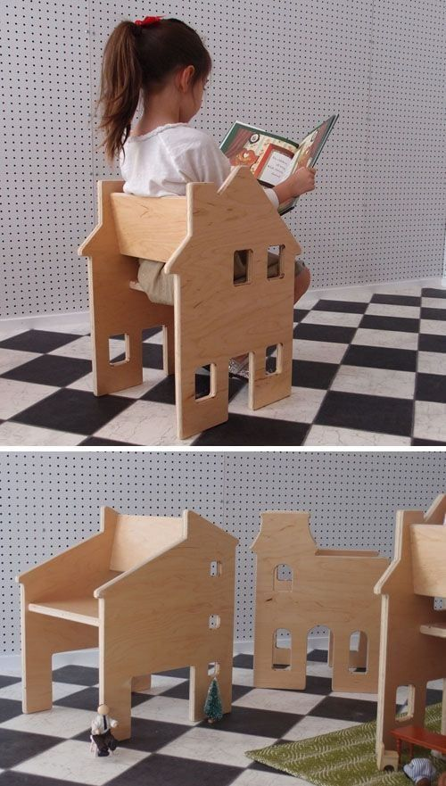
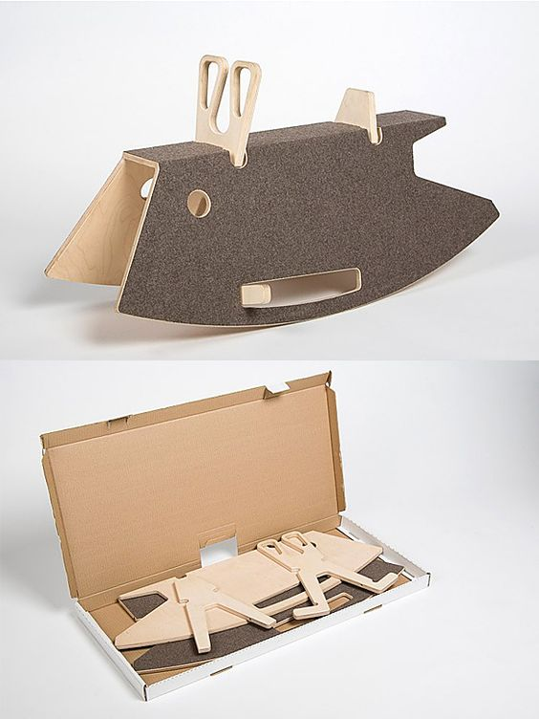
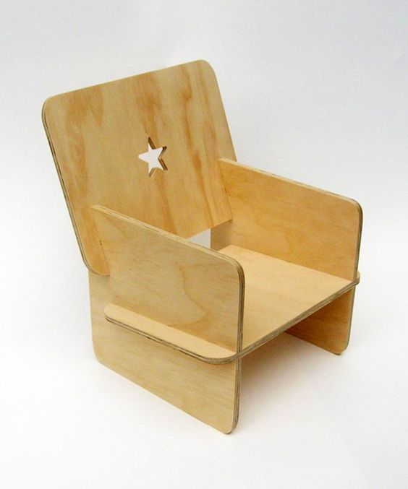
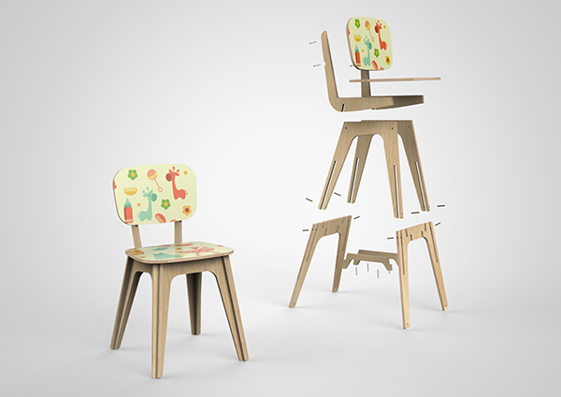
RESEARCH - Flat Pack Products
TASK: CREATE A PAGE OF RESEARCH
Use keywords to find images of FLAT PACK furniture that inspires you. I looked at ‘Childrens Flat Pack’.
What is your favourite? Why?

Slide 5
Existing Product Research - Flat Pack Furniture

Slide 6
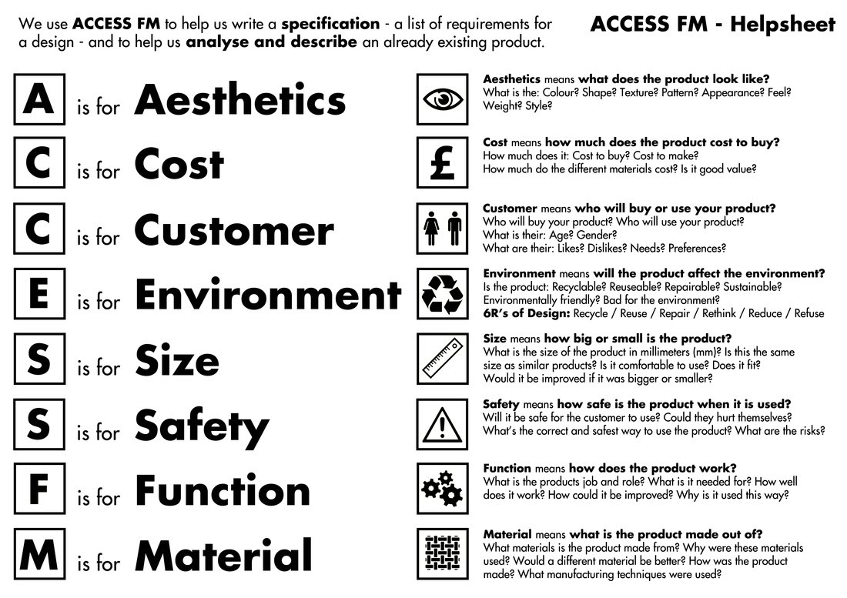
Design Specification
TASK:
Choose one product that you will complete a product analysis of. You should try to answer all the questions on the right side of the help sheet.

Slide 7
Product Design Specification

