Slide 1
Cardboard Flat-PAck Project

Slide 2
Lesson One

Slide 3
Introduction to project
Flat-pack furniture is a type of affordable furniture that people buy to build at home. IKEA is a company that is well known for making this kind of furniture.
Your task is to follow the pages in this booklet to show
Research
Designing
Making
Evaluation
You will make a 3D model using cardboard.

Slide 4
Structure of the project
You will need to create a presentation that shows all the areas listed in this help guide.
Mind map
Research
Initial Ideas
Mini 3D paper models
Final Design 2D and 3D
CAD Design
3D Cardboard model (photos)

Slide 5
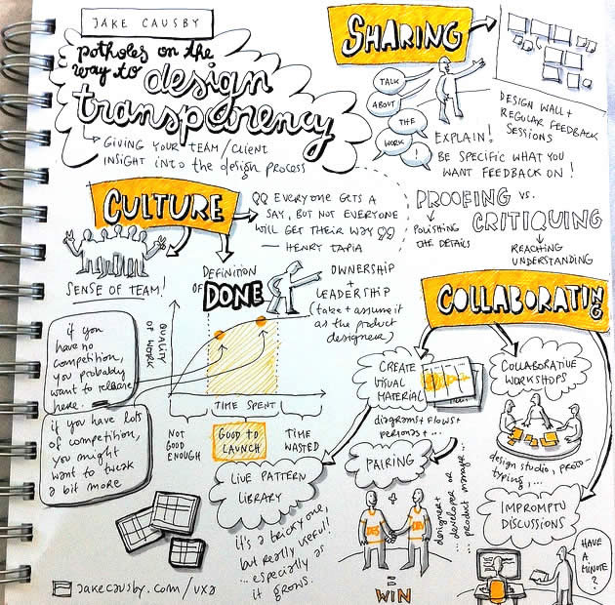
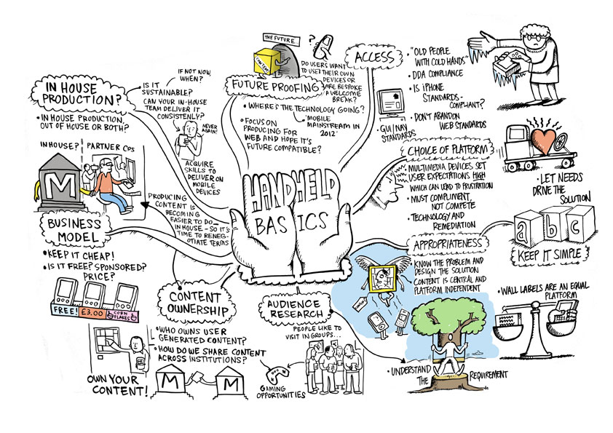
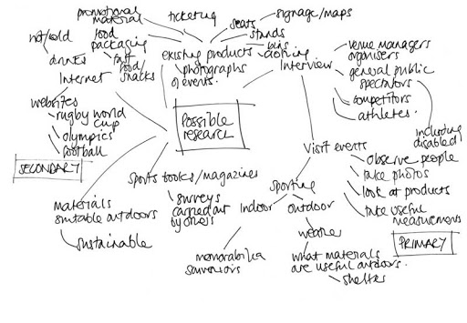
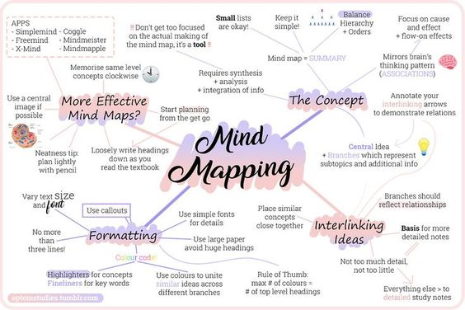
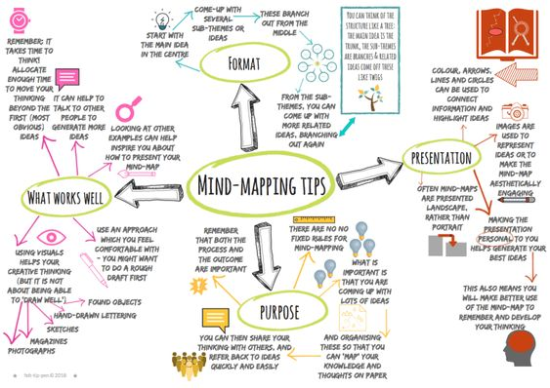
Mind Map
What is a mind map?
A visual diagram used for gathering information TASK: CREATE A MIND MAP
Create a visual mind map based on the design brief. You should create an ‘arm’ for each of the key words. You can create one on paper OR on the computer.
Suggested Apps (Websites)
https://app.mindmup.com/
https://bubbl.us/
https://app.mindmapmaker.org/#m:new
Key Words
Designer
Client/User
Furniture Ideas
Existing Products

Slide 6
Mindmap

Slide 7
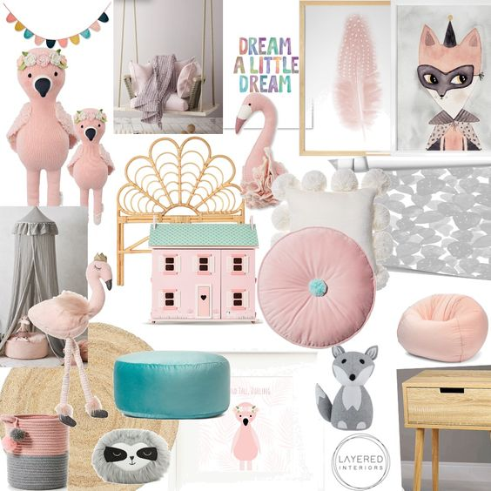
Target Market
What is a Target Market?
What kind of person will you be designing for?
TASK: Identify a Target Market
Create a moodboard that shows the style of your chosen user.
Things to think about:
Age
Gender
Job? Student?
Wealth
Personality
Cultural Background
Elsa, Age 5
Needs something lightweight and multifunctional

Slide 8
Target Market Mood board

