Slide 1
Fashion’s Dirty Secrets
Lesson 4

Slide 2
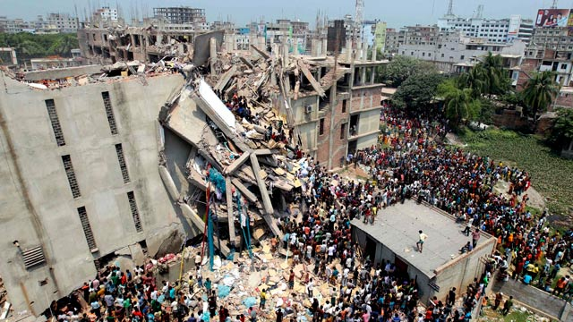
Fashion’s Dirty Secrets – sweat shops
Secondary geography
A picture in time…
Look at this photo.…
What might have happened before the photo was taken
What might be happening in the photo
What might happen afterwards

Slide 3
A picture in time…
Secondary geography
Using what you have learnt this lesson, create a headline or a caption for this photo as though it was in a newspaper. Print out the photo and stick it into your book and write the headline/caption above it……

Slide 4
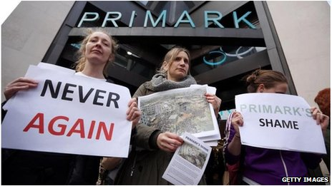
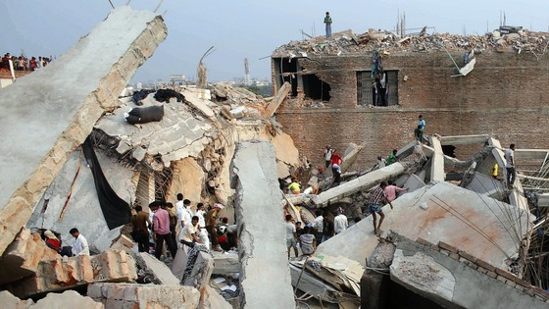
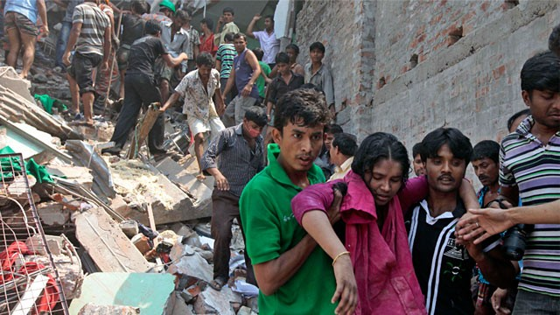
Secondary geography

Slide 5
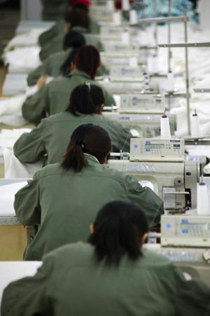
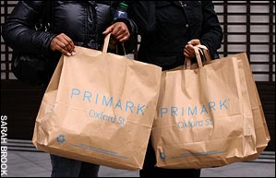
Before we begin…
Secondary geography
What is your opinion of sweatshops?
1
2
3
4
5
6
BAD
NOT SURE/
IN BETWEEN
GOOD
Write down a score between 1 and 6.
We will come back to it later to see if it has changed…

Slide 6
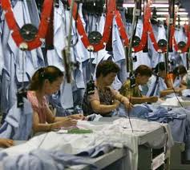
Aim 1: what are conditions like in these factories?
Secondary geography
We are going to collect three pieces of evidence about working conditions in sweatshops.
You need to write describing words down on the sheet in front of you.
Evidence 1:
Pictures
Evidence 2:
Diary entry
Evidence 3:
Video clip

Slide 7
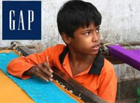
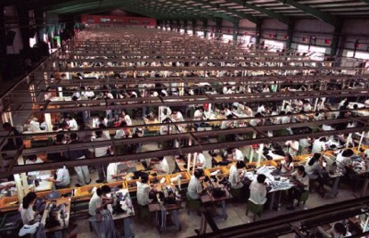
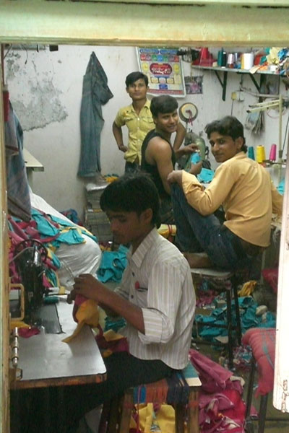
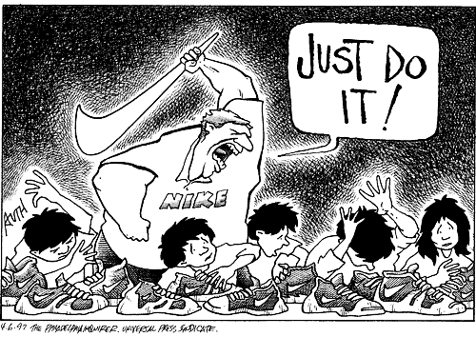
1. What do these images tell you about working in sweatshops? Write down as many describing words as you can.
Secondary geography

Slide 8
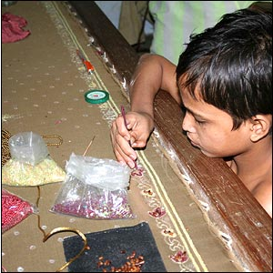
2. What does this diary entry tell you about clothing factories? Write down as many describing words as you can.
Secondary geography
“I am 14 years old. I have been working in a sweatshop for one year already. I get up at 5am to start work. I sleep at the factory, so I do not have to travel far.
It is hard work, and my back and neck hurt a lot. I get scared when inspectors come round to check the factories are not employing children. I have to hide so I do not get into trouble. I wish I could go to school instead.”

Slide 9
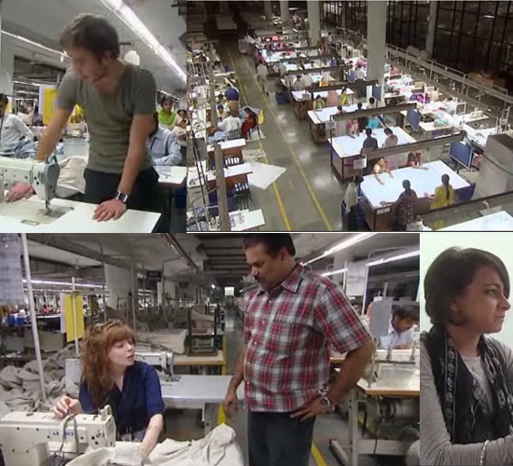
3. What does this video clip tell you about working in clothing factories?
Secondary geography
http://www.bbc.co.uk/programmes/p013k58r

Slide 10
Now that we have collected our first lot of evidence…
Secondary geography
What is your opinion of sweatshops?
1
2
3
4
5
6
BAD
NOT SURE/
IN BETWEEN
GOOD
How has your scored changed? How? Why?

Slide 11
Aim 2: How might sweatshops be good and bad?
Secondary geography
You are going to read another three pieces of evidence that are on the next 3 slides of the PPT.
Read the card and write down what it is telling you about sweatshops.
Easy: one point per card
Intermediate: two points per card
Hard: three points per card

Slide 12
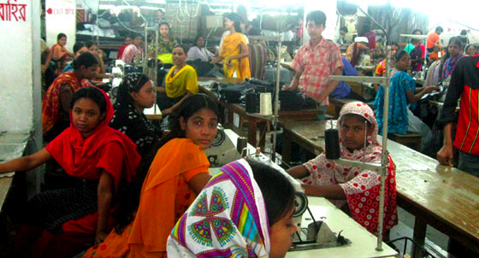
Evidence 1: Sweatshops help us to survive!
Secondary geography
Sweatshops actually pay workers higher wages than many other jobs that they could do.
The work is steady and reliable. People are happy to work there because they know they will get paid regularly.
This money can help people get on with their lives, and pay for food, medicines, and education.
If sweatshops are taken away, there will be many, many people without jobs. This will be bad for the economy and for the country’s development.

Slide 13
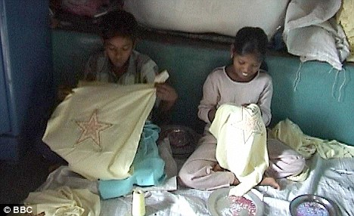
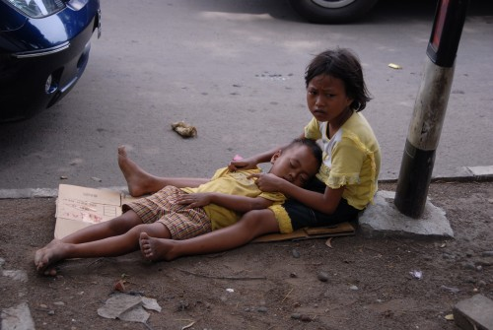
Evidence 2: Sweatshops keep children safe
Secondary geography
“We can’t afford to go to school. Our parents are working really hard, but still they do not have enough money to pay the school fees.
We prefer to work in a sweatshop than being out on the street. It is dangerous out there. Children like us can get kidnapped, or sometimes they can become involved in gangs or committing crimes.
I like it in the sweatshop because I can earn money to take back to my family. I also have friends here to talk to. I feel safer.”

Slide 14
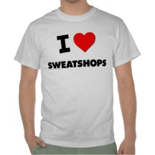
Evidence 3: Are you a global shopper?
Secondary geography
Who doesn’t love to shop? And who can resist a bargain when they see one?!
Just think about it – how many things do you own or wear that have been made in another country? Almost everything is made abroad these days. Your pens, your school bag, your shoes, even the music you listen to has influences from other cultures…
If we didn’t have factories in other countries, people wouldn’t have nearly as much choice in their shopping. Many people probably couldn’t afford to pay the higher prices for clothes if they were made in more developed countries, like the UK.
There probably isn’t even enough space in the UK for all the factories that we would need to make all the stuff that we buy…. it just wouldn’t be possible without these sweatshops!

Slide 15
Having collected our second lot of evidence…
Secondary geography
What is your opinion of sweatshops?
1
2
3
4
5
6
BAD
NOT SURE/
IN BETWEEN
GOOD
Write down a score between 1 and 6.
How has your opinion changed? Why?

Slide 16
Let’s summarise what we have learnt:
Secondary geography
On your sheet, write a short summary about the good and bad about sweatshops, and then explain your opinion:
I think sweatshops are bad because…
I think sweatshops are good because…
Overall, my opinion is that they are good/bad because…
Success criteria:
Easy: use one or two simple describing words and state your opinion
Intermediate: use two or three more complex describing words and explain your opinion
Hard: use several describing words, and fully explain your opinion, linking your sentences together using “because”

Slide 17
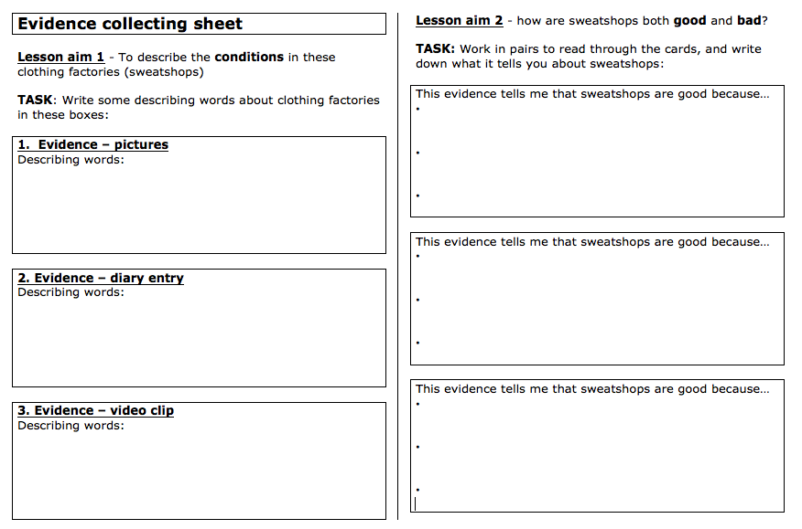
Secondary geography

Slide 18
Fashion’s Dirty Secrets
Secondary geography
Assessed activity – persuasive writing
Having watched the documentary and listened out for any facts or phrases that you think are particularly persuasive you now need to……
Task: Write a persuasive letter to your local MP telling them what you think about the fashion industry and what should be done to reduce the detrimental impacts of it.
Consider:
The scale of the fashion industry and some of the countries that are affected by it
The social, economic and environmental impacts of factories and farms used to produce clothes
You outline some of the stakeholders who are impacted by the fashion industry (+/-)
The +/- impacts of sweat shops – how could they be improved?
How we can change our shopping habits – sustainable fashion
Why it is important to protect our planet and people
Remember: use persuasive words and facts that will add weigh to your argument.

Slide 19
Fashion’s Dirty Secrets- Self assessment
Task: Write a persuasive letter to your local MP telling them what you think about the fashion industry and what should be done to reduce the detrimental impacts of it.
Grade | Meaning
1 | Your letter is well written and well balanced. You outline the scale of the fashion industry and include data and evidence to back up your points. You provide detailed explanation of the social, economic and environmental impacts of the fashion industry as well as explaining the role of several stakeholders who are both positively and negatively impacted by fashion. Again these ideas are backed up with evidence. You outline arguments for and against sweatshops, while offering appropriate suggestions about how to make fashion more sustainable. All ideas are backed up with evidence, facts and figures as well as reference being made to places. You explain why its important to protect the planet and its people
2 | Your letter is quite well written and balanced. You attempt to outline the scale of the fashion industry but lack data and evidence to back up your points. You provide some explanation of the social, economic and environmental impacts of the fashion industry but lack depth while explaining the role of one or two stakeholders who are both positively and negatively impacted by fashion. Ideas are backed up with some evidence. You outline some arguments for or against sweatshops, while offering some suggestions about how to make fashion more sustainable. Some ideas are backed up with evidence, facts and figures but little reference made to places. You try to explain why its important to protect the planet and its people
3 | Your letter is brief and superficial. You make little attempt to outline the scale of the fashion industry and lack data and evidence to back up your points. You provide little explanation of the social, economic and environmental impacts of the fashion industry while failing to explain the role of stakeholders who are both positively and negatively impacted by fashion. You outline few arguments for or against sweatshops and fail to offer suggestions about how to make fashion more sustainable. Ideas are not backed up with evidence, facts and figures and there is little reference made to places. You fail to explain why its important to protect the planet and its people

Slide 20
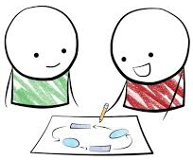
Fashion’s Dirty Secrets – persuasive writing
Secondary geography
Dear MP,
The fashion industry is a global business……
I believe that the fashion industry is a problem because…...
People who are impacted by the fashion industry include.....
The impacts of sweatshops that produce fast fashion inlcude.....
We should protect our ecosystems and people that live close to them because…...
We can stop the factories from being so damaging by …..
We can also change our shopping habits by …..
Finally, I believe that the problem of the fashion industry needs to be addressed because....
Yours faithfully,
WWW
EBI

