Slide 1
Fashion’s Dirty Secrets
Lesson 3

Slide 2
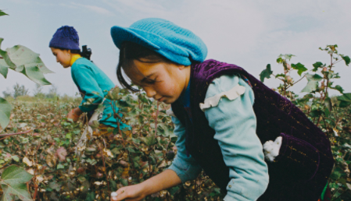
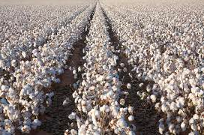
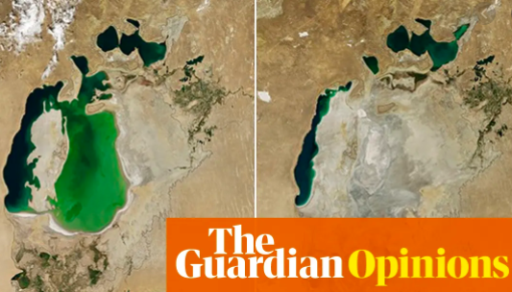
Fashion’s Dirty Secrets
Secondary geography
Fast Fashion Stakeholders
Read the article: Stacey Dooley investigates and this article https://www.theguardian.com/sustainable-business/sustainable-fashion-blog/2014/oct/01/cotton-production-linked-to-images-of-the-dried-up-aral-sea-basin#maincontent
Using the information above and your video notes for each of the groups below write a paragraph outlining their possible view of the fashion industry – are they in favour of it or against it? Why? Can you give reasons?
Western clothing brands (e.g. Primark, H&M, ASOS…)
Local people in Kazakstan
Environmentalists
Fishermen in Uzbekistan
Governments of Kazakstan and Uzbekistan
Fashion consumers

Slide 3
Fast Fashion Stakeholders
Print out and stick into your book
Read the article: Stacey Dooley investigates and this article https://www.theguardian.com/sustainable-business/sustainable-fashion-blog/2014/oct/01/cotton-production-linked-to-images-of-the-dried-up-aral-sea-basin#maincontent
Stakeholder | View of fashion industry with explanation
Western Clothing Brands
Fashion consumers
Fishermen
Locals
Environmentalists
Government

Slide 4
Fast Fashion Stakeholders
Print out and stick into your book
Read the article: Stacey Dooley investigates and this article https://www.theguardian.com/sustainable-business/sustainable-fashion-blog/2014/oct/01/cotton-production-linked-to-images-of-the-dried-up-aral-sea-basin#maincontent
Stakeholder | View of fashion industry with explanation
Western Clothing Brands | Globalization and the division of labour has allowed western clothing brands to produce clothes at a very low cost which allows them to sell them cheap and in high volumes making billions in profits
Fashion consumers | The globalization of the fashion industry allows clothing brands to produce vast quantities of clothes at very low cost – this means fashion consumers can by a wide range of clothes relatively cheaply – so benefit from the current set up
Fishermen | Local fisherman in the Aral sea have seen fish stocks depleted over the course of the last 20—30 years as water is extracted for the cotton industry and pollutants are discharged into the lake reducing water quality -
Locals | Local people benefit from jobs available in the textile industry that involve widespread cotton farming. These jobs bring higher incomes, although the working conditions at times can be challenging. Public services such as schools and hospitals can benefit from investment
Environmentalists | Extensive water abstraction and chemical pollution can impact the flora and fauna of the areas around the Aral sea reducing the overall biodiversity. Contamination of soil and water supplies can also impact the health of local people
Government | Direct investment by western clothing brands can bring foreign exchange into the economy and taxes paid by the companies can provide an income for the governments to spend on public services (although money can be lost to corruption) – Can lead to economic growth and jobs.

Slide 5
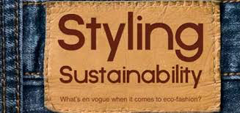
Fashion’s Dirty Secrets
Secondary geography
Prep activity – eco-friendly fashion campaign
Your task is to come up with a new type of clothing or garment that does not harm the environment! You need to think about its material, how much it will cost, and where it will be made…..

Slide 6
Campaign for eco-fashion
Secondary geography
Item of clothing:
Brand name and logo:
Product cost:
Product design (draw a picture):
How our product will help (include type of material and where it will be made):
Feedback
Product positives:
Things to improve:

