Slide 1
GCSE Physics Revision and Exam Skills

Slide 2
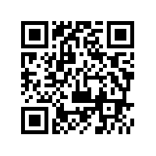
DON’T FORGET THE FEEDBACK!
bit.ly/GCSErevision6619

Slide 3
Mystery Physics Objects
What’s in YOUR prep room?

Slide 4
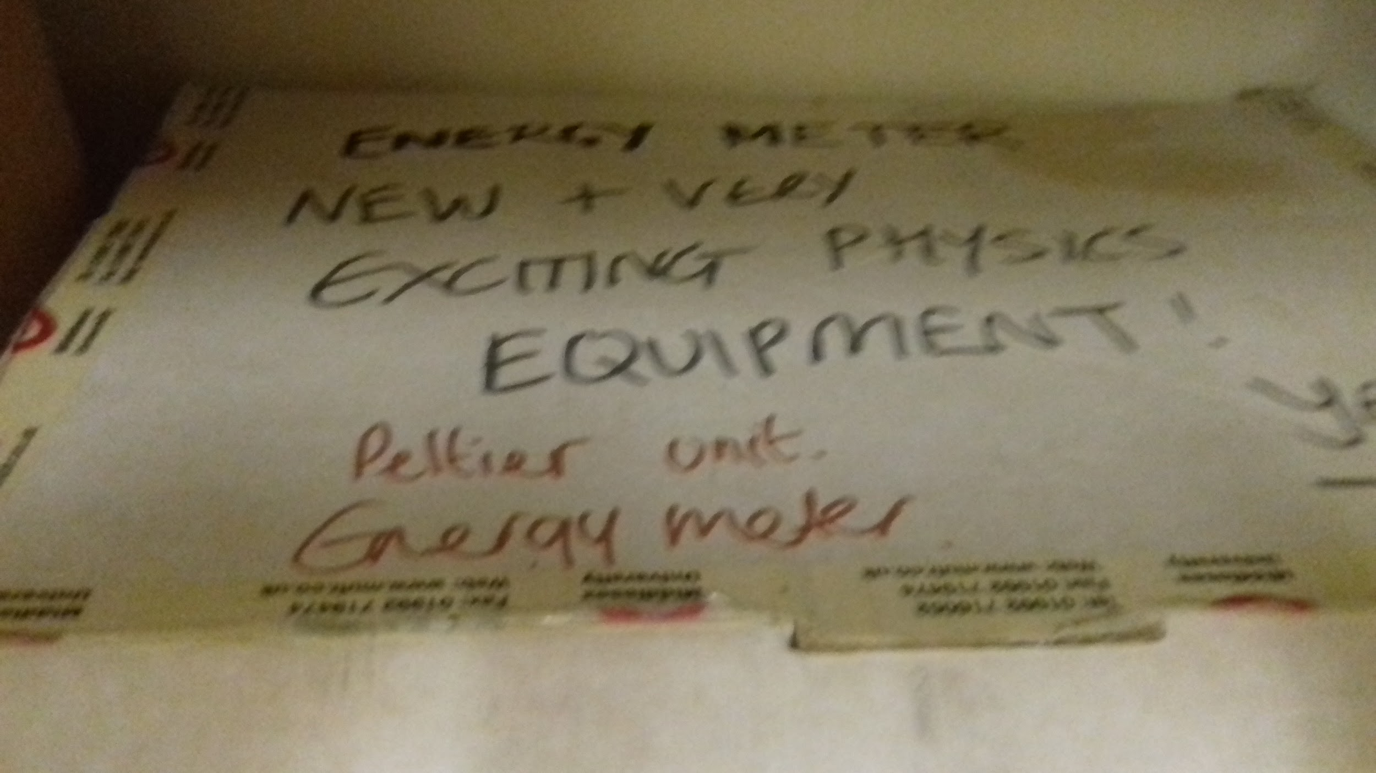

Slide 5
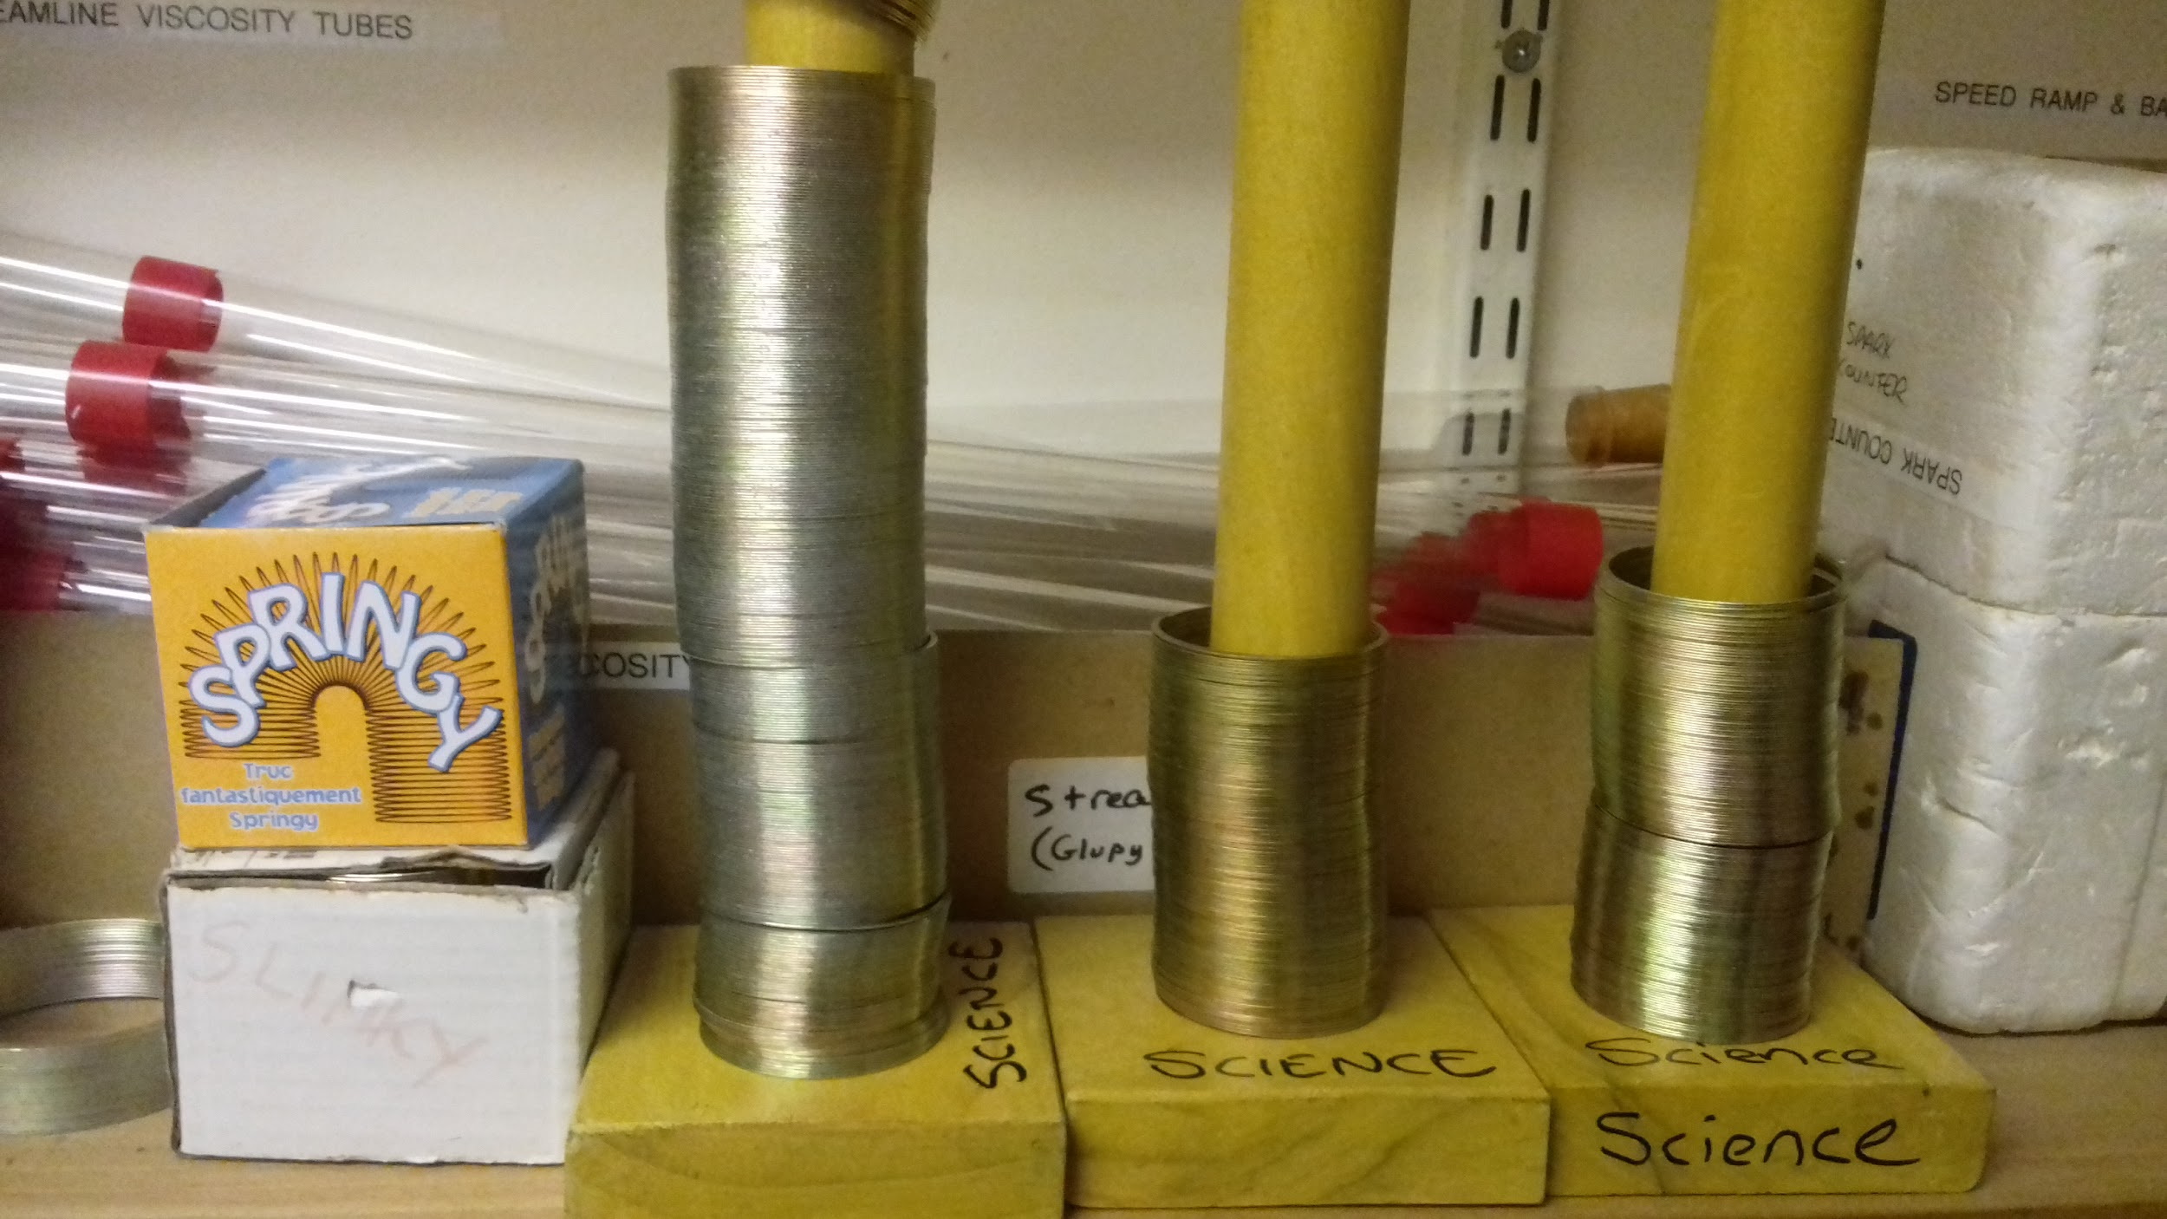

Slide 6
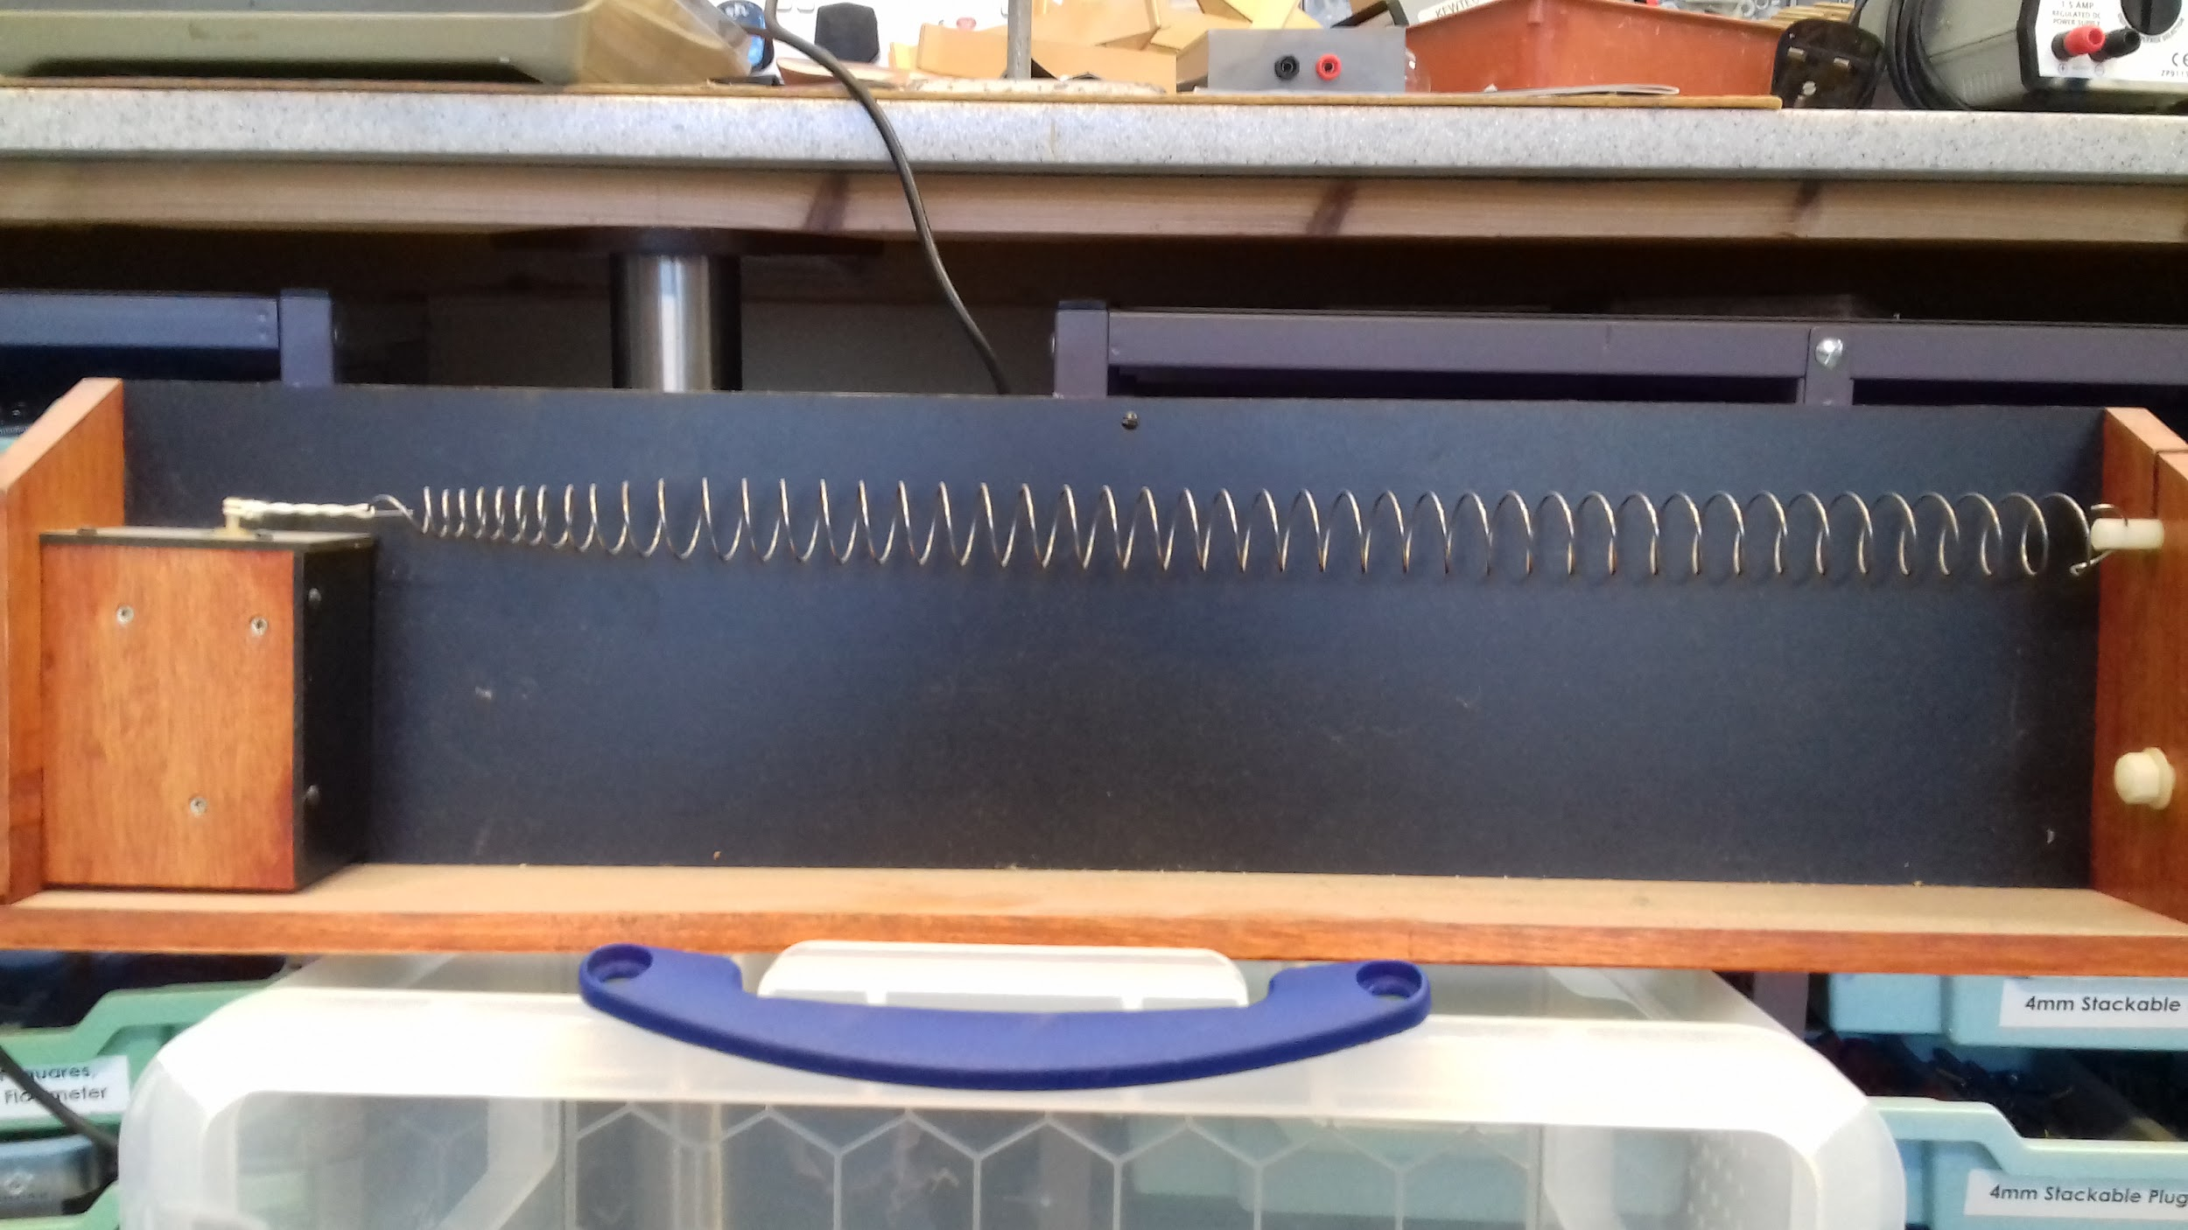

Slide 7
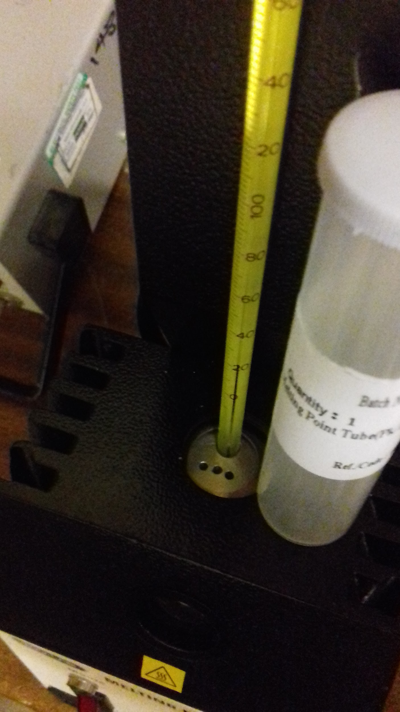

Slide 8
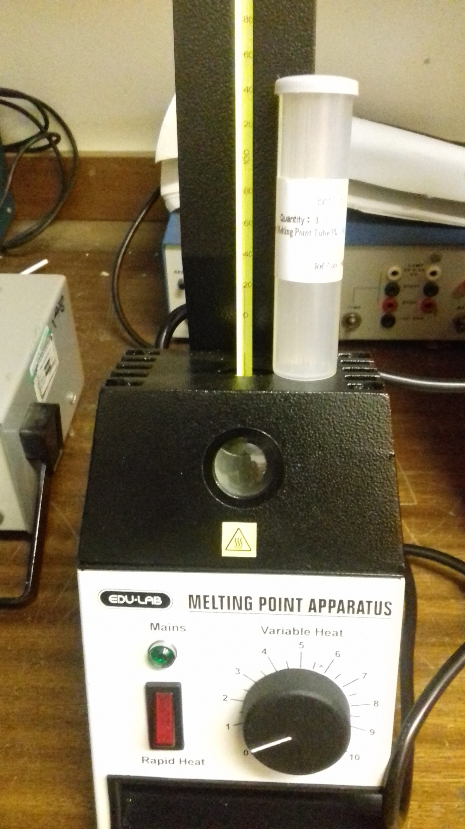

Slide 9
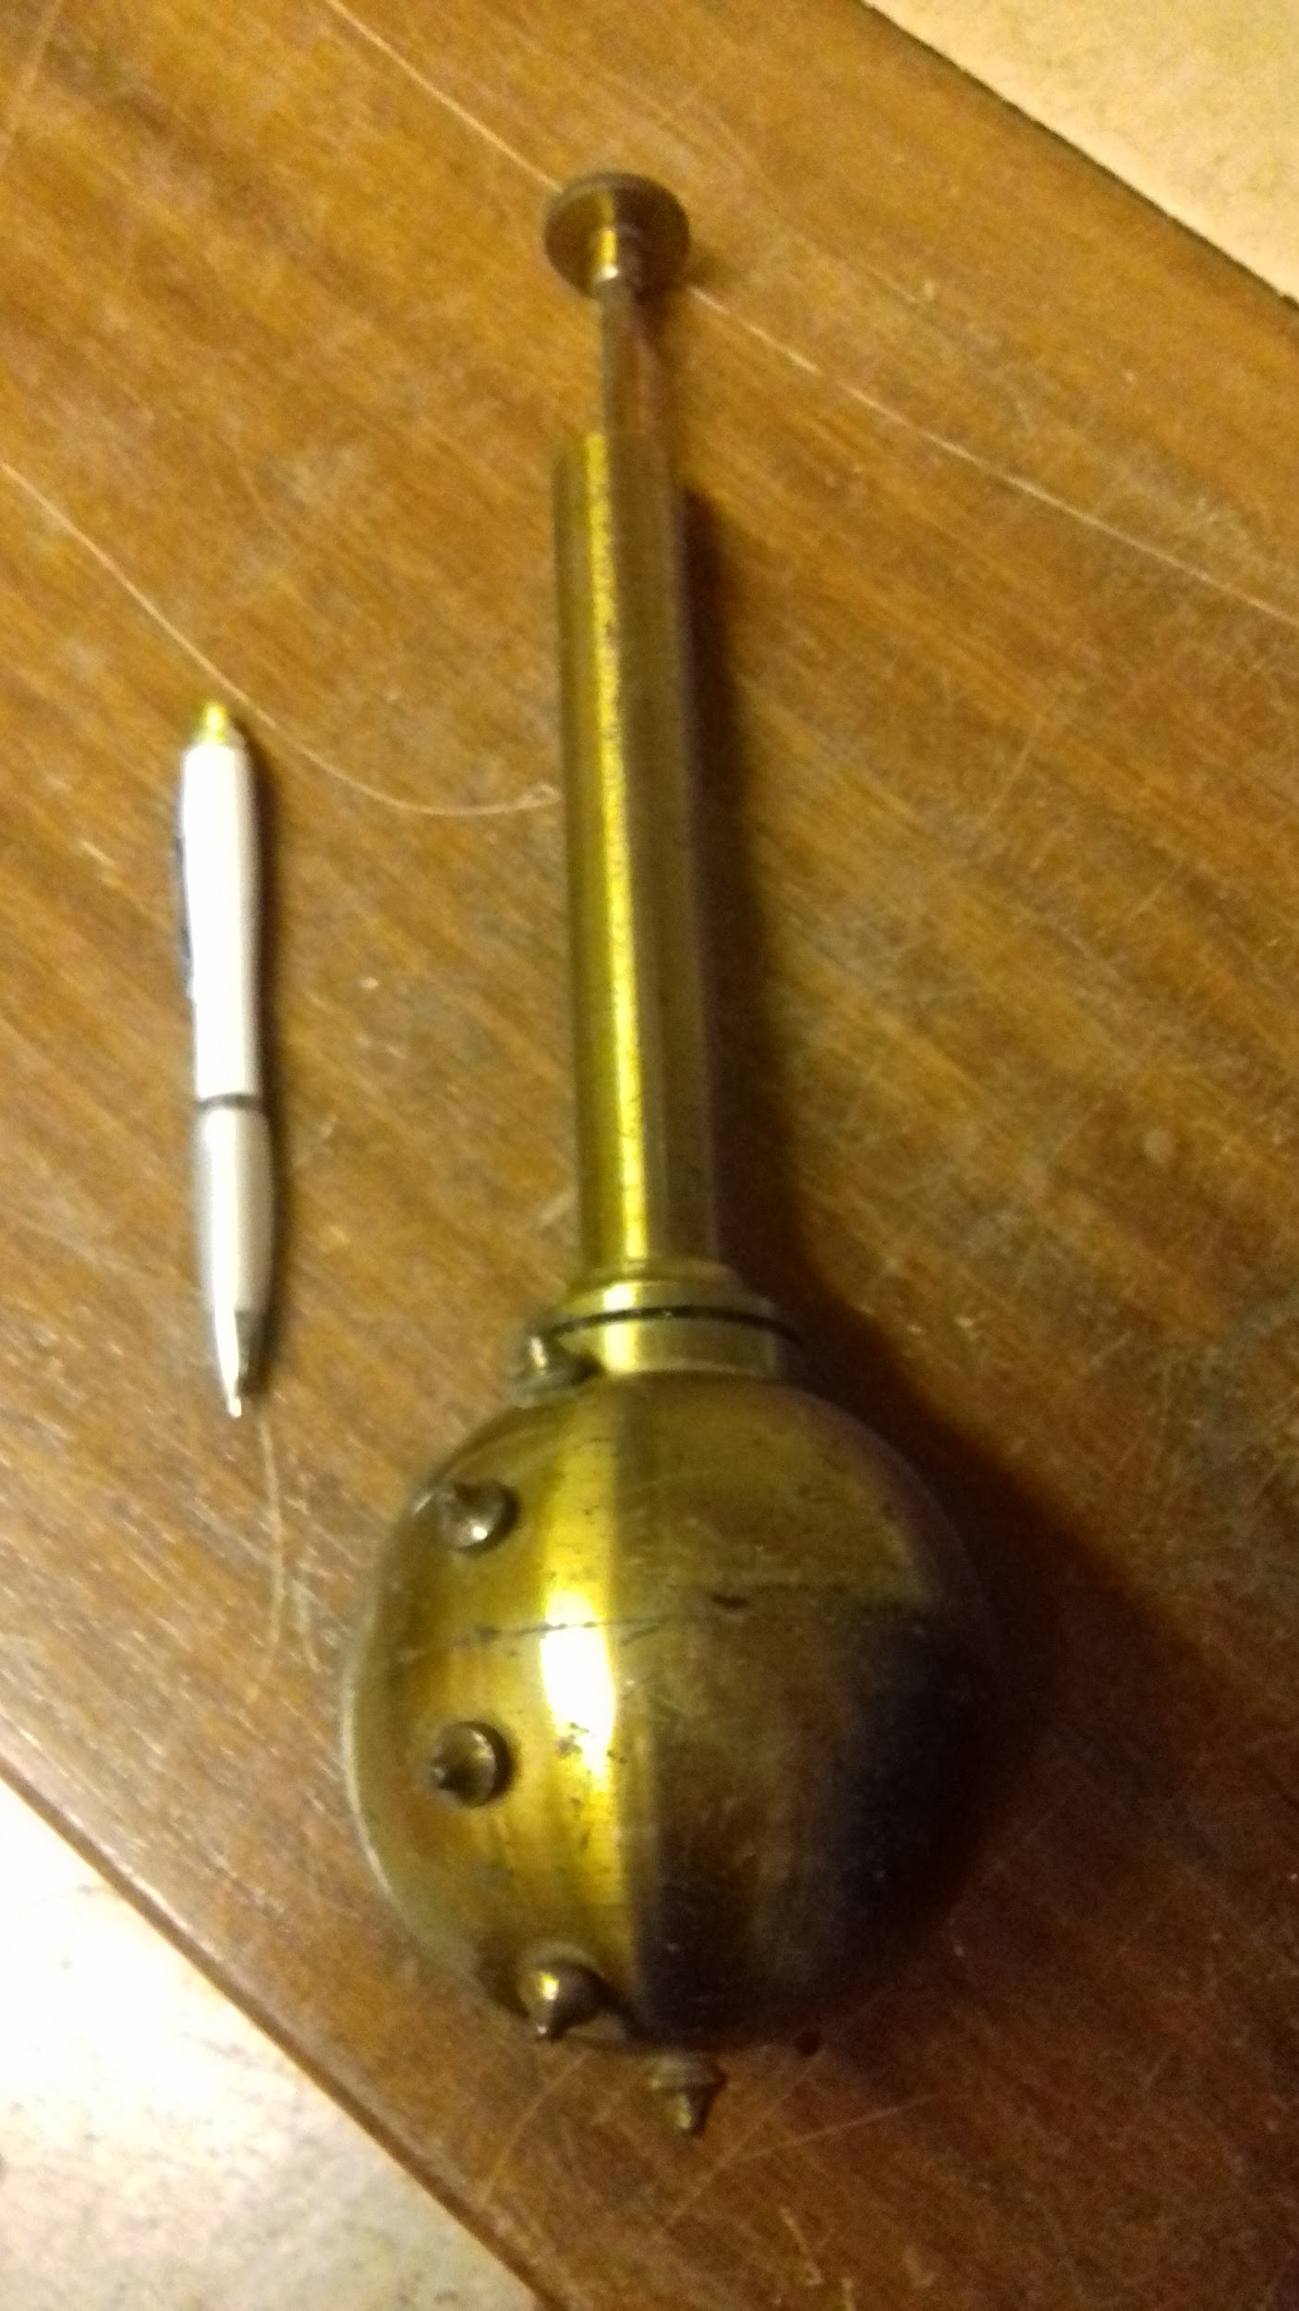

Slide 10
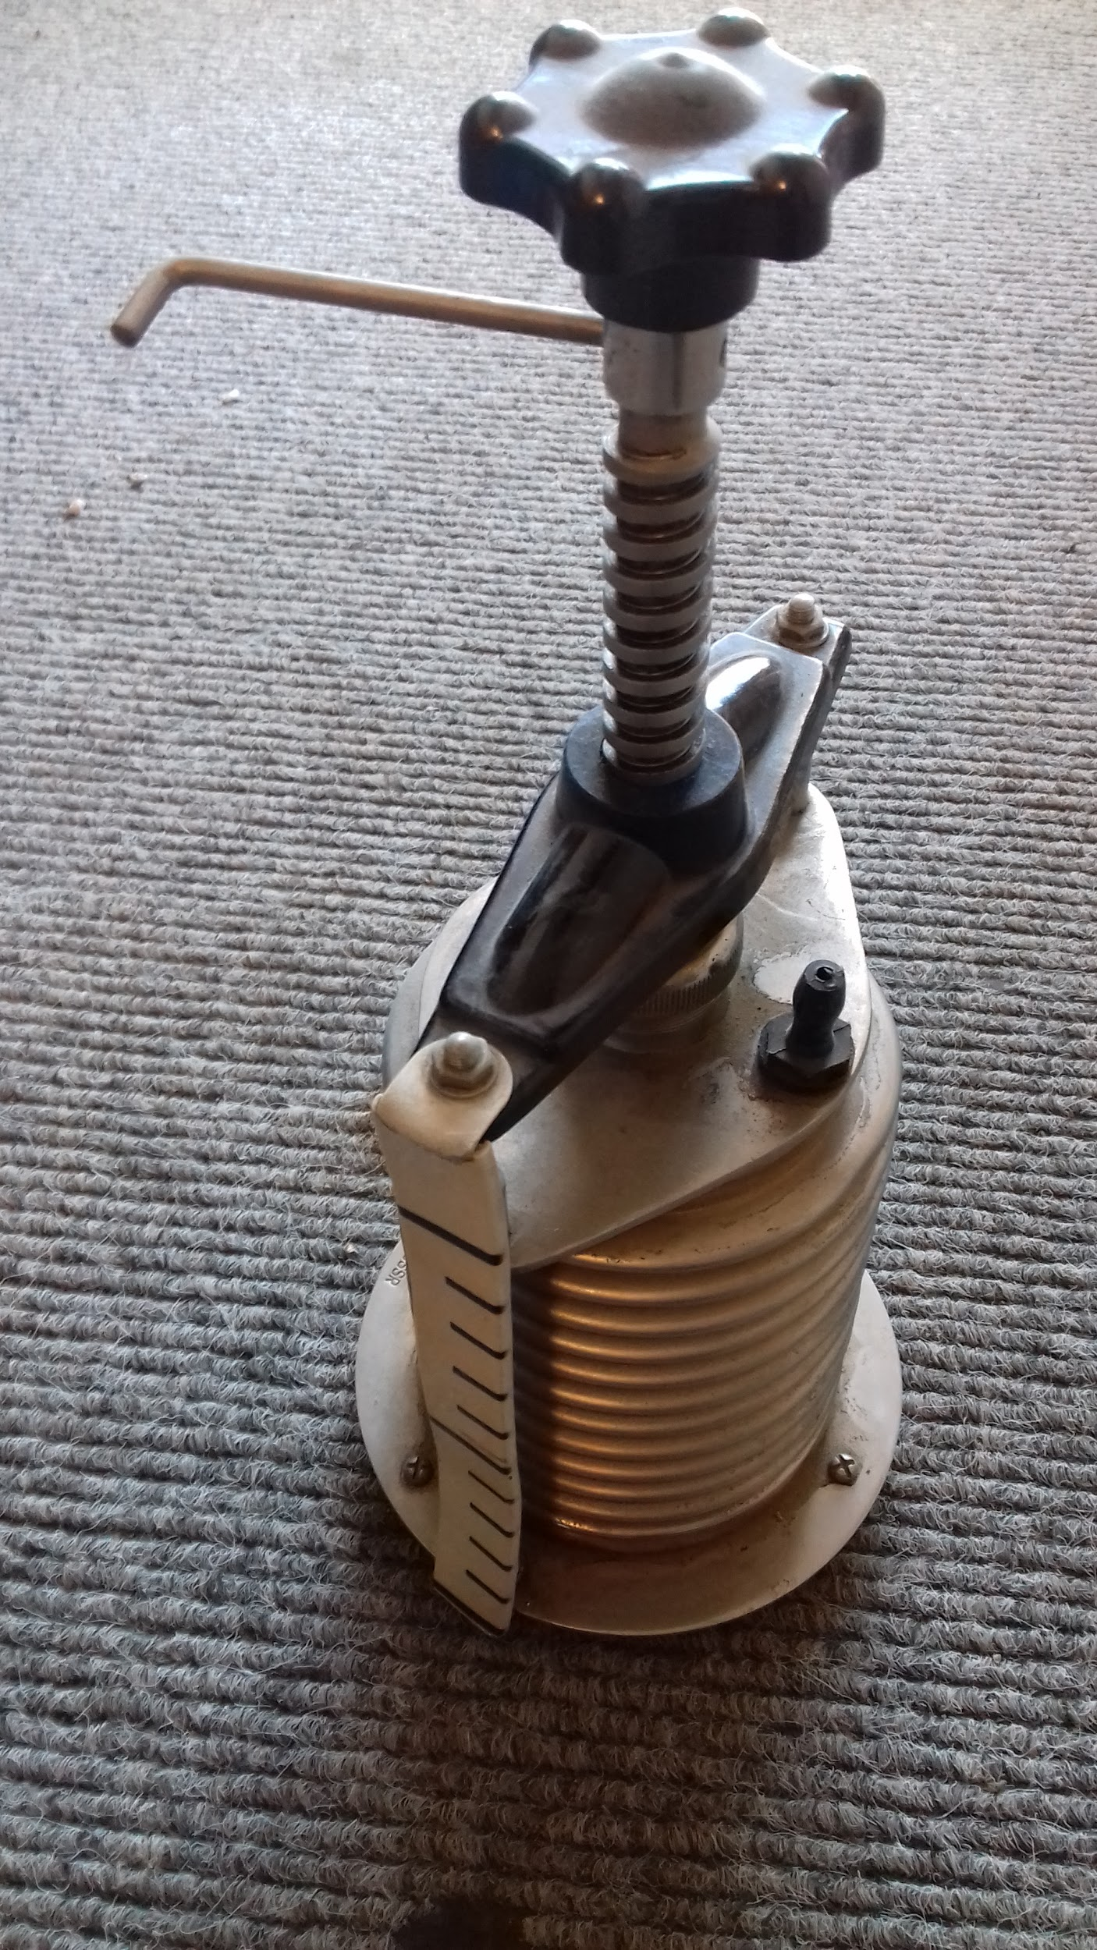

Slide 11
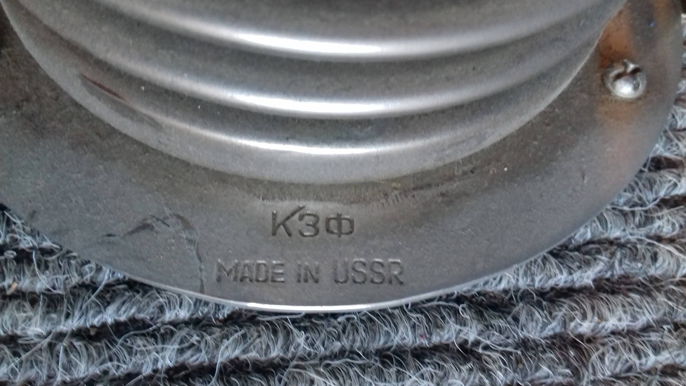

Slide 12
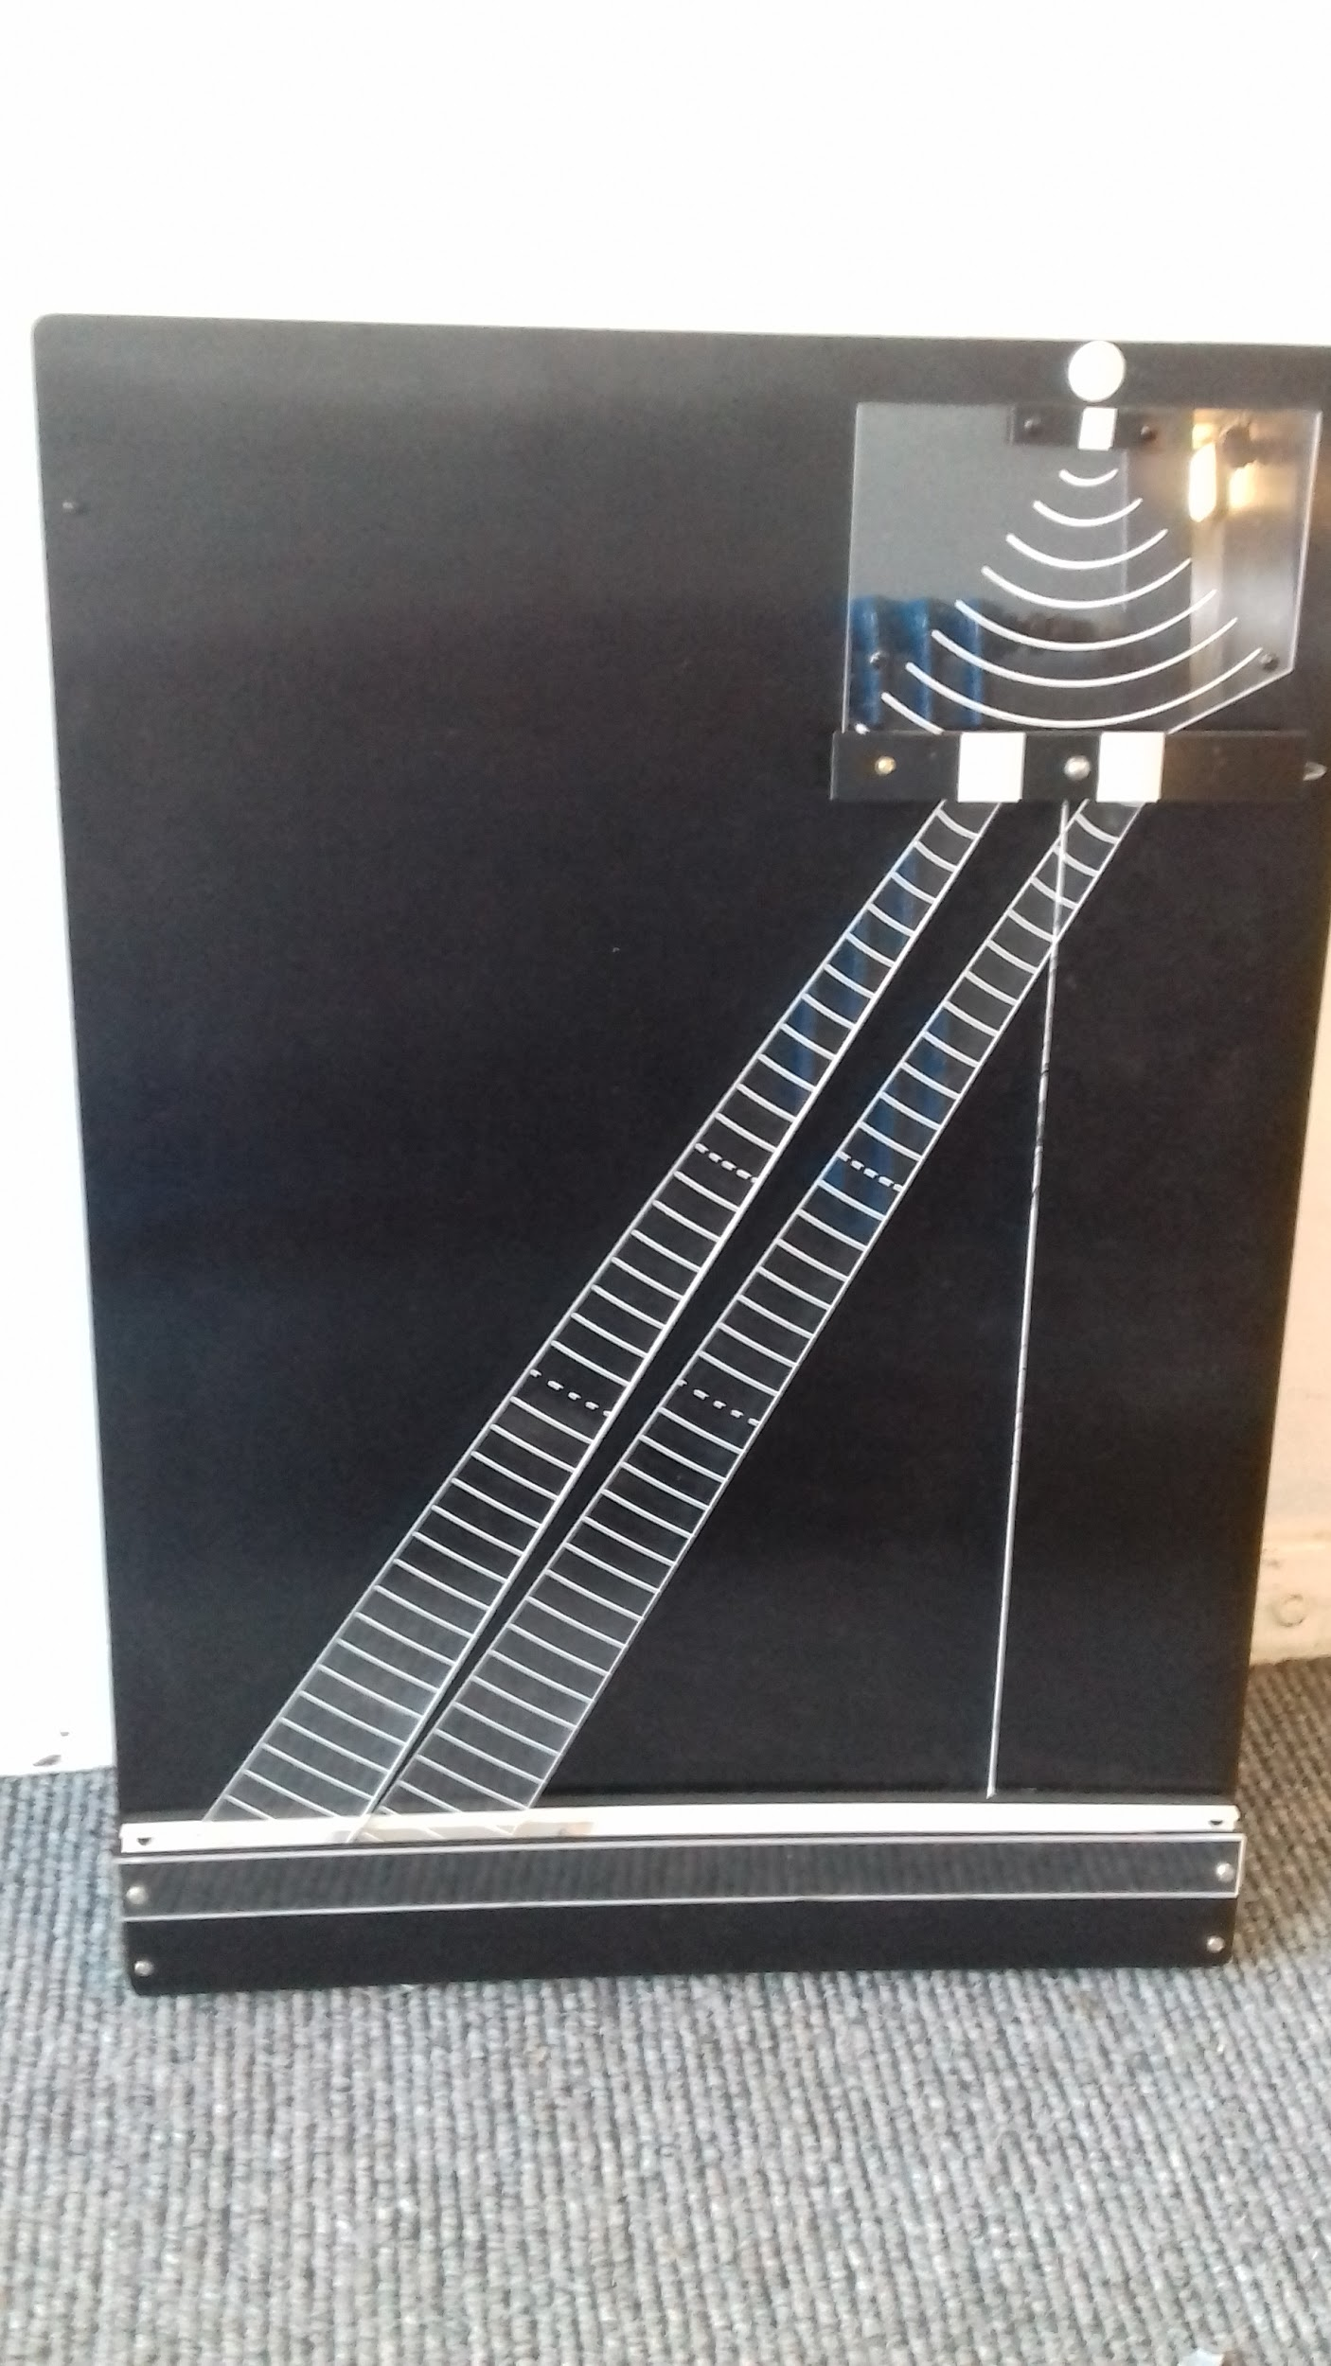
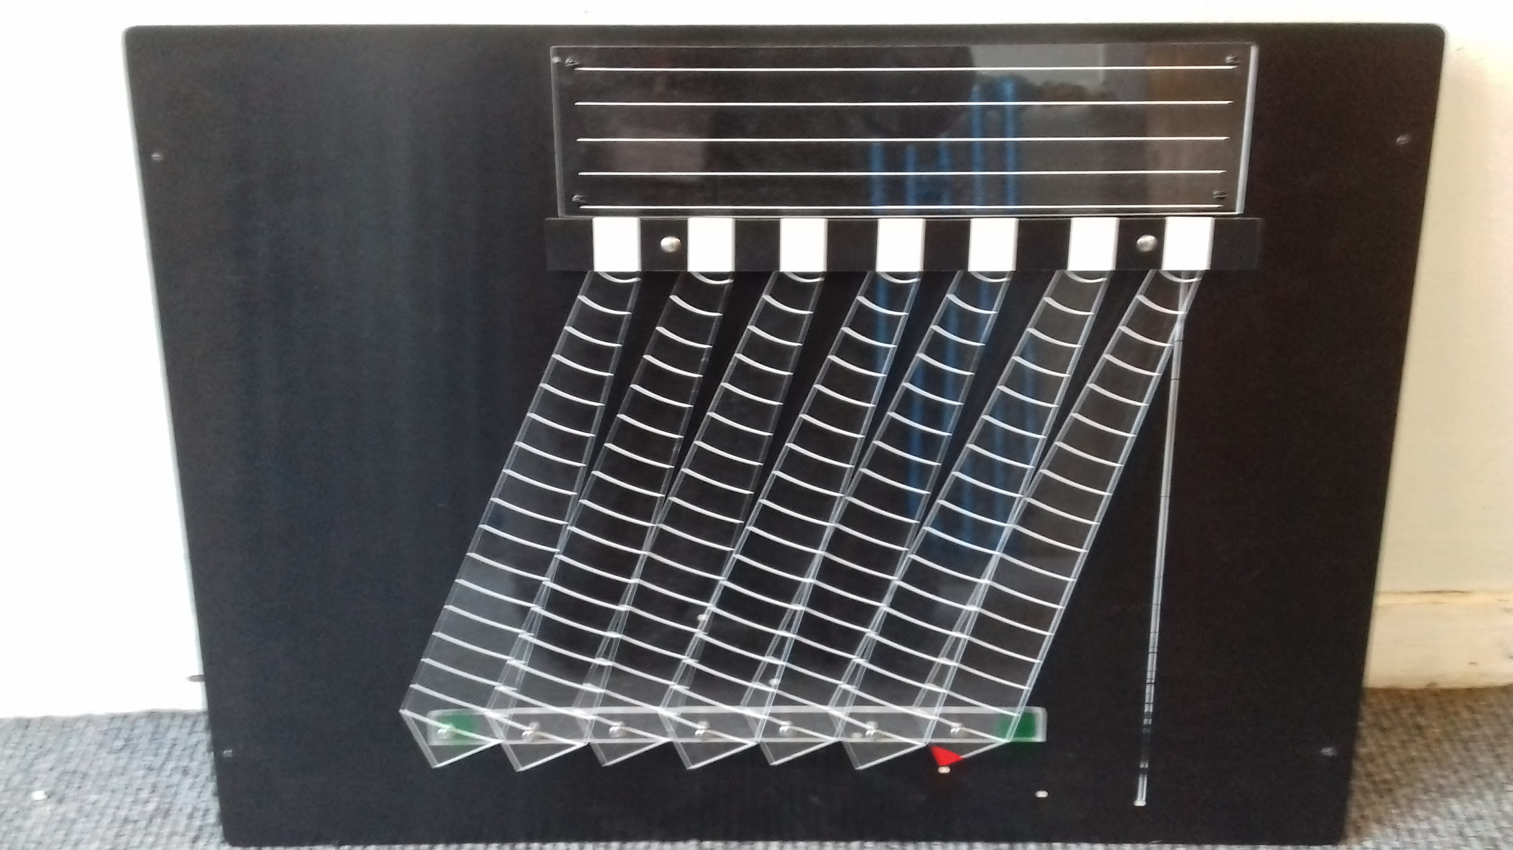

Slide 13
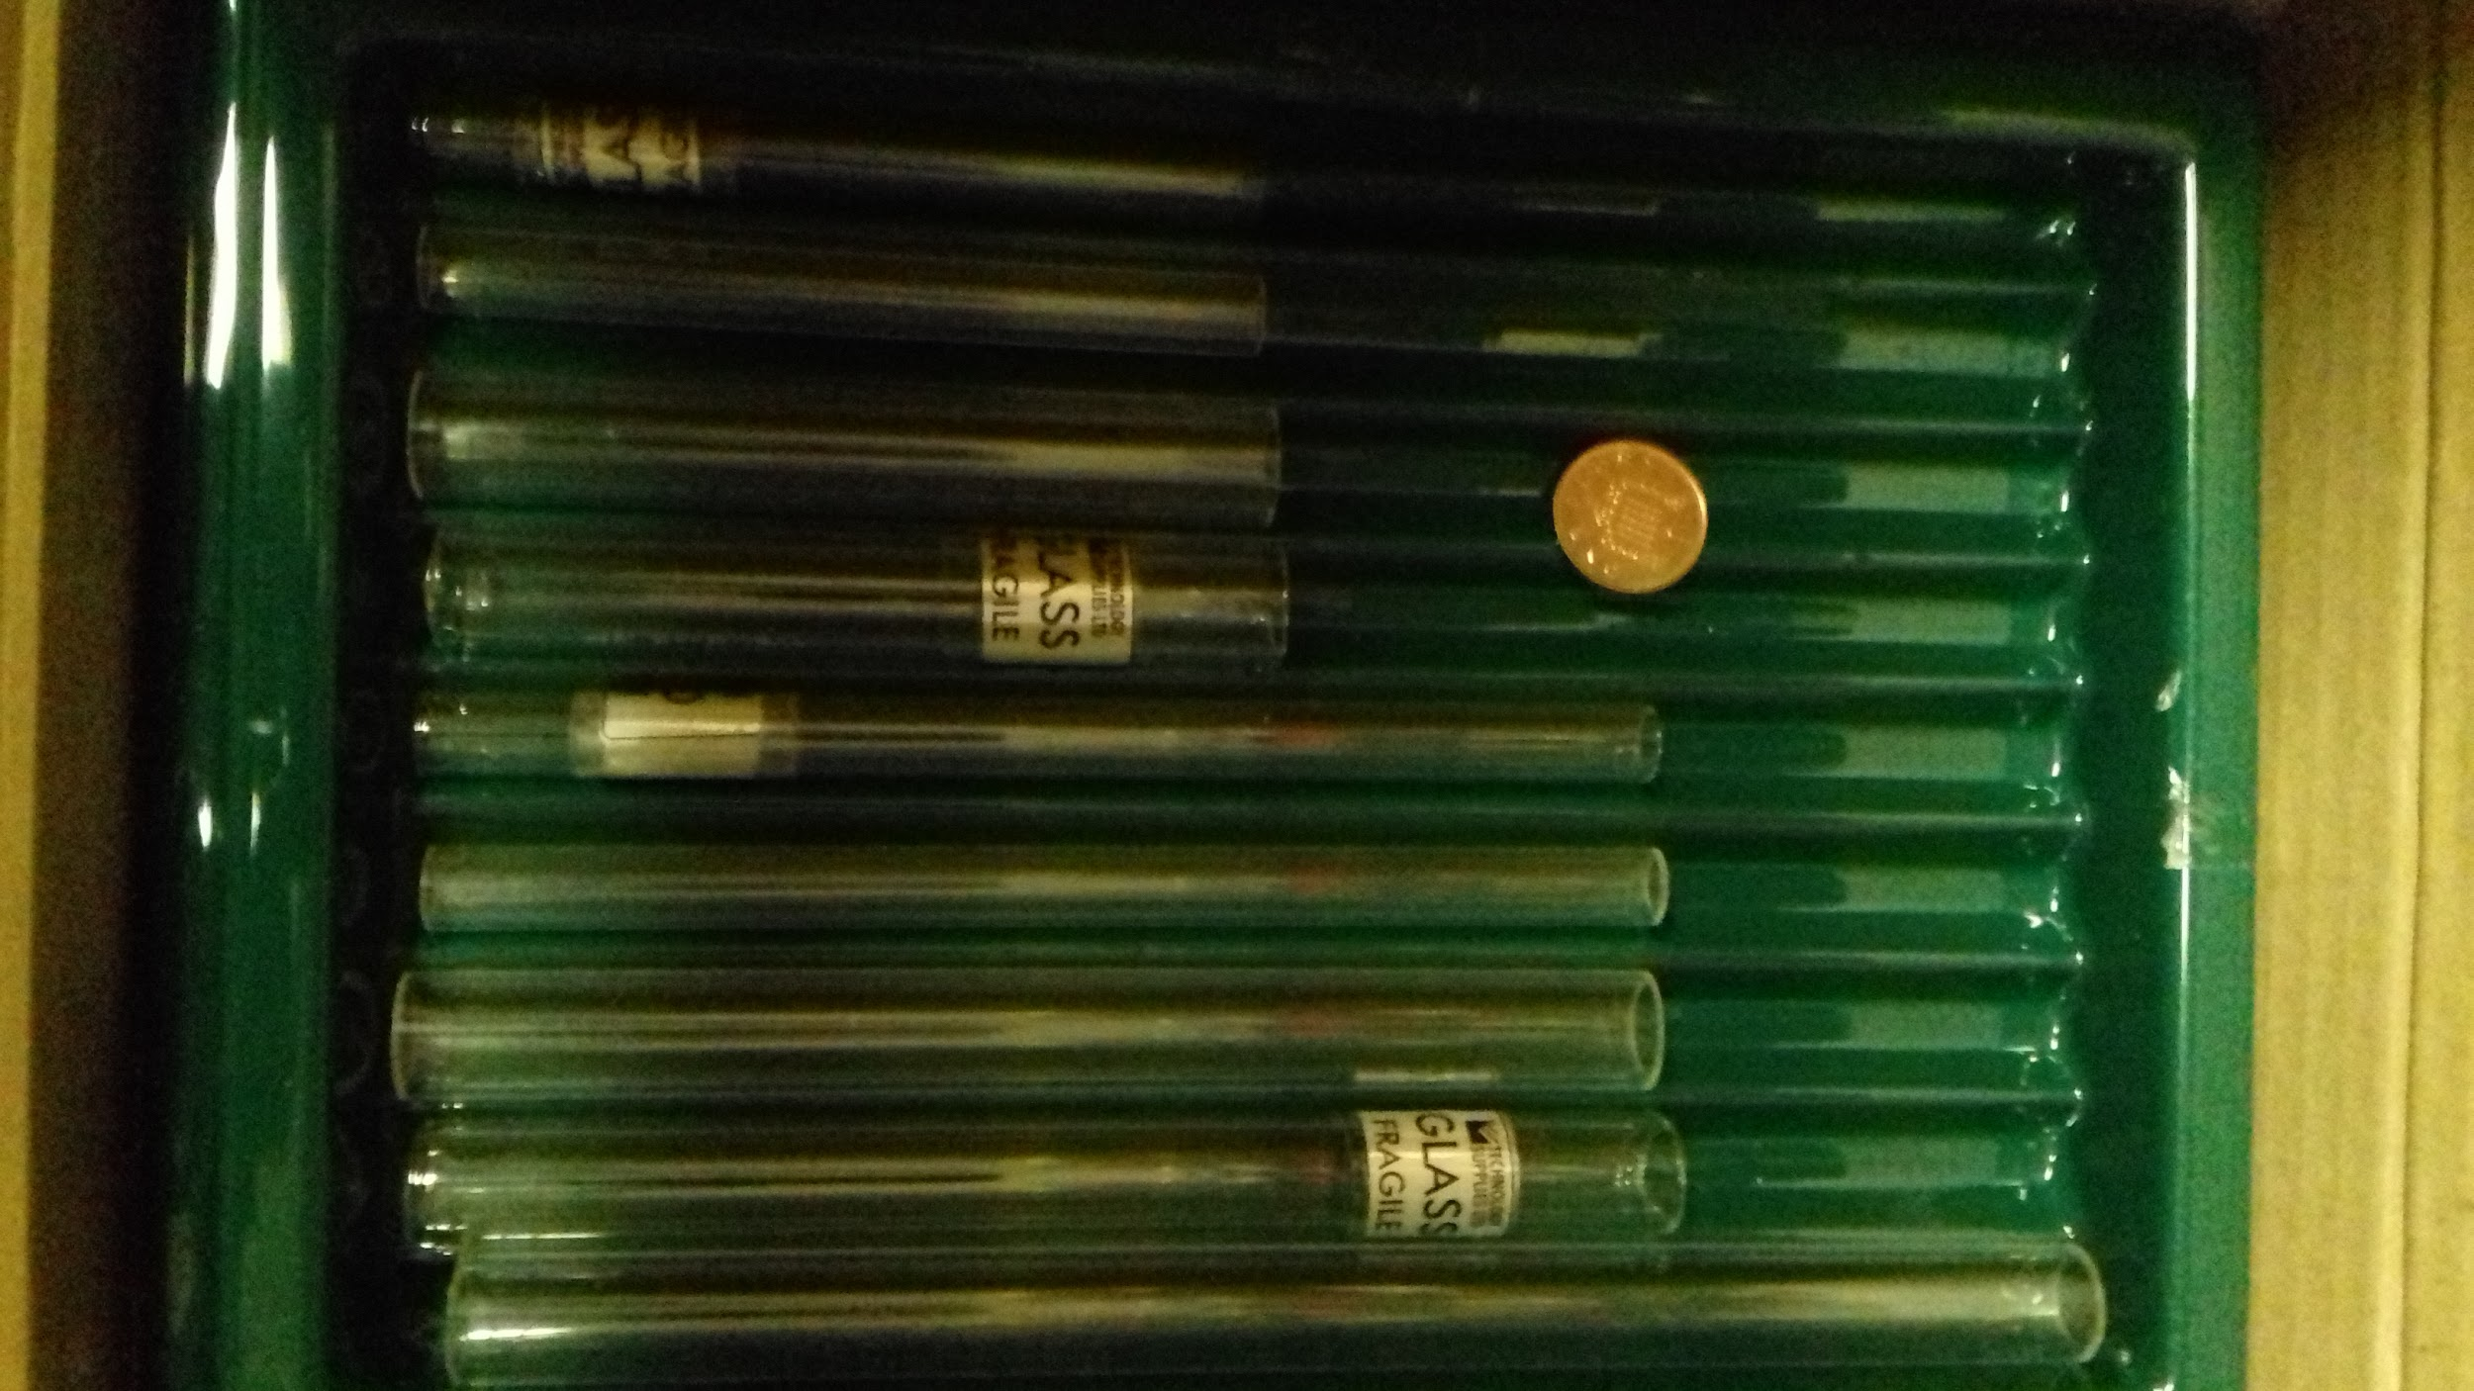

Slide 14
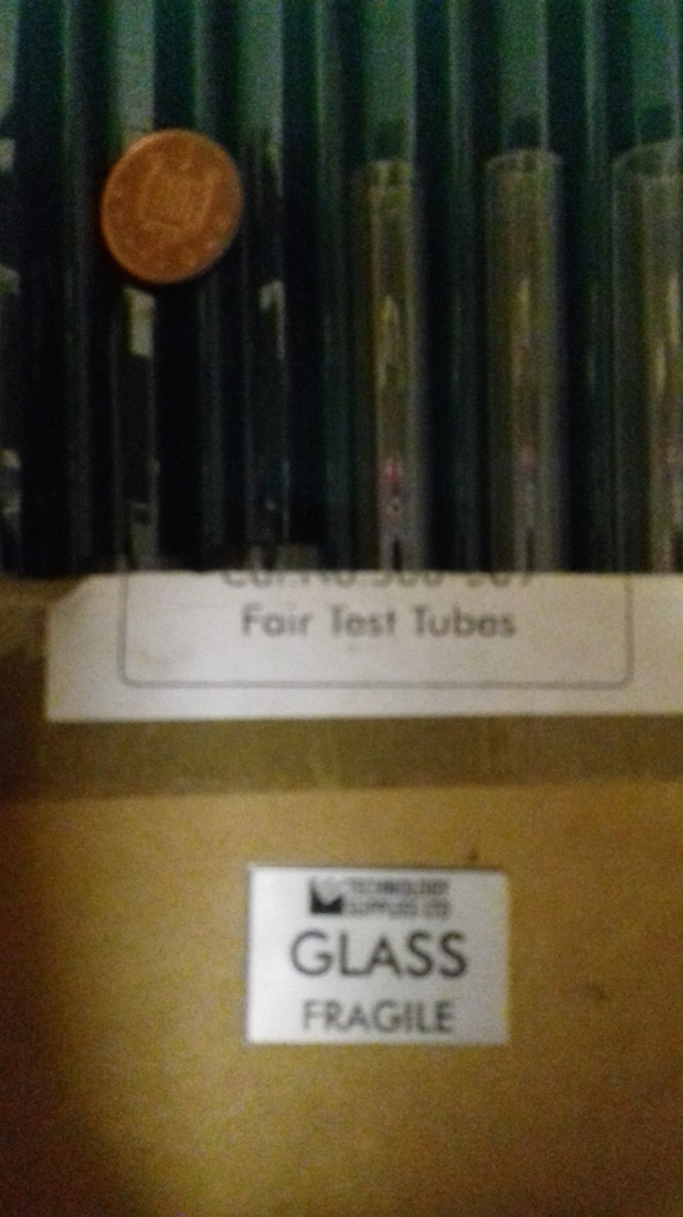

Slide 15
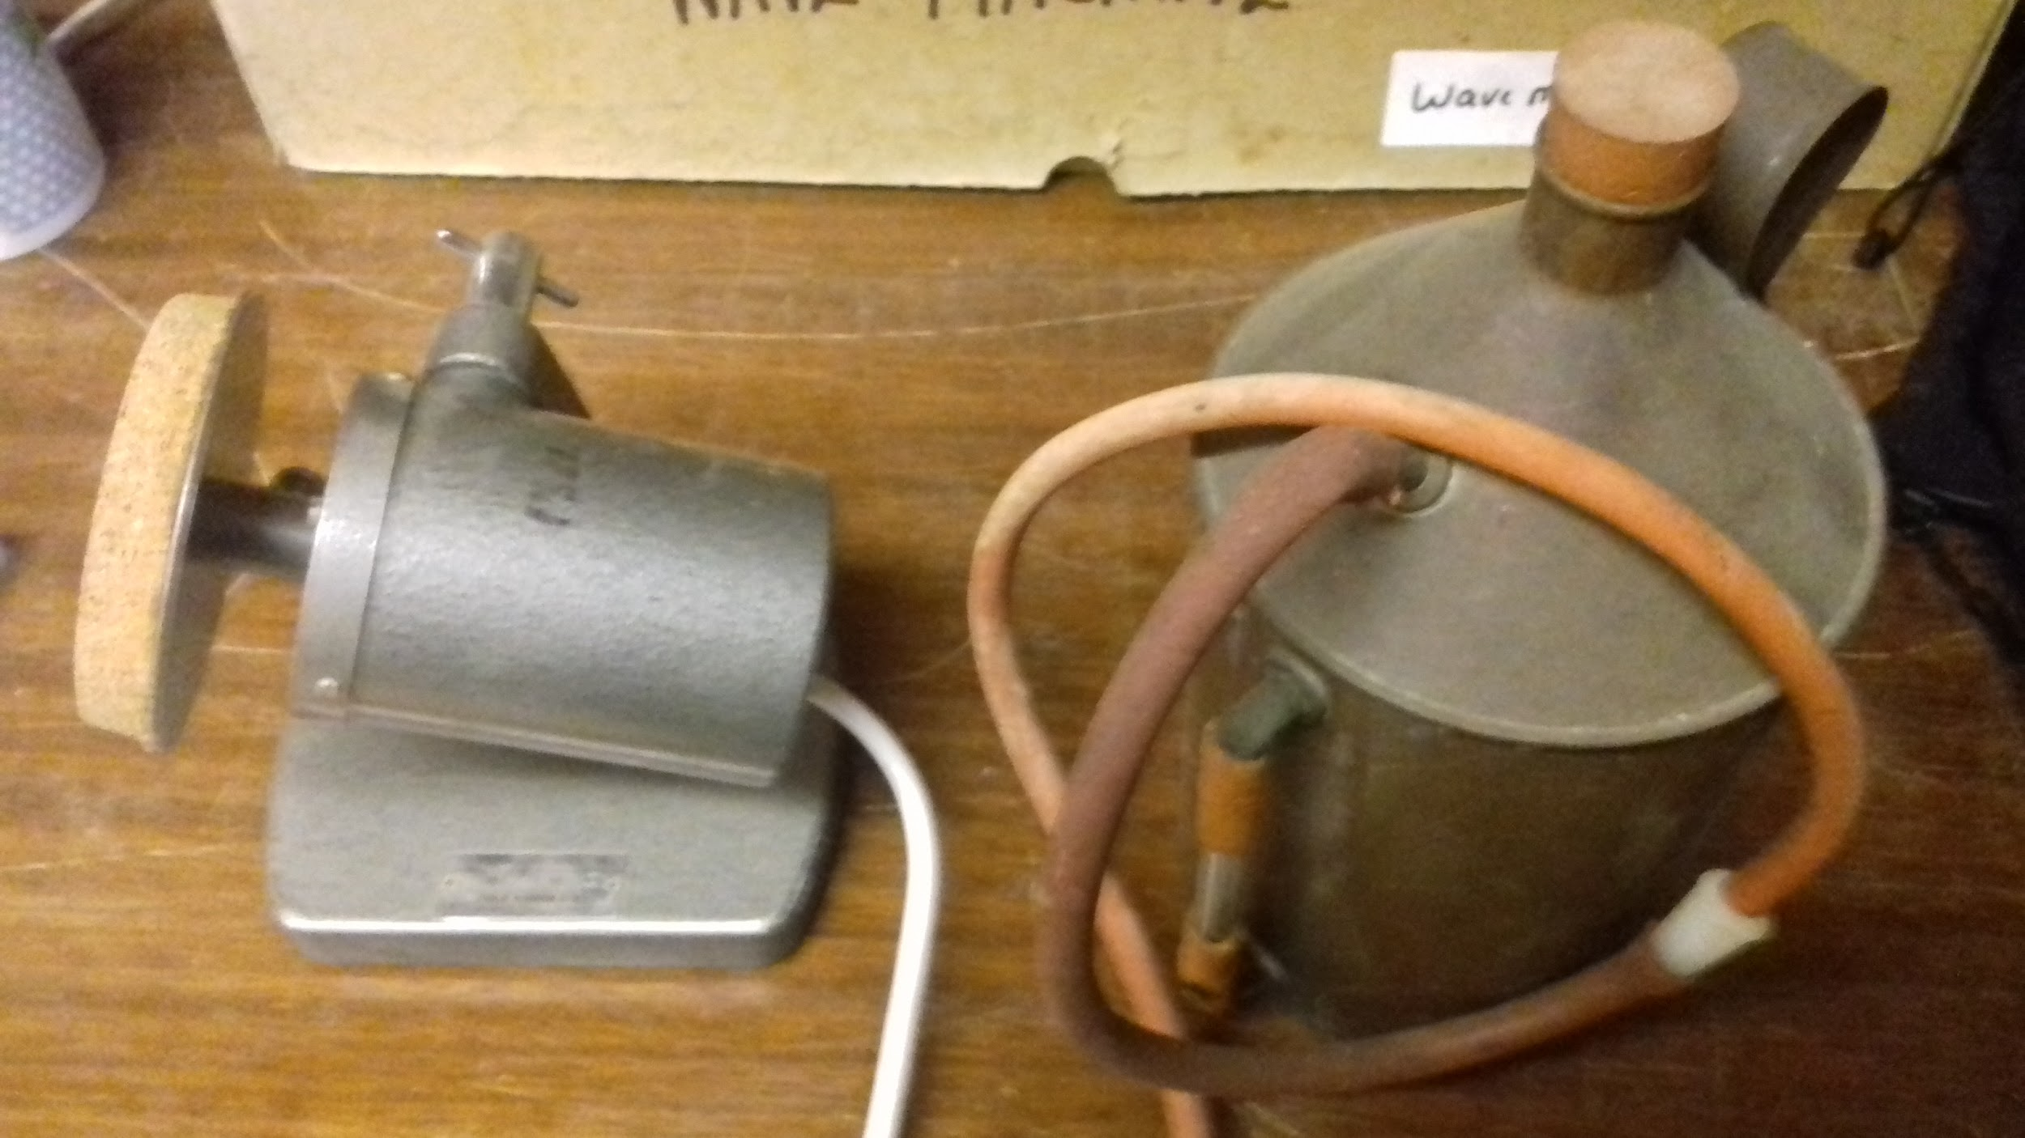

Slide 16
GCSE Physics Revision and Exam Skills
Thursday 28 March 2019, Abingdon Science Partnership:
3:30 Register and refreshments; mystery objects quiz
3:40 Intro by Jeremy Thomas ’How do pupils revise and why do they make silly mistakes - personal experience and academic ideas’
3:50 Analysing exemplars and ‘too much information’ exercises - Jeremy Thomas
4:30 Resources for recall - Sarah Beynon
5:00 Revision resources swap shop - bring your own ideas or recommended resources to share e.g. online resources (BBC Bytesize; commercial /subscription sites; CGP guides and flashcards; exam board publications; personal resources etc)
5:15 Plenary - what will you try?
5:30 End

Slide 17
What pupils do and why they make mistakes
https://theconversation.com/why-students-make-silly-mistakes-in-class-and-what-can-be-done-48826
(Linked from https://www.stem.org.uk/science-of-learning)
https://www.ted.com/talks/sarah_jayne_blakemore_the_mysterious_workings_of_the_adolescent_brain

Slide 18
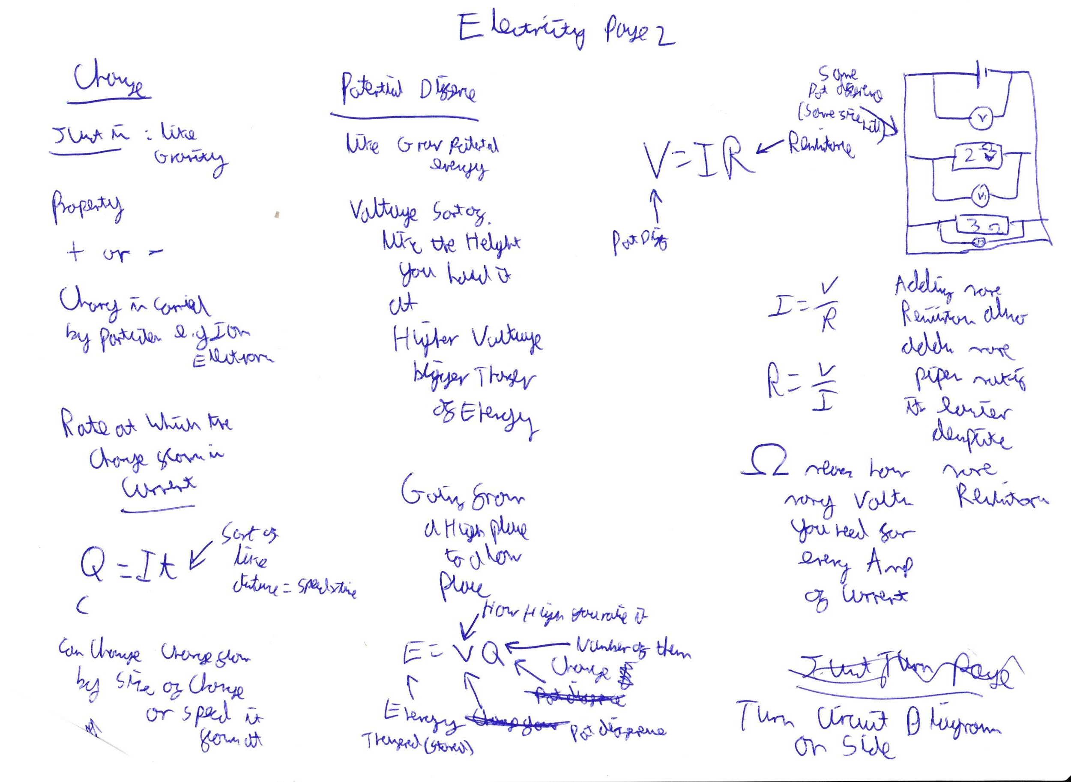

Slide 19
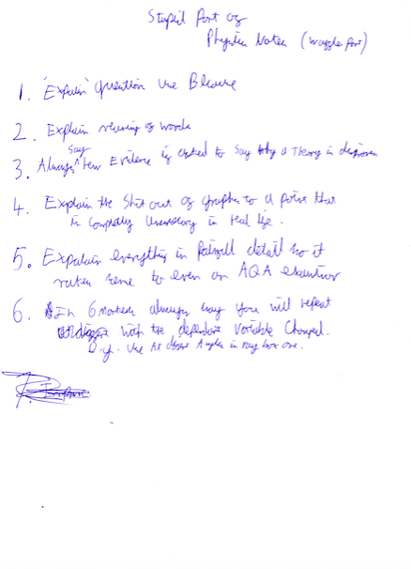

Slide 20
JPT Exemplars and TMI
See worksheets in folder
Kagan ideas:
https://www.youtube.com/watch?v=D-yzgJtgVrg

Slide 21
Resources for Recall
Mrs Sarah Beynon
Learning Support Teacher
Third Year (Year 9) Tutor, Morgan's House

Slide 22
Ideas Swap Shop
Post it equations/definitions/algebra
Topic notes by table circulation
Topic contribution to revision pack
CGP Flashcards
E-quizzes, Socrative, Kerboodle etc
Dissecting/redacting the spec

Slide 23
Suggestions from others:
Sarah:
https://www.my-gcsescience.com/multi-topic-questions-in-gcse-physics/
https://www.my-gcsescience.com/command-words-in-gcse-physics/
and the Free Science lessons channel on youtube https://www.youtube.com/channel/UCqbOeHaAUXw9Il7sBVG3_bw
Kate Richard, Oxford High School:
https://www.ezyeducation.co.uk/ezyscience.html
Ian Briggs, Head of Physics, Didcot Girls’ School:
Exampro subscription (Examwizard for Pearson)
There is also a CGP guide called, essential maths skils for GCSE science, which has a series of 10 minute tests. We haven't been promoting these this year, but having looked through them I think they look like an excellent way for students to do more practice of data analysis and maths practice.

Slide 24
6 Mark Questions
https://www.bbc.com/bitesize/guides/z92bqhv/revision/6

Slide 25
Using Bitesize for exam revision
Top:
https://www.bbc.com/bitesize/subjects/zpm6fg8
CHOOSE:
Exam board
Topic
See Sample Exam Questions on right

Slide 26
Command Words
https://filestore.aqa.org.uk/resources/science/AQA-SCIENCE-GCSE-COMMAND-WORDS.PDF

Slide 27
Exemplars Pearson
https://qualifications.pearson.com/content/dam/pdf/GCSE/Science/2016/Specification/SAMs_GCSE_L1-L2_in_Physics.pdf
https://qualifications.pearson.com/content/dam/pdf/GCSE/Science/2016/teaching-and-learning-materials/Pearson_Edexcel_GCSE_Sciences_Extended_Open_Response_Guidance.pdf

Slide 28
OCR Gateway Exemplars
https://www.ocr.org.uk/qualifications/gcse/gateway-science-suite-physics-a-j249-from-2016/assessment/
https://www.ocr.org.uk/Images/449557-candidate-style-answers-practical-activity-questions.pdf

Slide 29
Examiners’s Reports
https://www.my-gcsescience.com/physics-gcse-2018-summary-of-examiners-reports/

Slide 30
Online
http://www.physics.org/4landing.asp?contentid=437&pid=413&hsub=1
http://www.physics.org/article-study.asp?contentid=484
http://www.darvill.clara.net/myon.htm
Some games:
http://www.physics.org/article-study.asp?contentid=484

Slide 31
Maths techniques/graphs
https://www.stem.org.uk/triplescience/maths

Slide 32
Subscription resources review
https://www.teachitscience.co.uk/membership
https://www.my-gcsescience.com/
See emails from others: Kate, Ian...

Slide 33
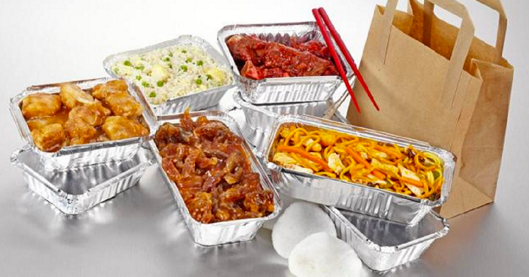
Take away ideas - what will you try?

Slide 34
DON’T FORGET THE FEEDBACK!
bit.ly/GCSErevision6619

