Slide 1
Resources for Recall
Sarah Beynon
Learning Support Teacher specializing in Sciences and Maths

Slide 2
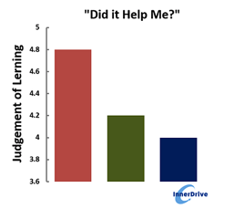
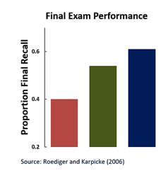
What students think works…. and what does.
Notes:
Summarise paper

Slide 3
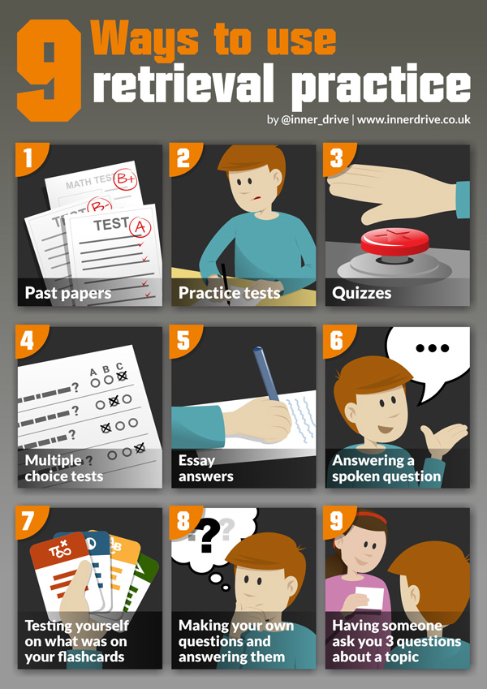
Notes:
Lots of sites telling you what to do and how to do it

Slide 4
Revision (or flash) cards
Useful for basic facts, equations, dates
Don’t put too much on them
Facts on one side, questions on the other
Test
Shuffle
Retest
Useful last minute strategy
Notes:
Egs for equations… make your own

Slide 5
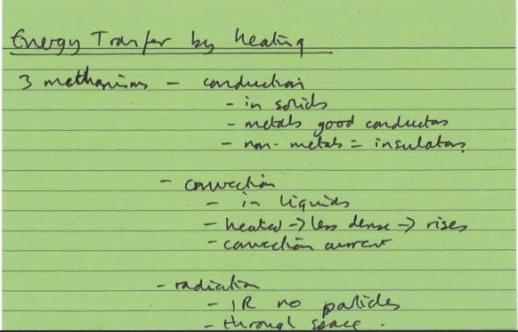
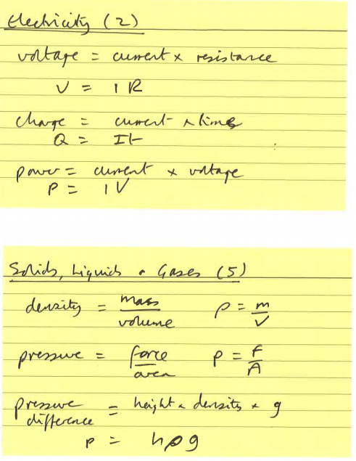
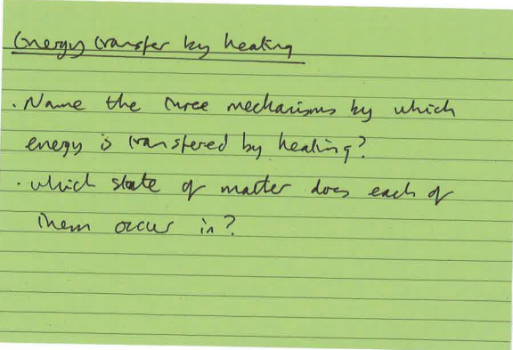
Examples
Notes:
What works and what doesn’t

Slide 6
Cornell Notes
4 text book pages to one side of A4
How to do them https://www.youtube.com/watch?time_continue=1&v=ErSjc1PEGKE
Use for recall by covering up main section and see if you can reproduce it from the prompts in the margin
Then see if you can recreate the notes from the summary panel or answer the questions posed in it
Notes:
Egs and handout in pack

Slide 7
Useful sites
www.innerdrive.co.uk
www.learningscientists.org
Youtube channels:
Freesciencelessons
Learn Physics
Ask your students to tell you when they find something useful

