Slide 1
Fashion’s Dirty Secrets
Secondary geography
A series of lessons based around the problem of fashion for the 3rd year during school closure .
Lesson | Task | Prep
1- Fashion’s Dirty little secret | Video - slides and worksheet to accompany the documentary ‘Fashion’s Dirty Secrets’; https://clickv.ie/w/ek2m | Impacts – a statement sorting activity around the environmental, social and economic impacts of the fashion industry
2- Mapping Fashion | Mapping fashion activity – plotting where students clothes come from Mapping fashion activity - plotting the areas affected by the fashion industry Bar chart activity – plotting the world’s biggest textile exporters | None
3) – Fashion Industry stakeholders | Role play activity – looking at different groups opinions from all aspects of the fashion industry | Campaign – create and design a new item of clothing that is ecofriendly
4) – Fashion and sweatshops | Sweatshops – a series of activities based around another controversial aspect of the fashion industry, sweatshops and child labour | Persuasive writing activity – persuading an MP to act on the fashion industry

Slide 2
Fashion’s Dirty Secrets
Lesson 1

Slide 3
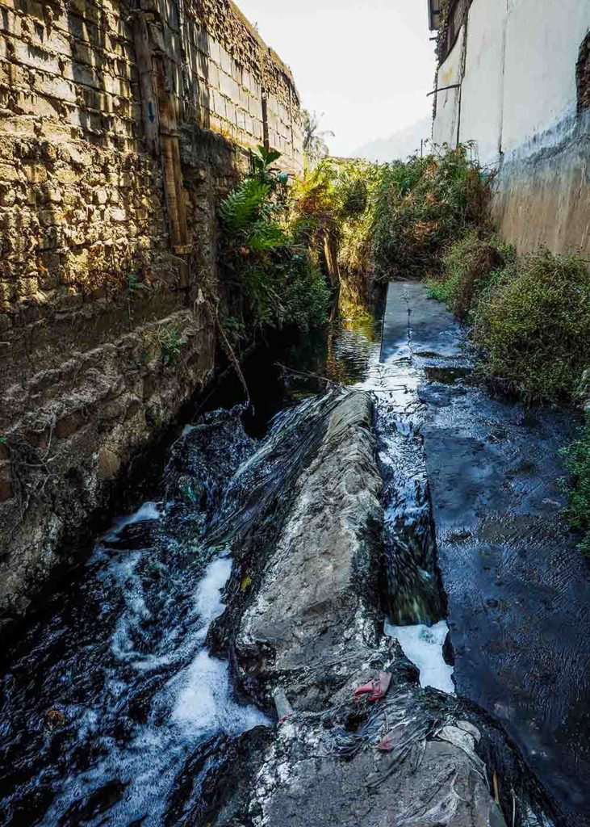
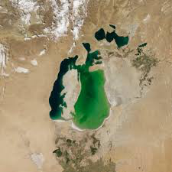
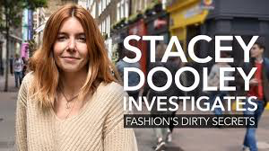
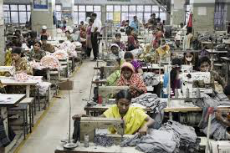
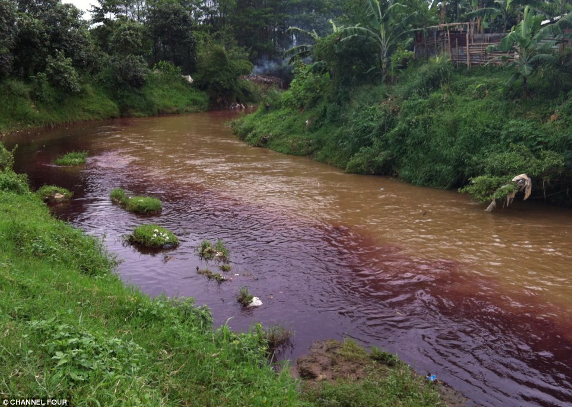
Fashion’s Dirty Secrets
Secondary geography

Slide 4
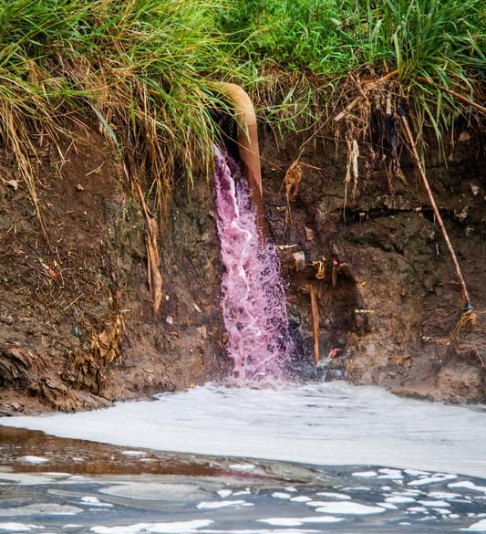
Fashion’s Dirty Secrets
Secondary geography
Starter: WHAT is this image showing?
WHY is this happening?
WHERE do you think this is happening?
HOW does it make you feel?

Slide 5
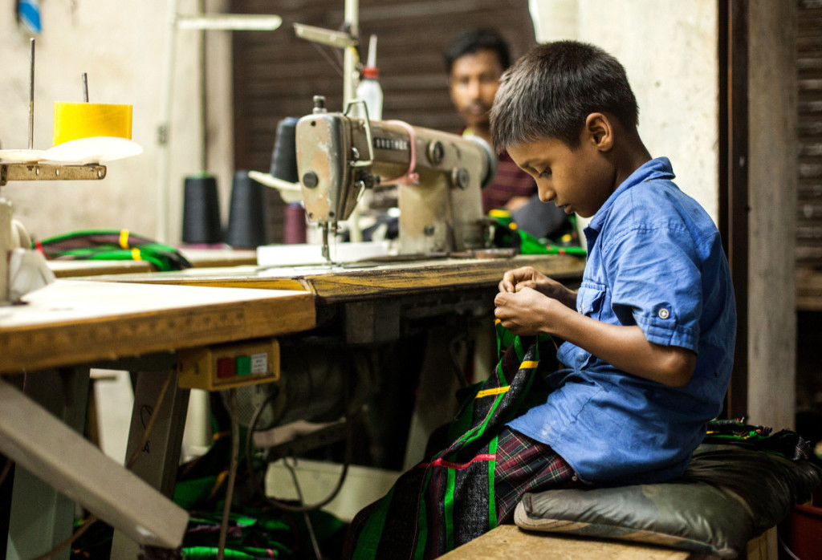
Fashion’s Dirty Secrets
Secondary geography
Starter: WHAT is this image showing?
WHY is this happening?
WHERE do you think this is happening?
HOW does it make you feel?

Slide 6
Fashion’s Dirty Secrets
Secondary geography
Part 1: the Aral Sea environment
WHAT has happened to this lake?
WHY is this happening?
HOW does this make you feel?
WHAT could we do about it?

Slide 7
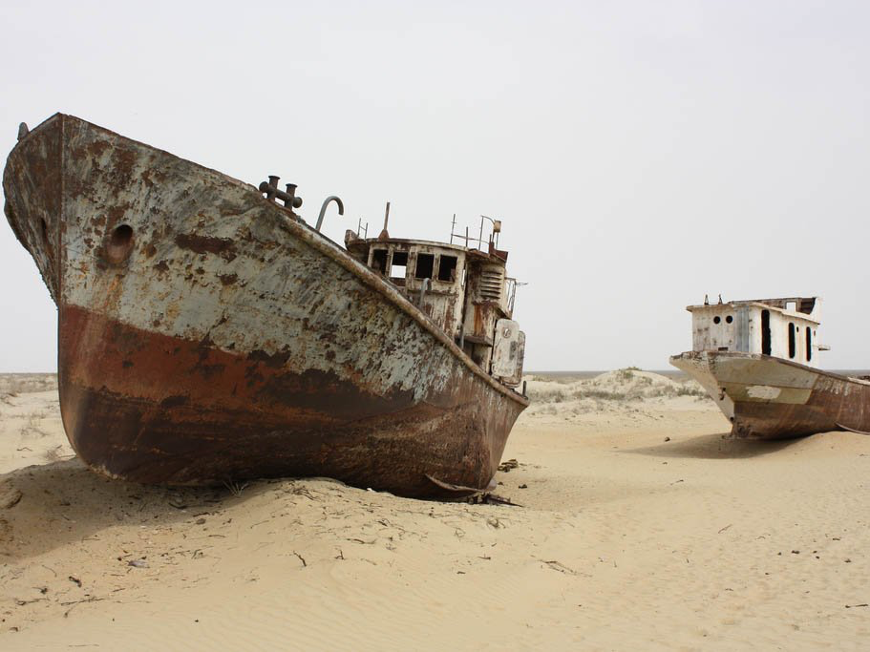
Fashion’s Dirty Secrets
Secondary geography
Part 2: the people of the Aral Sea
WHAT has happened to the lives of people here?
WHY is this a problem?
HOW does this make you feel?
WHAT could we do about it?

Slide 8
Fashion’s Dirty Secrets
Secondary geography
Part 3: the Citarum River, Indonesia
WHAT is happening to the river here?
WHY is this happening?
HOW does this make you feel?
WHAT could we do about it?

Slide 9
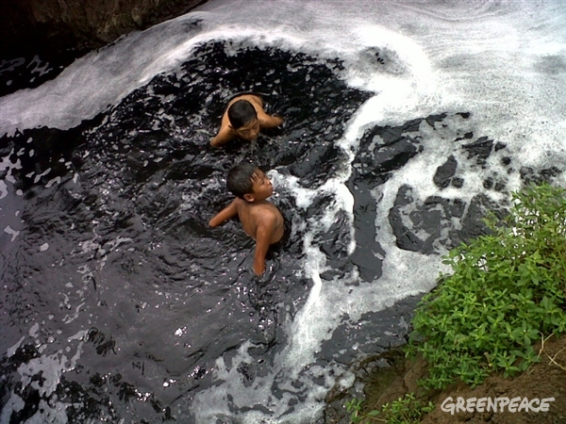
Fashion’s Dirty Secrets
Secondary geography
Part 4: the people of the Citarum River, Indonesia
WHAT is happening to the people living here?
WHY is this happening?
HOW does this make you feel?
WHAT could we do about it?

Slide 10
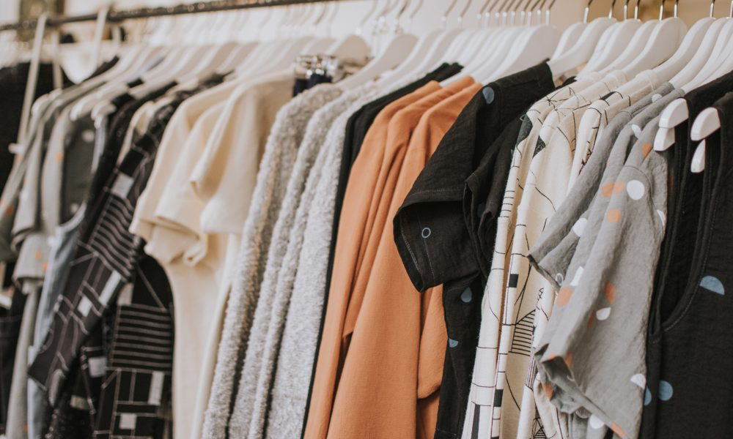
Fashion’s Dirty Secrets
Secondary geography
Part 5: changing our choices
WHAT can we do to solve the problem?
WHY is this important?
WHO can help to do this?
HOW will this make a difference?

Slide 11
Fashion’s dirty secrets – video notes sheet (A3 format)- please print out and stick in your book
Secondary geography
Part 1: the Aral Sea environment
WHAT has happened to this lake?
WHY is this happening?
HOW does this make you feel?
WHAT could we do about it?
Part 2: the people of the Aral Sea
WHAT has happened to the lives of people here?
WHY is this a problem?
HOW does this make you feel?
WHAT could we do about it?
Part 3: the Citarum River, Indonesia
WHAT is happening to the river here?
WHY is this happening?
HOW does this make you feel?
WHAT could we do about it?
Part 4: the people of the Citarum River, Indonesia
WHAT is happening to the people living here?
WHY is this happening?
HOW does this make you feel?
WHAT could we do about it?
Part 5: changing our choices
WHAT can we do to solve the problem?
WHY is this important?
WHO can help to do this?
HOW will this make a difference?

Slide 12
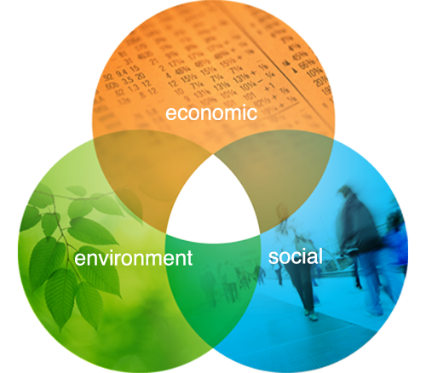
Fashion’s Dirty Secrets
Secondary geography
Prep - Impacts of fashion
Read through the statements and code them into the environmental, social or economic impacts of fashion.
Remember:
ENVIRONMENTAL = to do with nature and wildlife
SOCIAL = to do with people, health and wellbeing
ECONOMIC = to do with money and jobs

Slide 13
Fashion’s Dirty Secrets Please print out and stick in your book
Secondary geography
 | 300,000 tonnes of clothes are dumped in landfill every year | Polluted water becomes so depleted of oxygen that animals can no longer live in it and so the river biodiversity reduces | Tens of thousands of fishing jobs were lost when the Aral Sea dried up
£50 billion a year are spent on clothes, increasing the demand for fast fashion | Millions of people worldwide suffer from water shortages and health problems as a result of cotton production | The Aral Sea is now 10% of its original size; this is affecting the microclimate making the weather more extreme | The Chairman of the textile Manufacturers Association wants to close factories down in Indonesia, but is unable to as it can only be done by the police
Hundreds of factories in Indonesia use rivers as a waste water sewer; over 400 hundred factories alone release waste water into the Citarum River every day, making it one of the most polluted rivers in the world | Chemicals that used to be in the Aral Sea now like on the exposed ground and can be whipped up into toxic dust storms that cause increased blood pressure, strokes, TB and cancers | Growing cotton uses more water, pesticides and fertilisers than any other fabric | Most western companies won’t charge more for their clothes because consumers don’t want to pay high prices
People who protest against factory waste in Indonesia can often then face death threats as a result of their actions | Many factories dump polluted water from factories into the river at night or using underwater pipes to make it less detectable | Social media plays a huge role in influencing (often) young people to want to buy clothes that fit in with the latest trends | People near the Citarum River use water for washing, fishing, bathing; this can cause long term health problems and untreatable skin conditions
 | Environmental
 | Economic
 | Social
Challenge: which type of impact is the greatest? Explain your answer.

Slide 14
Fashion’s Dirty Secrets
Secondary geography
Text activity - glossary
Create a glossary of any geographical or unfamiliar words and use a dictionary, textbook or the internet to find out the meanings.
Word | Definition
Pollution
Garment
Microclimate
Heavy metals
Toxic
Biodiversity
Sustainable
Consumer
Eco-friendly
Sewer
Depleted
Disposable
Neurological
Manufacturer

Slide 15
Glossary task – please print out and stick in your book
Secondary geography
Word | Definition
Pollution
Garment
Microclimate
Heavy metals
Toxic
Biodiversity
Sustainable
Consumer
Eco-friendly
Sewer
Depleted
Disposable
Neurological
Manufacturer

Slide 16
Fashion’s Dirty Secrets
Lesson 2

Slide 17
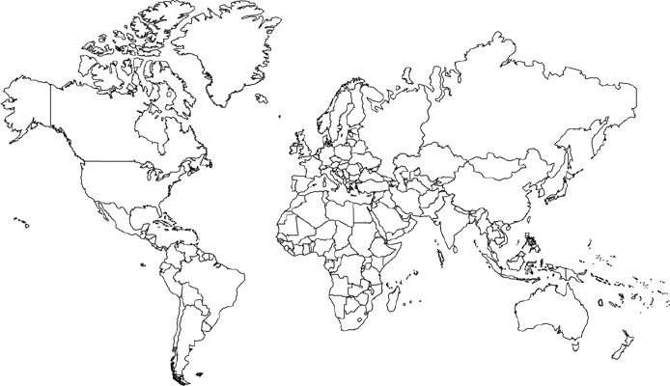
Fashion’s Dirty Secrets
Secondary geography
Skills activity – mapping fashion
Annotate the map with the location of where 8 items of clothing you own are made – Draw a line between where you live and each country- What do you notice?

Slide 18
Mapping fashion
Secondary geography
Annotate the map with the location of where 8 items of clothing you own are made – Draw a line between where you live and each country- What do you notice? – please print out and stick in your book
Challenge: What do we mean by the term globalization?

Slide 19
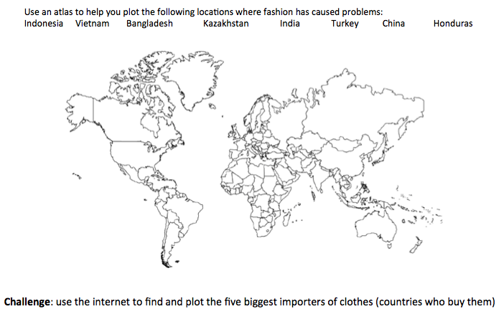
Fashion’s Dirty Secrets
Secondary geography
Skills activity – mapping fashion
https://www.youtube.com/watch?v=BiSYoeqb_VY: (watch this video)
Annotate the map with the listed locations to show where the fashion is a problem in the world.

Slide 20
Mapping fashion
Secondary geography
Use an atlas to help you plot the following locations where fashion has caused problems: please print out and stick in your book :
Indonesia Vietnam Bangladesh Kazakhstan India Turkey China Honduras
Challenge: use the internet to find and plot the five biggest importers of clothes (countries who buy them)
https://www.worldatlas.com/articles/top-10-textile-importing-countries-in-the-world.html

Slide 21
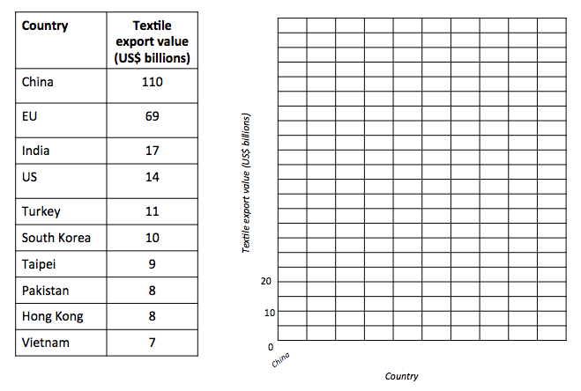
Fashion’s Dirty Secrets
Secondary geography
Skills activity – plotting the life of plastic
Draw a bar chart to show the top ten textile exporters in the world. Remember to keep your work neat and label the axes.

Slide 22
Plotting fashion- please print out and stick in your book
Secondary geography
Country | Textile export value (US$ billions)
China | 110
EU | 69
India | 17
US | 14
Turkey | 11
South Korea | 10
Taipei | 9
Pakistan | 8
Hong Kong | 8
Vietnam | 7
Textile export value (US$ billions)
20
10
0
China
Country

